Slide 1
WA2-WA3 Coordination Meeting –
Nieuwegein, The Netherlands, 17 March 2016
The DESSIN ESS Evaluation Framework
Gerardo Anzaldúa (Ecologic Institute)

Slide 2
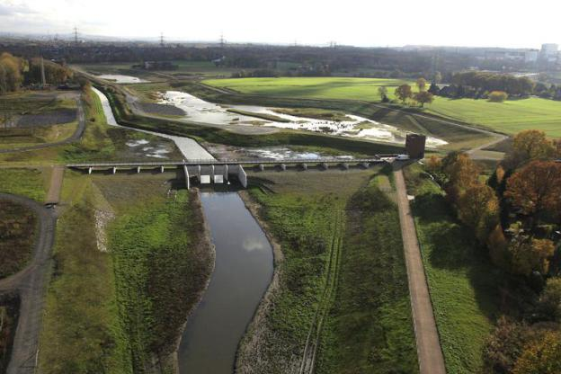
Introduction of WA1
The development of a “new decision making framework”: ESS concept at the forefront.
Concrete guidance for business, practitioners and policy makers in enabling change to happen: linking good practice and lessons-learnt for innovation-friendly governance regimes and financing options.
Practical application and fine-tuning of the “new framework” after testing in three mature sites: Aarhus (DK), Emscher (DE) and Ebro (ES).

Slide 3
WA1 achievements so far…WP11-13
Consolidation of ESS terminology to be used within the project
Selection of a common classification of ESS to be used as a practical basis for our framework: CICES Typology
Agreement on a conceptual approach upon which the ESS Evaluation Framework has been built (and its adaptation to fit the needs of DESSIN): customised DPSIR Framework with a distinct focus on beneficiaries of ESS
Completion of D11.1 (state of the art on ESS assessment and valuation) and MS12 (progress report on development of the DESSIN ESS Evaluation Framework)
Database of economic valuation studies (holding +70 entries)
The various elements of the evaluation methodology are tested at the mature sites, the results of this are feeding into D13.1
First draft of the DESSIN cookbook has been reviewed by the consortium, the final draft of the full framework is currently under external review

Slide 4
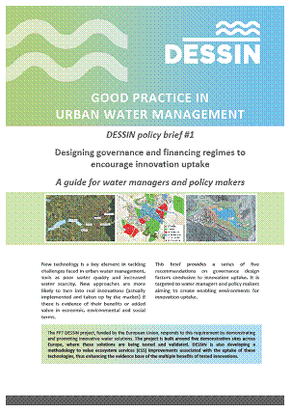
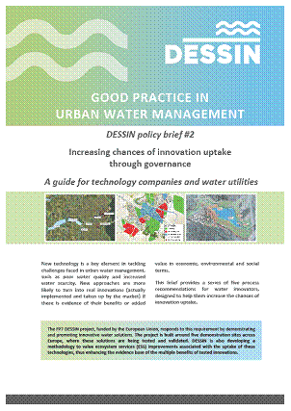
WA1 achievements so far…WP12
A framework has been developed for governance analysis for innovation uptake and applied in three mature case studies (Ebro, Emscher, Aarhus).
Two specialized policy briefs submitted in summer 2015:
- Designing governance and financing regimes to encourage innovation uptake (for policy and decision-makers)
Increasing chances of innovation uptake through governance
(for tech companies and water utilities)
Deliverable on financing mechanisms conducive to water sector innovations submitted in summer 2015

Slide 5
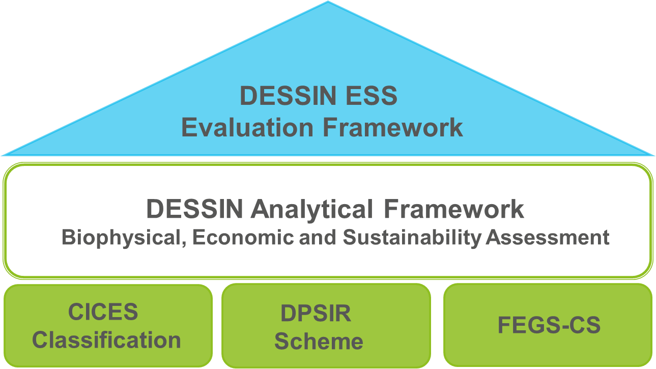
Components and foundations of the DESSIN ESS Evaluation Framework

Slide 6
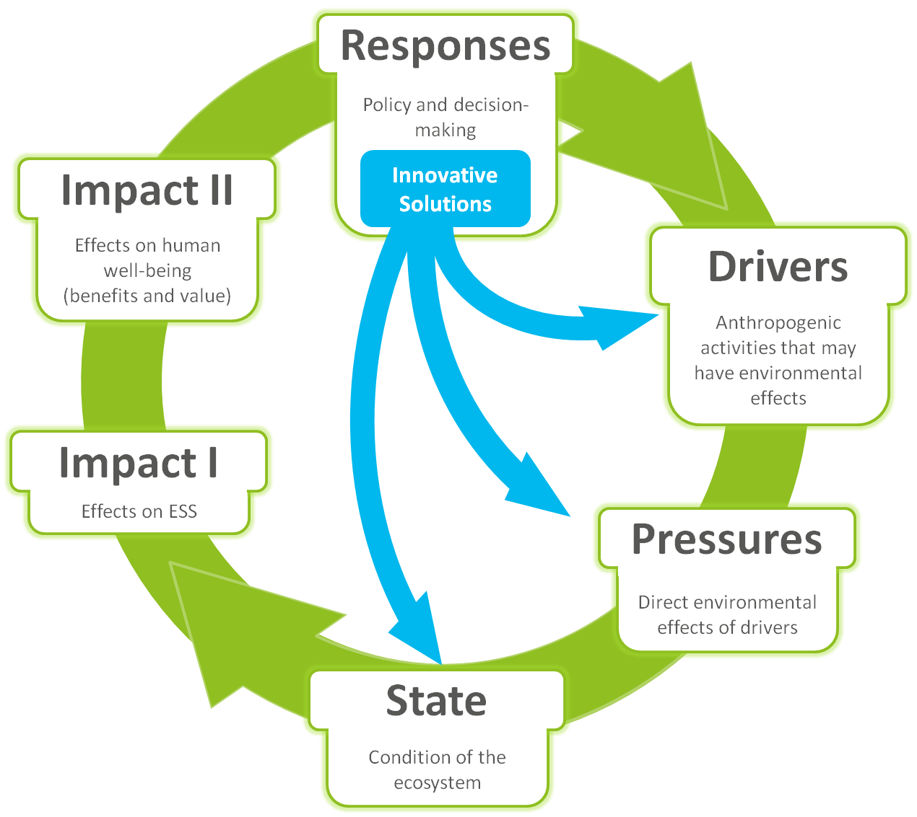
Conceptual approach of the DESSIN ESS Evaluation Framework
(based on Müller and Burkhard, 2012, Van Oudenhoven et al., 2012 and Haines-Young and Potschin, 2010; 2013).

Slide 7
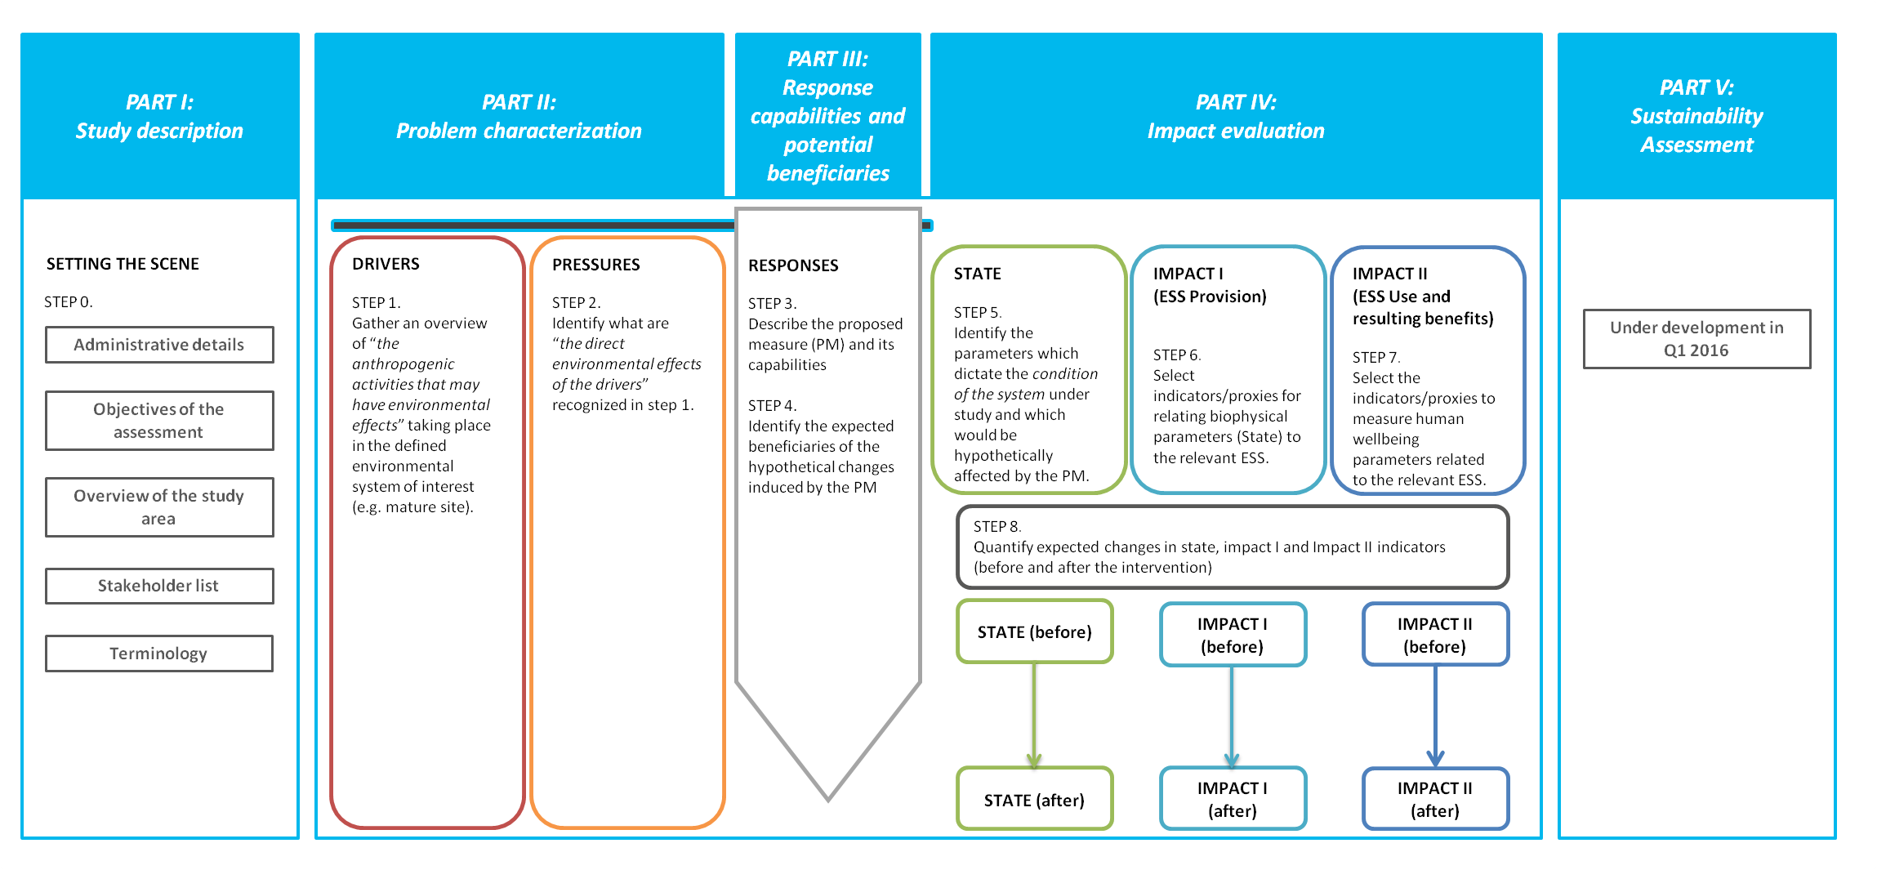
Practical steps for the application of the DESSIN ESS Evaluation Framework – Full Overview

Slide 8
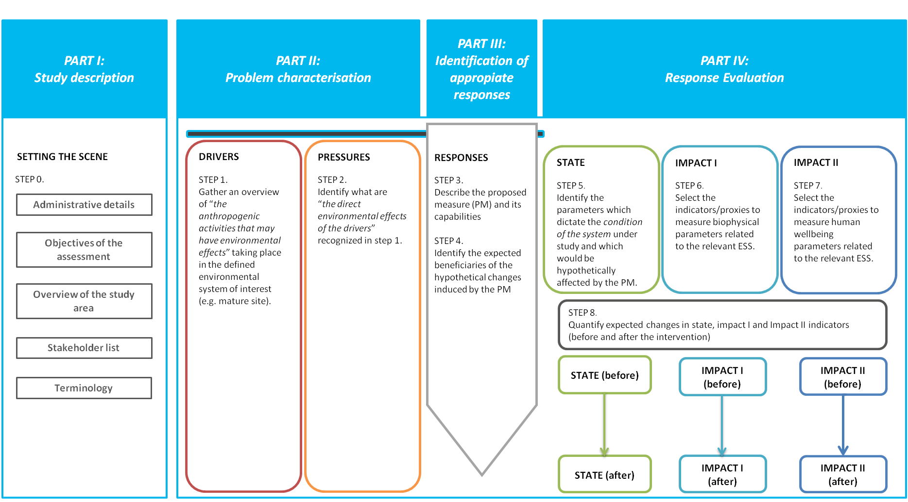
Practical steps for the application of the DESSIN ESS Evaluation Framework – Part I
PART I:
Study description
SETTING THE SCENE
STEP 0.
Administrative details
Objectives of the assessment
Overview of the study area
Stakeholder list

Slide 9
Practical steps for the application of the DESSIN ESS Evaluation Framework – Part II
PART II:
Problem characterisation
DRIVERS
STEP 1. Gather an overview of “the anthropogenic activities that may have environmental effects” taking place in the defined environmental system of interest (e.g. mature site).
PRESSURES
STEP 2. Identify what are “the direct environmental effects of the drivers” recognized in step 1.

Slide 10
Practical steps for the application of the DESSIN ESS Evaluation Framework – Part III
PART III:
Response capabilities and potential beneficiaries
RESPONSES & BENEFICIARIES
STEP 3. Describe the proposed measure (PM) and its capabilities
STEP 4.
Identify the expected beneficiaries of the hypothetical changes induced by the PM

Slide 11
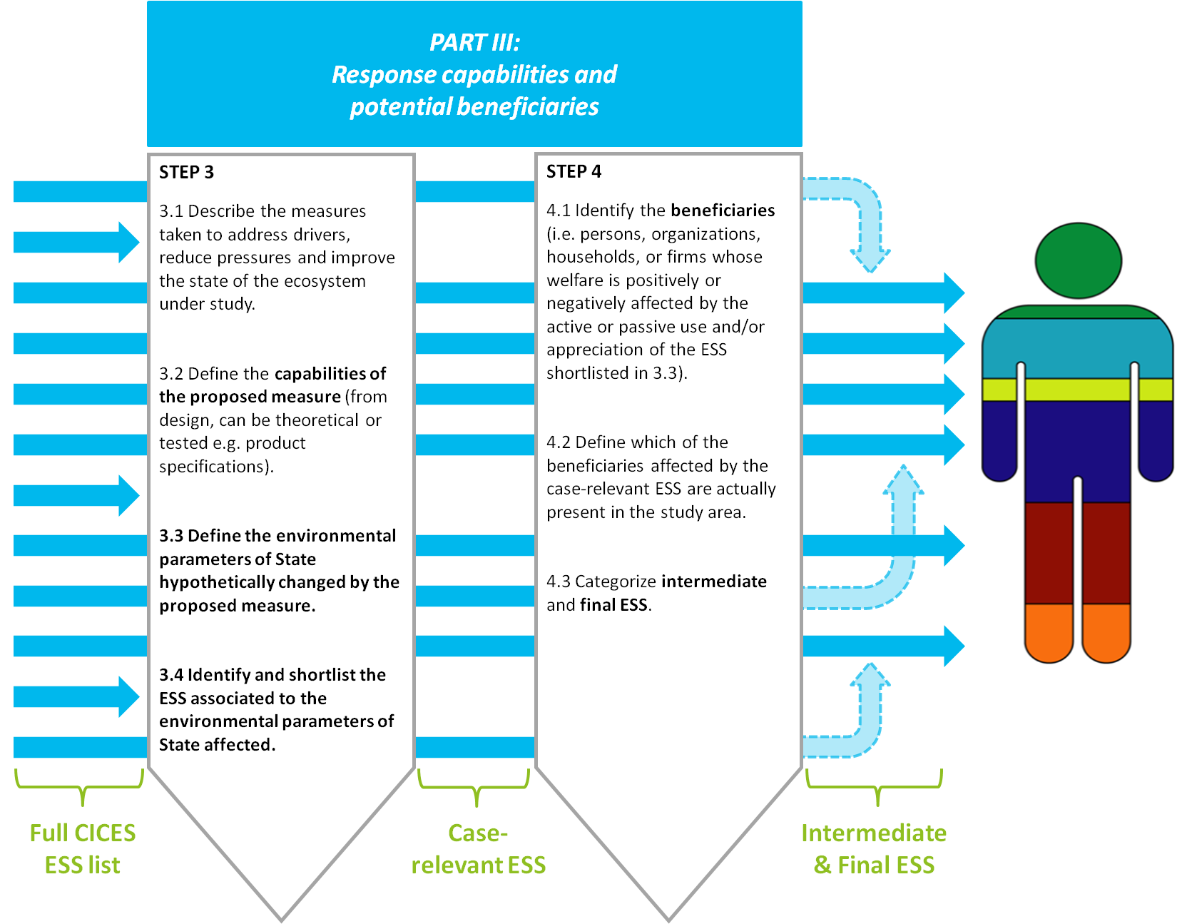
Relating the capabilities of the measures to beneficiaries…

Slide 12
Practical steps for the application of the DESSIN ESS Evaluation Framework – Part IV
PART IV:
Impact evaluation
STATE
STEP 5. Identify the parameters which dictate the condition of the system under study and which would be hypothetically affected by the PM.
IMPACT I (ESS Provision)
STEP 6. Select indicators/proxies for relating biophysical parameters (State) to the relevant ESS.
IMPACT II (ESS Use and resulting benefits)
STEP 7. Select the indicators/proxies to measure human wellbeing parameters related to the relevant ESS.
STEP 8. Quantify expected changes in state, impact I and Impact II indicators (before and after the intervention)
STATE (before)
IMPACT I (before)
IMPACT I (before)
STATE (after)
IMPACT I (after)
IMPACT I (after)

