Slide 1
DESSIN WA2/3 Meeting – Nieuwegein – 16-17 Mar 2016
WP13 – Emscher mature case
Nadine Gerner (EG)

Slide 2
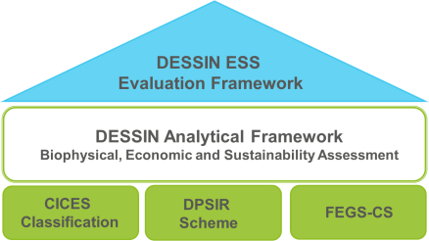
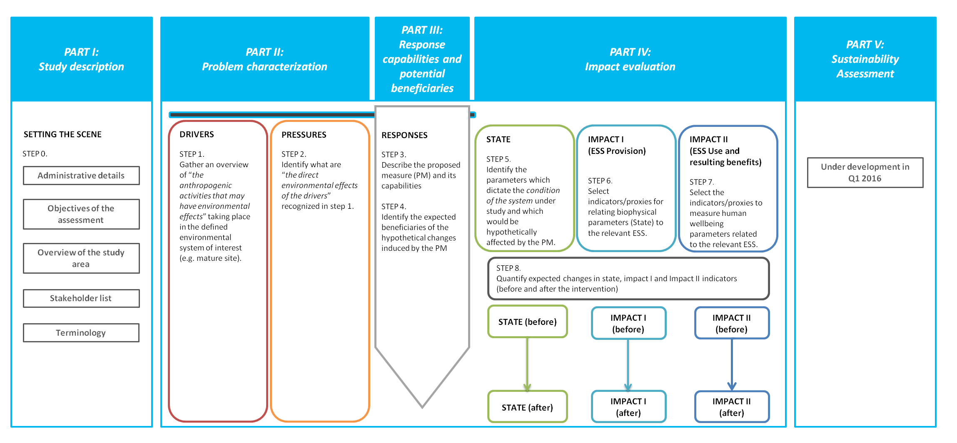
ESS Evaluation Framework: Cookbook
Figure 3: Practical steps for the application of the DESSIN ESS Evaluation Framework

Slide 3
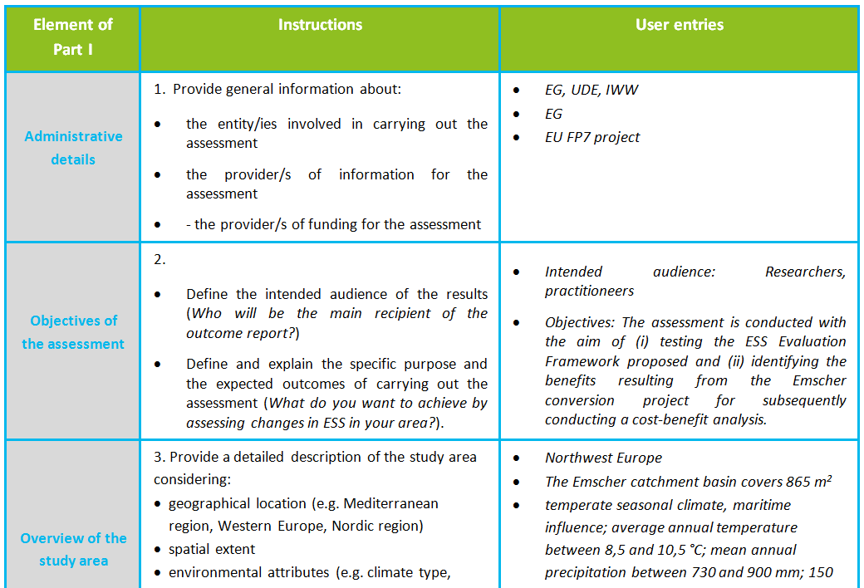
Setting the scene

Slide 4
Figure 3: Practical steps for the application of the DESSIN ESS Evaluation Framework

Slide 5
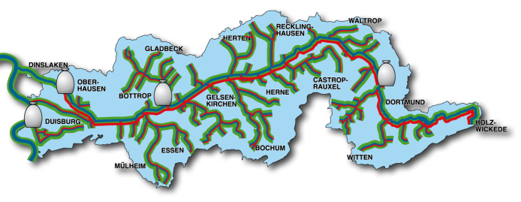
Response/ Proposed measure
BASELINE RESPONSE AFTER IMPLEMENTATION
Water quality challenges:
WFD & adaptation to future challenges
Measures = Responses:
Construction of sewer network, WWTPs, CSOs
Revitalization of water courses
Notes:
- Advantage in Emscher region: many datasets available – several studies – planning phase – monitoring phase – recovery monitoring

Slide 6
Figure 3: Practical steps for the application of the DESSIN ESS Evaluation Framework

Slide 7
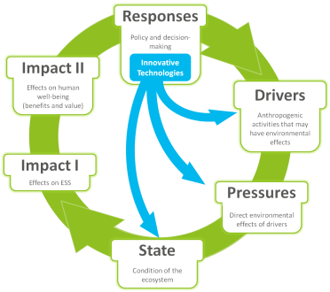
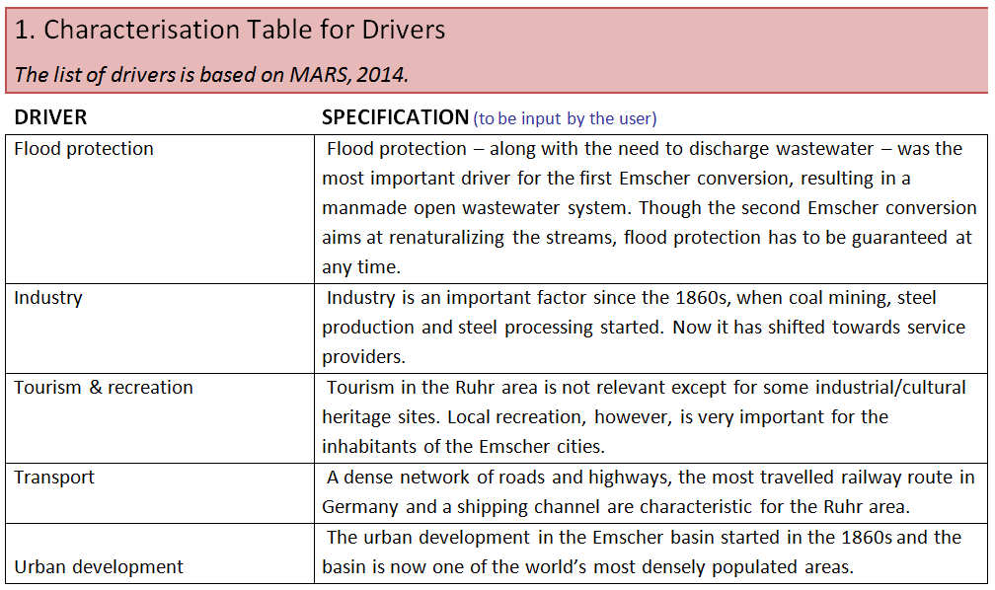
DRIVERS

Slide 8
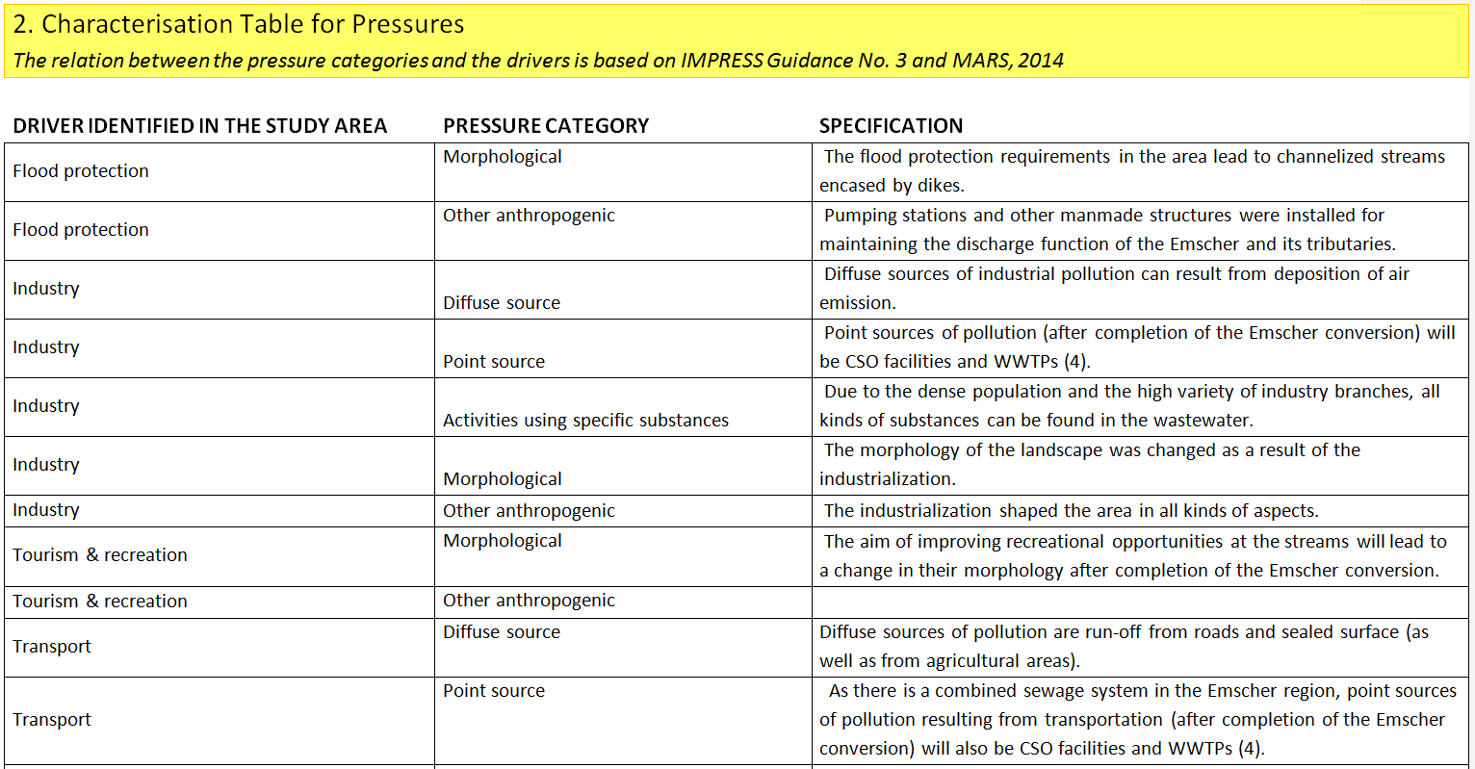
PRESSURES

Slide 9
Figure 3: Practical steps for the application of the DESSIN ESS Evaluation Framework

Slide 10
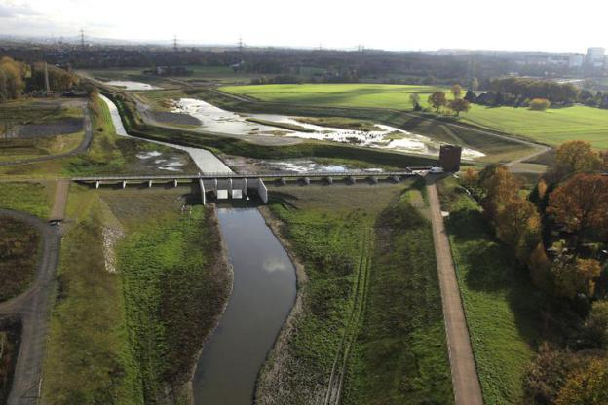
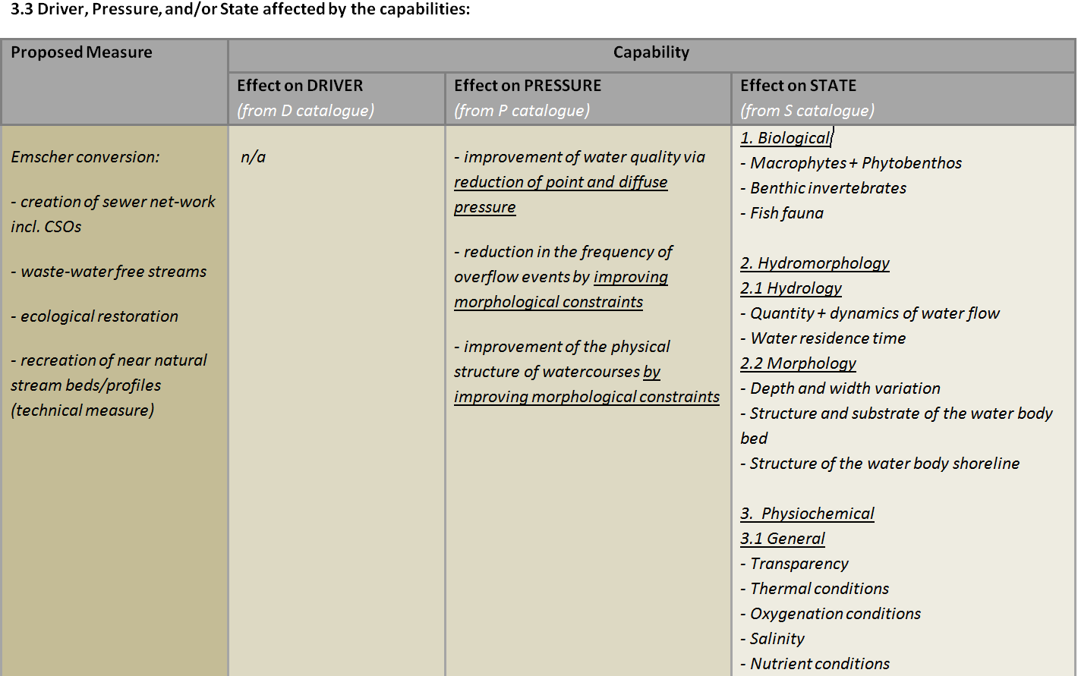
RESPONSE → STATE

Slide 11
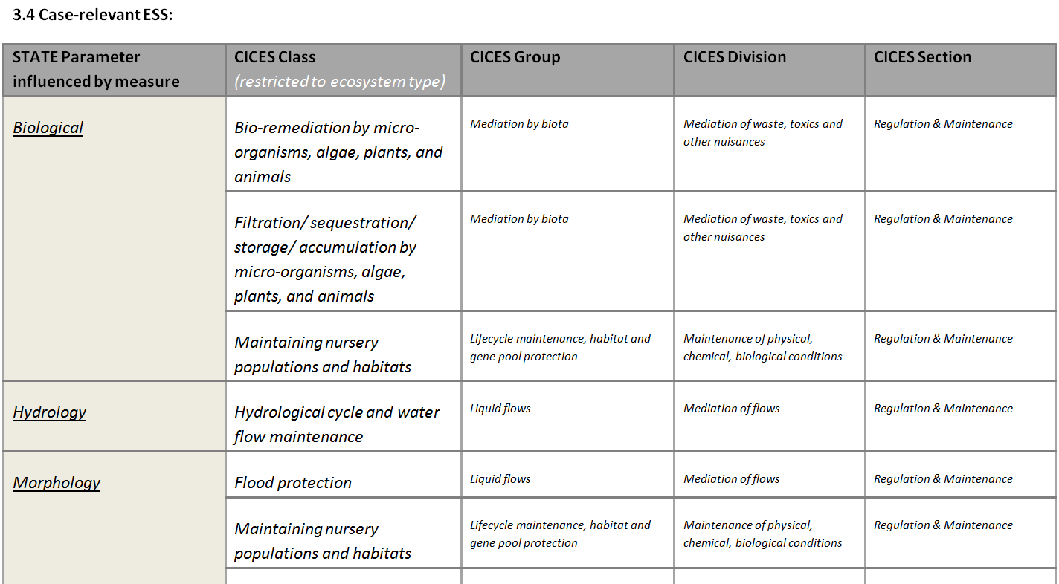
STATE → ESS (CICES)

Slide 12
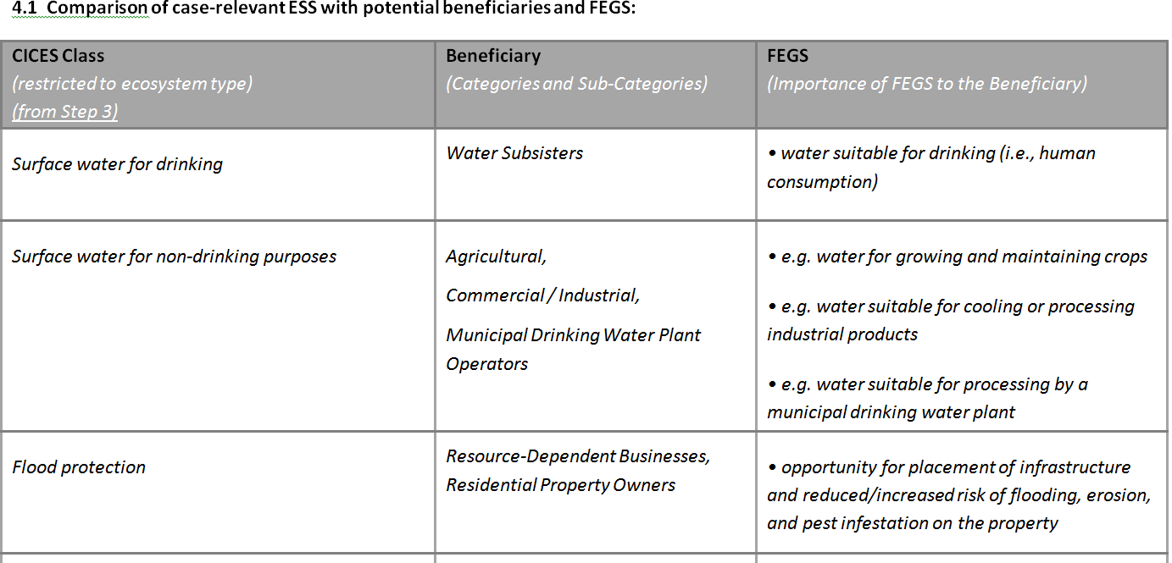
ESS (CICES) → Beneficiaries → FESS (US EPA)

Slide 13
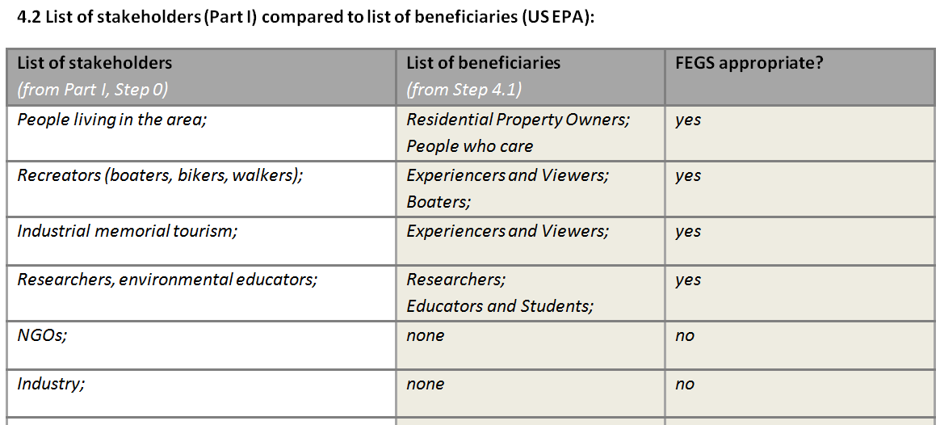
Beneficiaries & Stakeholders

Slide 14
Figure 3: Practical steps for the application of the DESSIN ESS Evaluation Framework

Slide 15
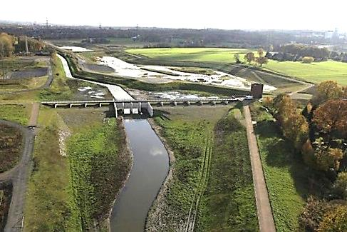
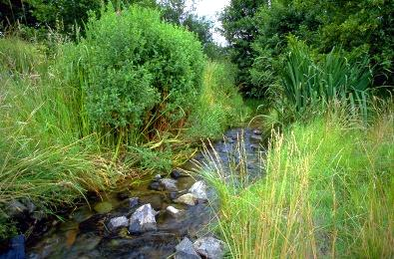
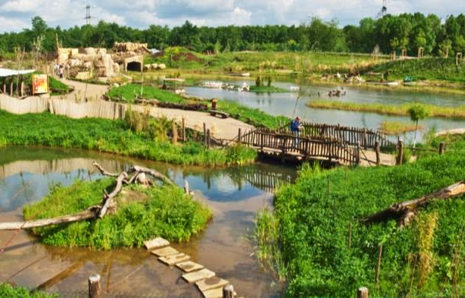
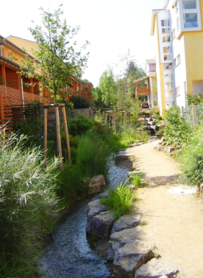
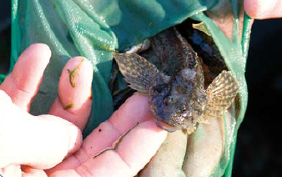
Impact I Provision
Purification
Flood protection
Recreation
Urban
climate
Biodiversity/
Habitats
Life quality

Slide 16
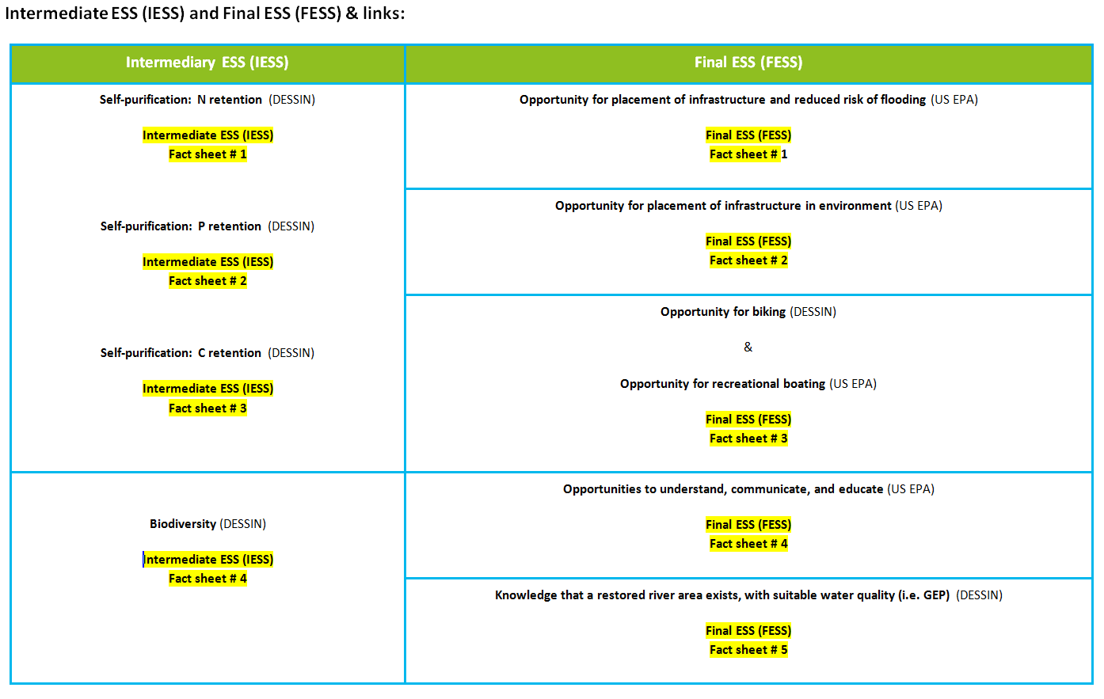

Slide 17
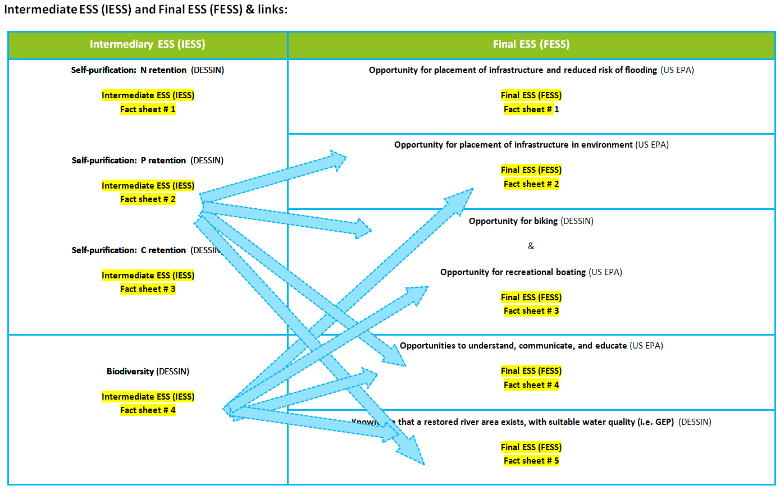

Slide 18
STATE & IMPACT I Provision

Slide 19
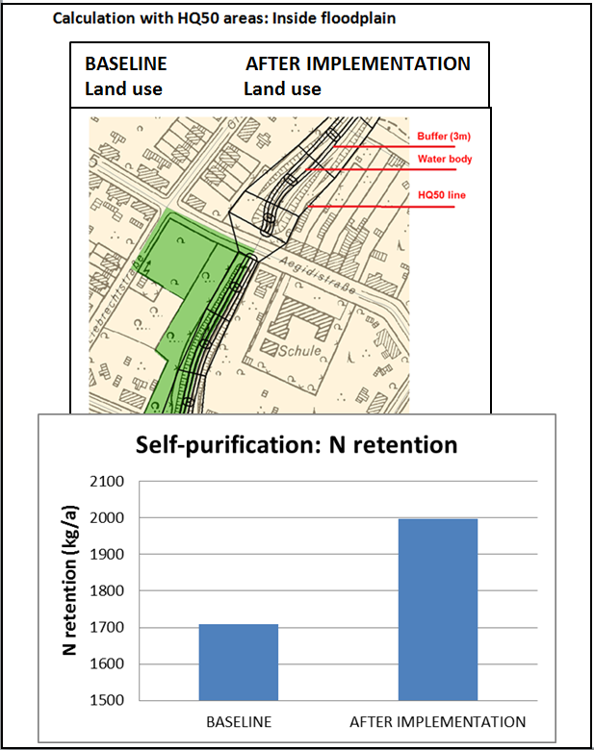
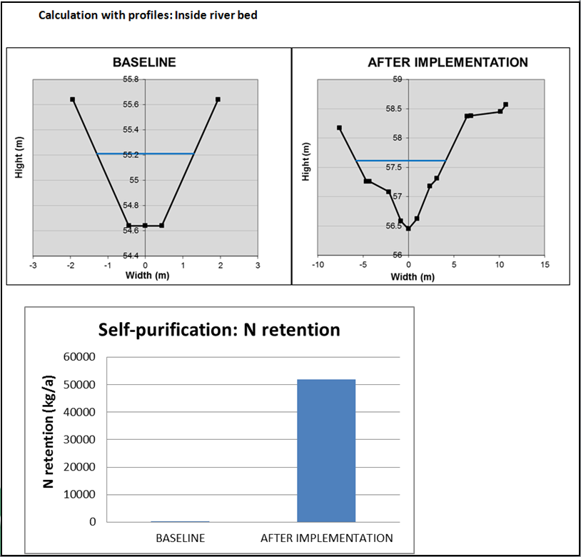
IMPACT I Provision

Slide 20
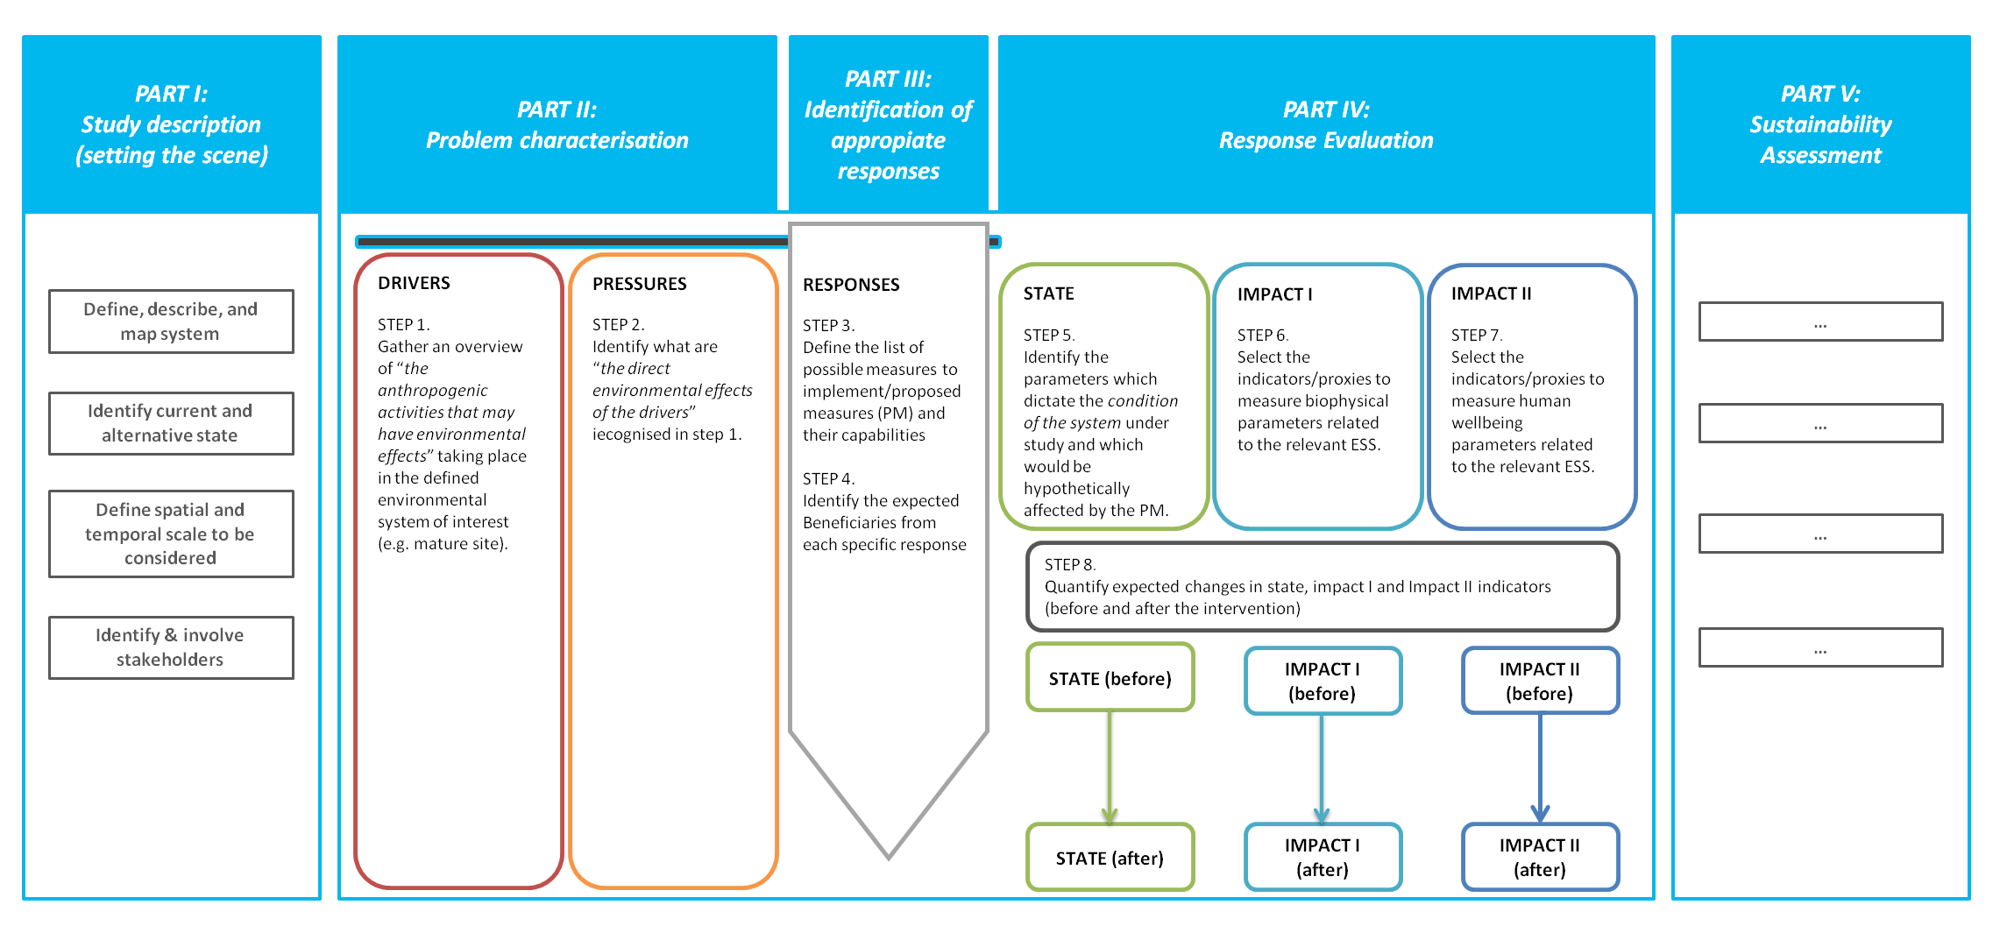
Figure 3: Practical steps for the application of the DESSIN ESS Evaluation Framework

Slide 21
IMPACT II Use & Benefit

Slide 22
IMPACT II Use & Benefit

Slide 23
Sustainability Assessment (1/2)
scope and goal: evaluate effects of a single solution
timeframe: lifetime of the solution
spatial scale: Emscher catchment
Data from ESS evaluation:
„do nothing“
renaturalized
 | DESSIN ESS | unit | before | after
Imp II | Economic impact of hedonic pricing | [€/a] | n/a | 16,599,840 | → S151
Imp II | Economic impact of biking | [€/a] | 0 | 1,330,000
Imp II | Economic impact of boating | [€/a] | 0 | 53,600
Imp II | Economic impact of educational excursions | [€/a] | 0 | 25,400 | → S152
Imp II | Avoided costs from flooding | [€/a] | tbc | tbc | → F113
Imp I | Potential denitrification rate in total Emscher basin |  | tbc | tbc | → A151
Imp I | Potential P-retention rate in total Emscher basin |  | tbc | tbc
Imp I | Potential C-retention rate in total Emscher basin |  | tbc | tbc

Slide 24
Sustainability Assessment (2/2)
Further information available:
„do nothing“
renaturalized
 | indicator/metric | unit | before | after | source
S113 | Presence of toxic chemicals | [-] | tbc | tbc | EGLV
S121 | Economic impact derived from initial spending | [-] | 0 | 0.62 | RWI study
S131 | Employment created by implementation of solution | [1/a] | 0 | 1,400 | RWI study
S141 | Number of beneficiaries affected | [-] | 2,210,557 | 2,210,557 | EGLV
F111 | Investment expenditure | [€] | - | 4,500,000,000 | RWI study
F112 | Operational expenditure (between 1991-2020) | [€] | - | 450,000,000 | RWI study
F114 | Other sources of financing (e. g. subsidies) | [%] | - | 100 | EGLV
G111 | Compliance improvement w/ relevant EU standards | [-] | tbc | tbc | EGLV
A111 | MTTF | [a] | - | 80 (sewers) ∞ (other) | EGLV
A221 | lifetime of solution/start up time | [-] | - | 2.7 | EGLV
Problem:
There is (currently) no information on the environmental effects of the conversion measures available. Thus, the environmental dimension can only be described qualitatively.

