Slide 1
DESSIN WA2/3 Meeting – Nieuwegein – 16-17 Mar 2016
WA 3 – Showcase – Emscher demo cases
Nadine Gerner (EG), Gebhard Weiß (UFT), Silja Mendes (SEGNO), Gerard van den Berg (KWR), Hans Ruijgers (KWR)

Slide 2
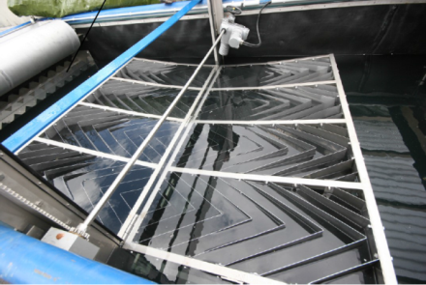
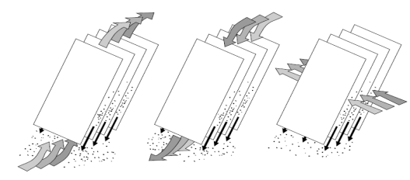
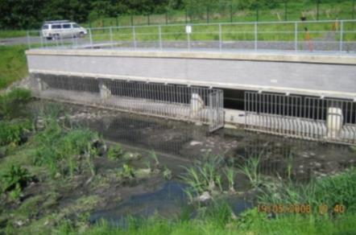
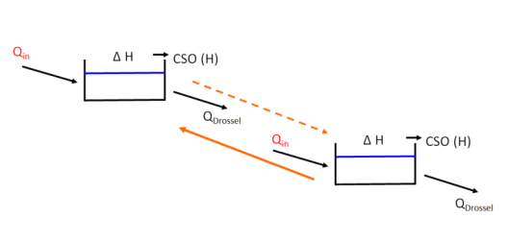
DESSIN WP31
WP 31.1 – Improved CSO treatment
WP 31.2 – Real Time Control of sewer network
Notes:
Decrease in CSO discharge amount, load and times per year → improvement of water quality → indicator: macroinvertebrates, chemical status, saprobic level
→ less hydraulic pressure → indicator: macroinvertebrates

Slide 3
Overview
Aim: 3 short movies (1st general, 2nd lamella settler, 3rd RTC)
Partner: KWR, EG, UFT, SEGNO,
Platform: DESSIN website, EGLV website, UFT website, SEGNO website, fairs, regional governments websites?
Audience: people interested in DESSIN project; water boards, cities (sewer system operator/owner); technology applicators

Slide 4
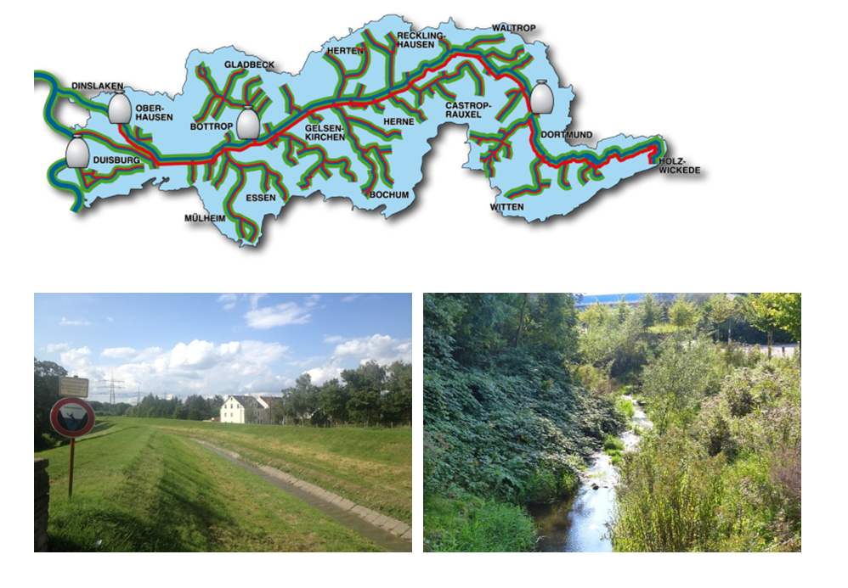
1st movie: Emscher basin
EG movie

Slide 5
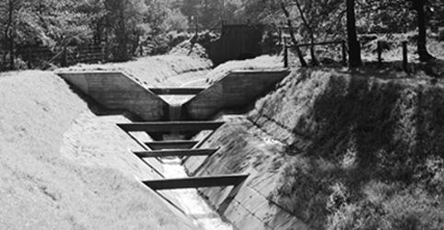
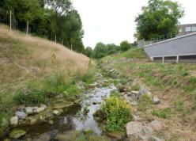
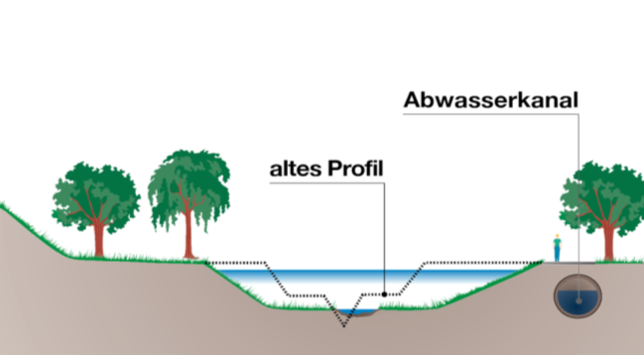
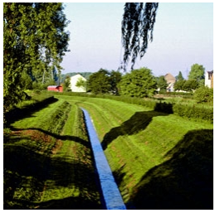
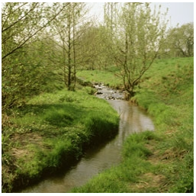
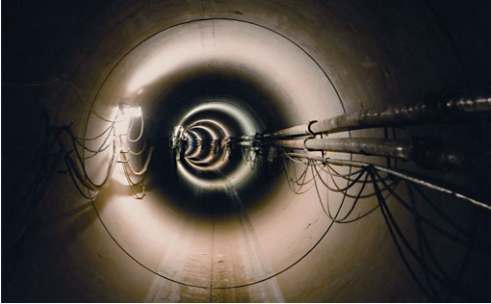
1st movie: Emscher re-conversion
wastewater channel
old profile
Notes:
- Advantage in Emscher region: many datasets available – several studies – planning phase – monitoring phase – recovery monitoring

Slide 6
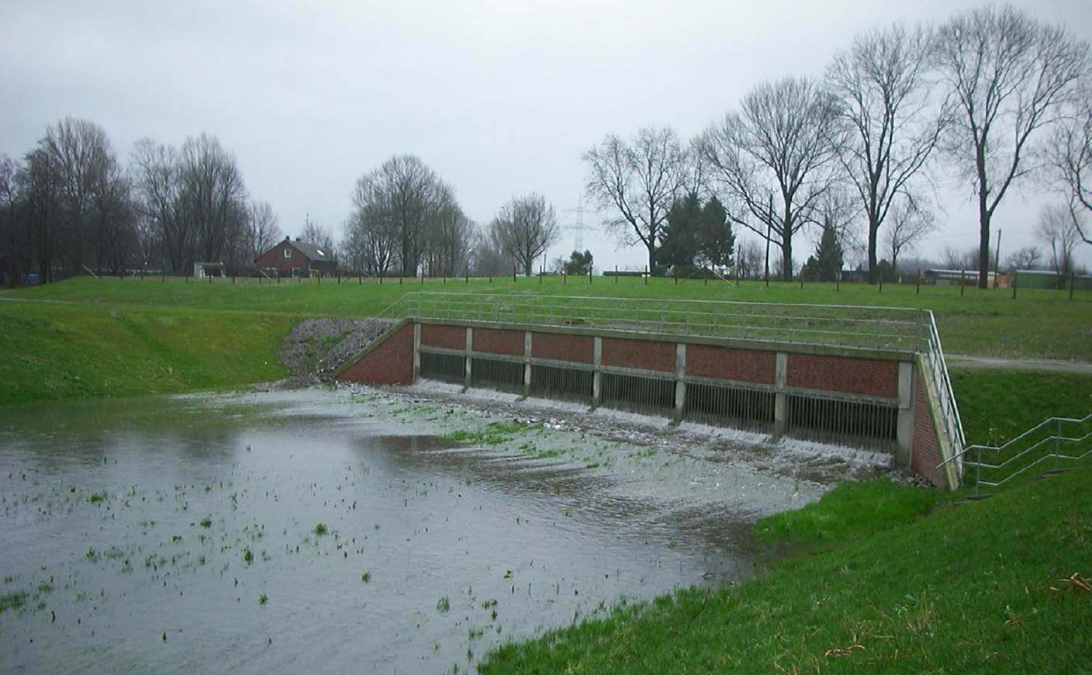
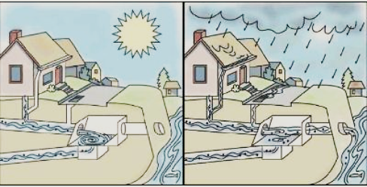
1st movie: CSOs

Slide 7
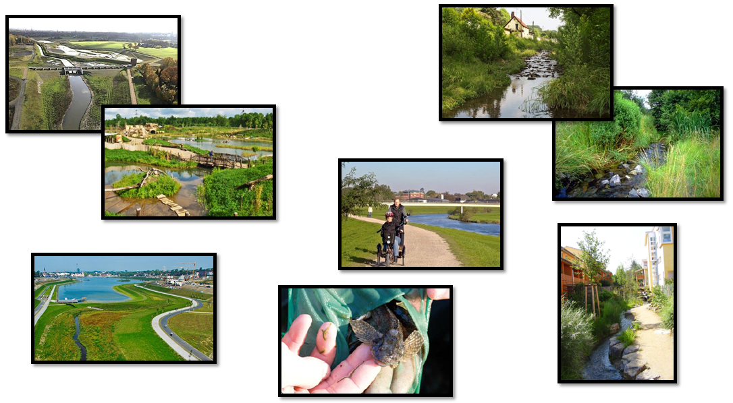
1st movie: ESS

Slide 8
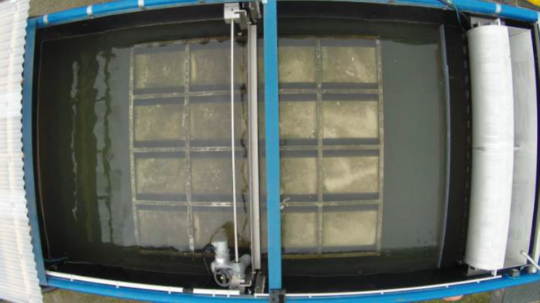
2nd movie: Lamella settler

Slide 9
2nd movie: Lamella settler
3D simulation movie

Slide 10
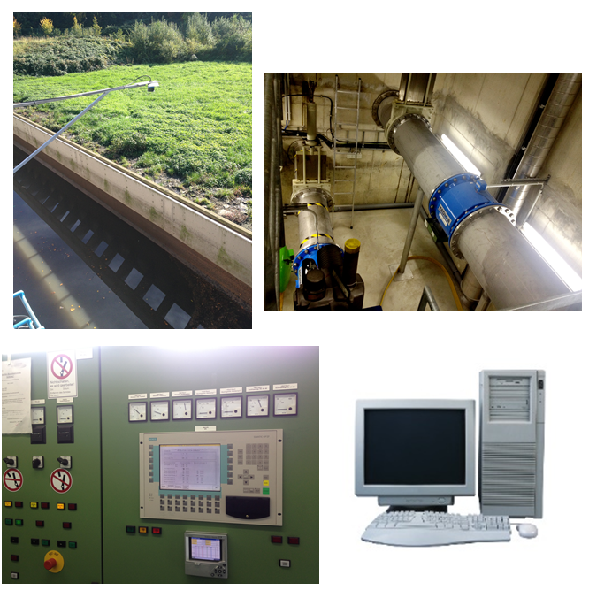
3rd movie: RTC of sewer network

Slide 11
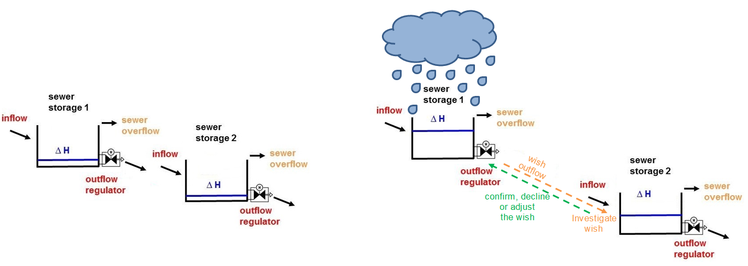
3rd movie: RTC of sewer network
2D simulation movie

