Slide 1
Llobregat demo site
Progress of work
M. Hernández¹, P. Camprovín¹, E. Vilanova²
¹Cetaqua, ²Amphos21

Slide 2
INDEX OF CONTENTS
Main goals of Llobregat case study
Scheme of inter-relations WA2-WA3 Llobregat demo site
Experimental phase (WP22) Status and outcomes
Demonstration phase (WP35)
Field work and sampling campaigns
Results
Next steps
Other important issues in Llobregat demo site
Questions / open discussion

Slide 3
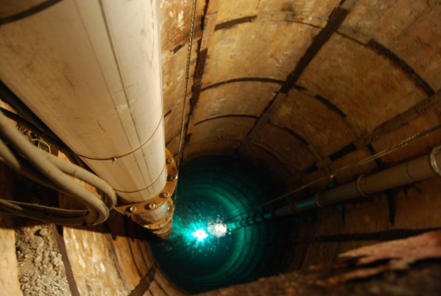
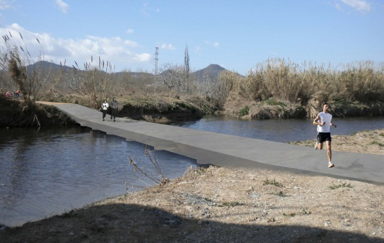
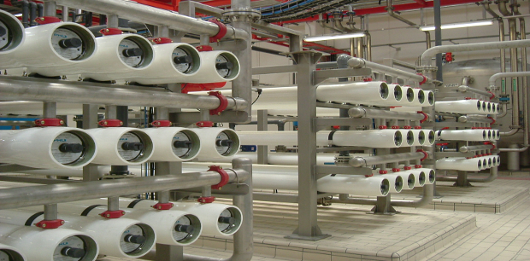
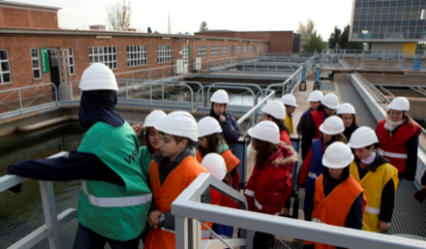
MAIN GOALS
Flexibilisation of ASR scheme in Llobregat area
Existing ASR system (70s) not operated due to high costs.
Demonstrate the feasibility of using pre-potable water (sand filtered)
Demo phase: 10 L/s to 50 L/s and along 1 year of operation
Assessment of:
Hydrogeochemical impact
Pathogens removal
Fate of priority and emerging pollutants
Bioclogging (cleaning cycles)
Full scale implementation and ESS related
Notes:
For those of you not familiar with the Llobregat site I would like to highlight the context ans what we want to assess.
We want to assess mainly chemico-physical changes in the aquifer and also socio-economic impacts using the evaluation of the ESS related.
Cross section: has been produced recently using the existing information of each pumping well. 50 meters depth. 20 meters of screen: gravel and sand (main aquifer).

Slide 4
SCHEME OF TASKS
T35.1. Selection and design of additional pre-treatments to comply wit WFD and specific Europeans operators’ requests (M10 – M20) (CETaqua)
Chemical characterization (T22.3.1) & Identified potential impacts (T22.3.3) (CETaqua)
PRE - INECTION
T35.2_Conditioning of existing network of observation wells and implementation of additional piping and selected pre-treatment (M18-M26) (CETaqua)
VALIDATION
T35.3_Evaluation of the impact of the injection wit pre-potable water by GW and recharge water monitoring (M26-M40) (CETaqua)
INJECTION
WP22: SOLUTIONS FOR WATER SCARCITY
DEMO PHASE EVOLUTION
Regional model of flow at local scale to evaluate the expected impacts of flexible deep injection systems (water availability) (T22.3.2) (CETaqua / A21)
T35.4_Advanced hydrogeochemical modeling: application to the case study and calibration with real data (M20 – M44) (CETaqua)
T35.5_Valuation of the changes en ESS resulting from a full-scale injection (M36-M48) (CETaqua / A21)
Software developed: interface to couple GW with surface water processes establishing connections between ASR and aquatic ecosystems in strategic reservoirs (T22.3.4) (A21)
TOOL
POST - INJECTION
T35.6_Developement of a methodological approach of economic analysis and payment regulation of the related ESS(M36-M48) (A21)
TOOL
WA1
ESS APPROACH
WA4
SHOWCASE ASR
Notes:
Pre-injection (preparatory tasks) – injection – post-injection
WA2 is providing the research outputs for demonstration implementation, as the chemical characterisation, the identification of impacts, the local and regional numerical models of flow and conservative transport.

Slide 5
T22.3: STATUS AND OUTCOMES
Task already finished: D22.4 available
164 pp divided in 3 chapters:
Chapter A: Description of the ASR system in the Llobregat Area and Water Quality Evaluation based on historical data
Chapter B: Evaluation of pre-treatments and pilot test results
Chapter C: Regional and local numerical modeling to simulate the flow and conservative transport in the Llobregat demo site
Main findings and outcomes:
Design of innovative pilot test: traditional column test with aquifer material enhanced with the iron screen.
Analysis of biofilm development:
Pressure loss in the column (physical & biological)
Percentage of organic / inorganic
Extracellular polysaccharides
SEM microscopy: identification
Results of disinfection methods to sand filtered water: evaluation and doses and by-products formation. Disinfections methods are not going to be applied before injection in the aquifer.
Notes:
Analysed 37 international ASR experiences. Validated by Pieter J Stuyfzand (KWR).
Values Llobregat site is represented in green bars.
One of the most surprising results is the top position of our site in hydraulic transmissivity, which means a high capacity of the aquifer in water transport, and a low increase of groundwater level when injecting.
Regarding physical clogging parameters MFI index and Turbidity values indicates an average value in comparison with other experiences using non-potable water.

Slide 6
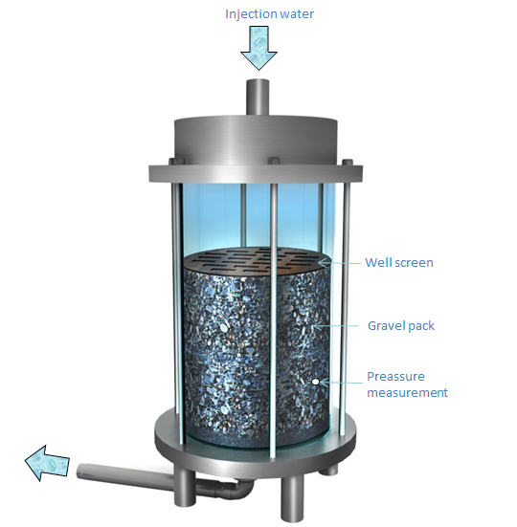
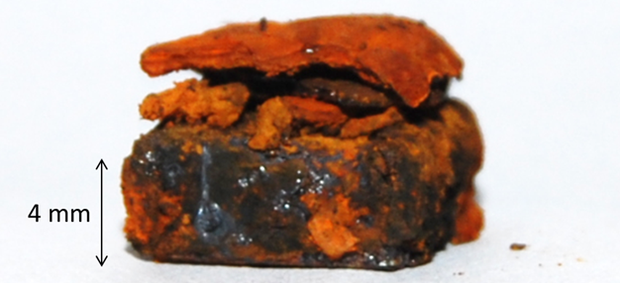
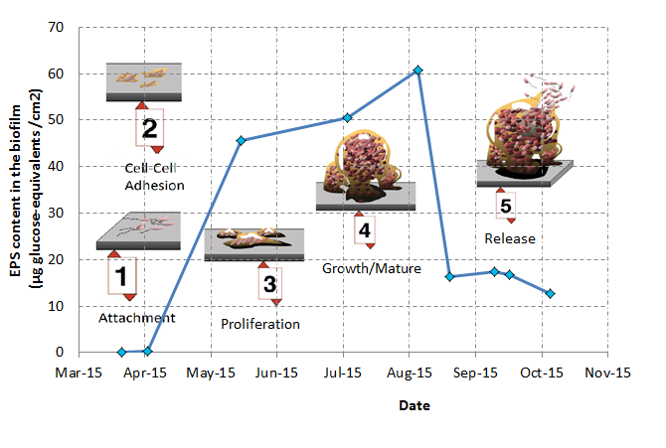
T22.3: STATUS AND OUTCOMES
Sediments layer in well screen after 73 days
4x4 cm pieces of iron (16 ud)
(removable)
Flow = 3.7 L/min
Dark conditions
Pressure measurement daily (40 cm)
Notes:
Analysed 37 international ASR experiences. Validated by Pieter J Stuyfzand (KWR).
Values Llobregat site is represented in green bars.
One of the most surprising results is the top position of our site in hydraulic transmissivity, which means a high capacity of the aquifer in water transport, and a low increase of groundwater level when injecting.
Regarding physical clogging parameters MFI index and Turbidity values indicates an average value in comparison with other experiences using non-potable water.

Slide 7
T22.3: STATUS AND OUTCOMES
Notes:
Analysed 37 international ASR experiences. Validated by Pieter J Stuyfzand (KWR).
Values Llobregat site is represented in green bars.
One of the most surprising results is the top position of our site in hydraulic transmissivity, which means a high capacity of the aquifer in water transport, and a low increase of groundwater level when injecting.
Regarding physical clogging parameters MFI index and Turbidity values indicates an average value in comparison with other experiences using non-potable water.

Slide 8
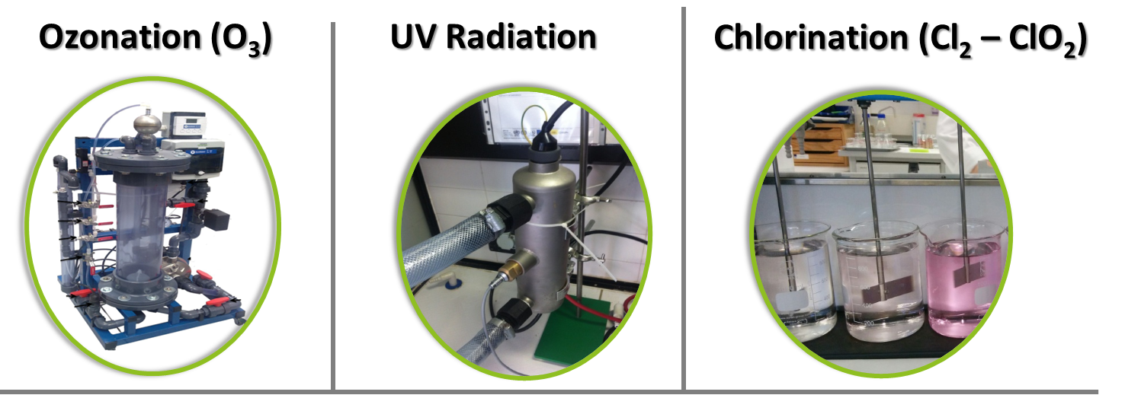
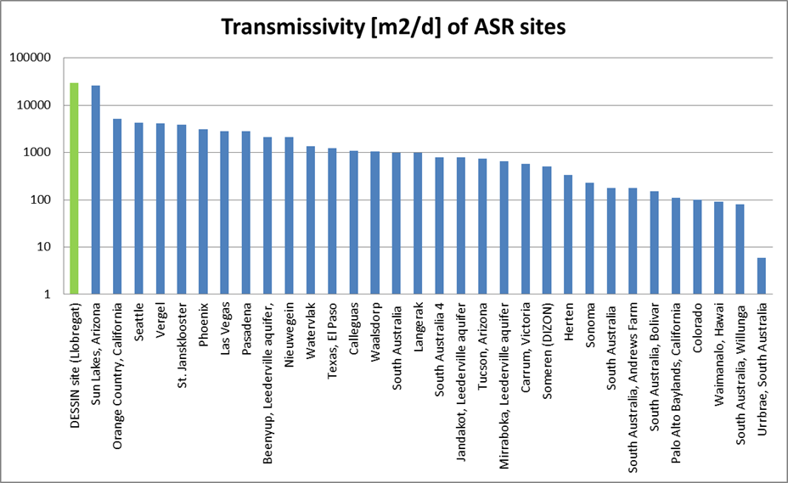
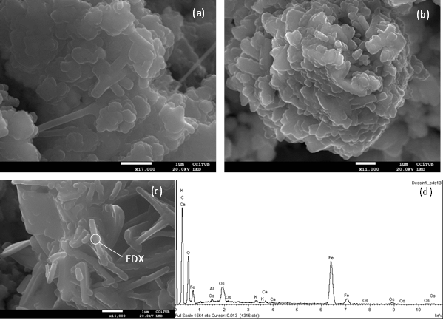
T22.3: STATUS AND OUTCOMES
What could we share / explain?
Overview of ASR systems with pre-potable water worldwide: map?
Quality standards review for ASR with pre-potable water
Innovative methodology to simulate a ASR well screen
Open discussion about the disinfection before injection in the aquifer
Biofilm: techniques available for its characterisation
Notes:
Analysed 37 international ASR experiences. Validated by Pieter J Stuyfzand (KWR).
Values Llobregat site is represented in green bars.
One of the most surprising results is the top position of our site in hydraulic transmissivity, which means a high capacity of the aquifer in water transport, and a low increase of groundwater level when injecting.
Regarding physical clogging parameters MFI index and Turbidity values indicates an average value in comparison with other experiences using non-potable water.

Slide 9
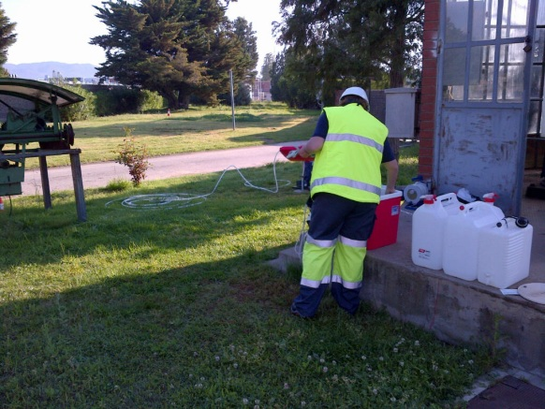
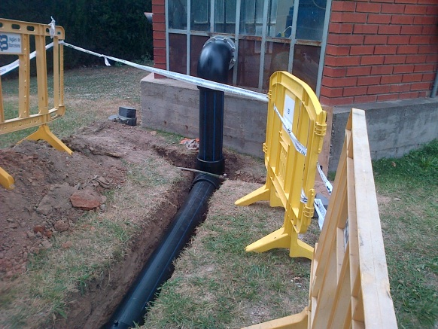
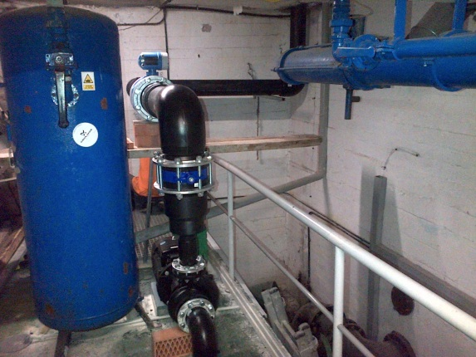
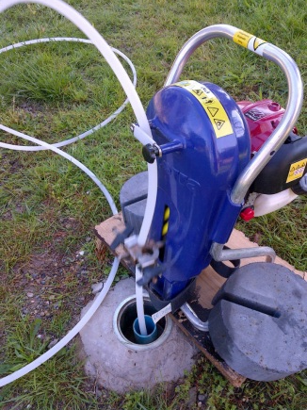
WP35: FIELD WORK AND SAMPLING CAMPAIGNS
APRIL 15 | MAY 15 | JUNE 15 | JUL 15- SEP 15 | MARCH 16 | JULY 16
Phase 1: Blank
Concentration in initial conditions
3 weeks
Phase 2: Injection of Potable water
Evaluation of conventional ASR
2 weeks
Phase 4:
Sand Filtered water injection
Discontinuous + cleaning
Ongoing
5 months
Connection works: equipment installation (Sand Filtered tank - well P18)
Phase 3: Sand Filtered water injection
continuous
3 months
Notes:
Regarding WP35 which corresponds to the implementation of the pre-potable water injection in P18 we’ve summarised here the steps followed last months. We’ve already completed the phae 1 and 2 consisting in blanck and potable water injection.
Last week connetion work finished sucessfully and next steps will be the the continuous injection and monitoring of sand filtered water along one year.

Slide 10
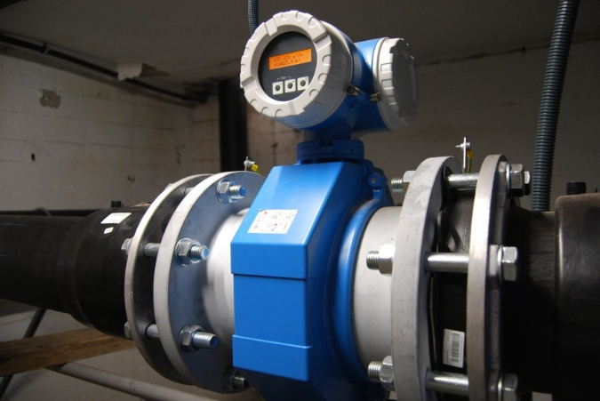
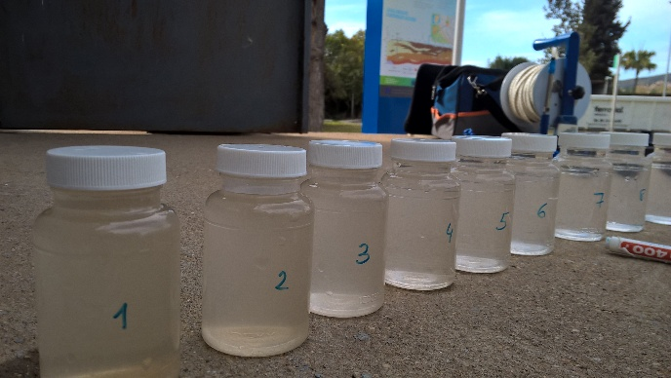
WP35: FIELD WORK AND SAMPLING CAMPAIGNS
a) Continuous injection regime (June 2015 – Nov 2015)
Without cleaning / pumping : exceptional situation
Demonstration of the most “extreme” conditions
b) Injection – cleaning – injection (March 2016 – May 2016)
Evaluation of optimum cleaning time
Development of a cleaning control protocol
c) Injection – cleaning – pumping (May 2016 – July 2016)
Application of cleaning control protocol
Evaluation of recovery capacity of recharged water

Slide 11
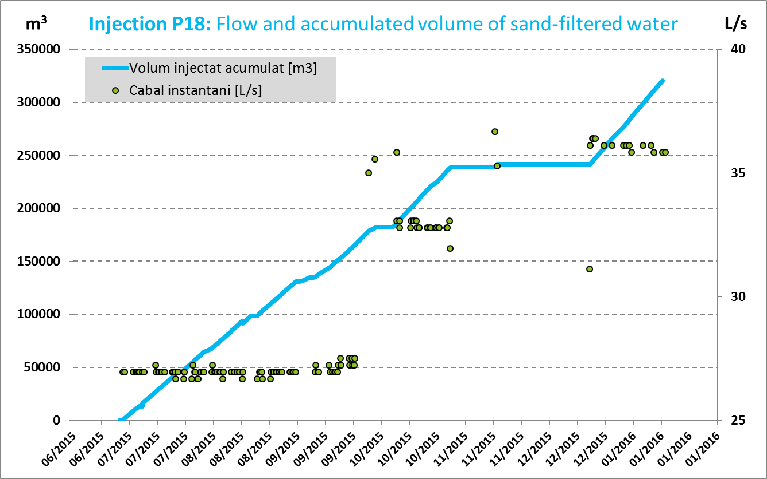
WP35: FIELD WORK AND SAMPLING CAMPAIGNS

Slide 12
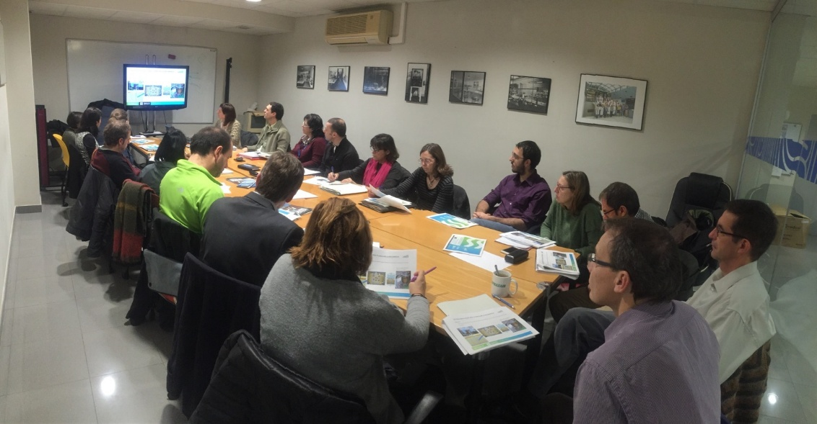
WP35: RESULTS
14/01/2016: Local stakeholder meeting (20 attendants)
Presentation of impact of sand-filtered water injected in the aquifer
Mixing ration percentage (85 – 97%)
Inorganic parameters (metals, major ions)
Microbiology (indicator microorganisms & environmental microorganisms)
Emerging and priority pollutants

Slide 13
WP35: RESULTS
Example: ammonium concentration reduction in the aquifer
Injecció aigua FS < 0,15 mg/L

Slide 14
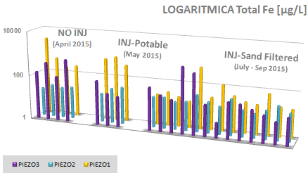
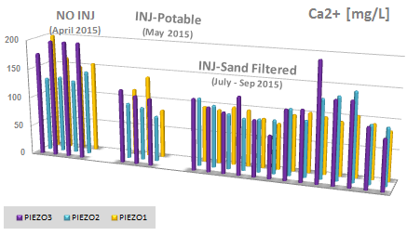
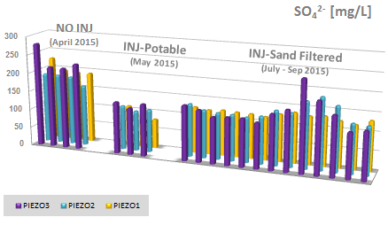
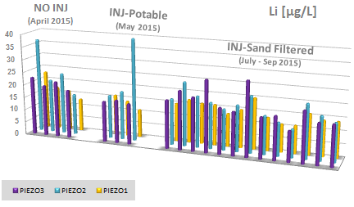
WP35: RESULTS
Most chemical species without relevant changes

Slide 15
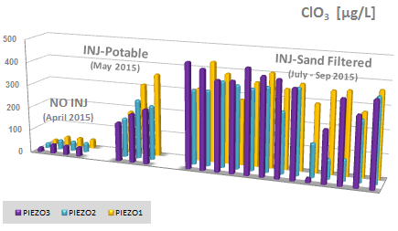
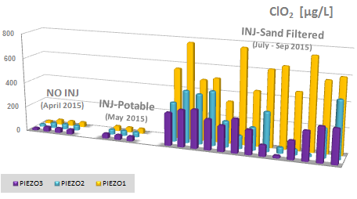
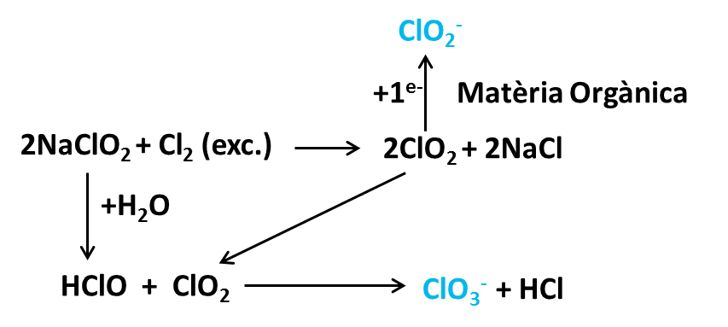
WP35: RESULTS
SF water chemical species (undesired): chlorite & chlorate
Sand Filtered water: Initial value770 µg/L
Sand Filtered water: Initial value 340 µg/L
Formation of chlorite and chlorate in first stage of drinking water treatment (dioxichlorination)

Slide 16
WP35: NEXT STEPS
Specific experiment to verify the elimination of chlorite & chlorate (done)
Internal report (catalan) to explain in detail the selection of priority and emerging pollutants, results in DESSIN project and overview in Llobregat area.
Planning of injection / cleaning / recovery already scheduled (February – July)
Other important issues in Llobregat demo site
Plenary meeting in Barcelona: end of January 2017
(project meeting & workshop ASR – ESS)
Interaction with Westland (hydrogeologists)
ESS assessment of infiltration ponds (Mature Case) → almost finished! (Jaume)
ESS assessment of ASR in Llobregat → A21 (hydraulic barrier example)
Support to ESS assessment in Westland

Slide 17
THANKS FOR YOUR ATTENTION
… Questions? Comments?

