Slide 1
ATHENS CASE (GREECE)
Developing a showcase for Sewer Mining Pilot
C. Makropoulos¹
¹NTUA

Slide 2
Showcase value
Become acquainted with the idea of sewer mining given the fact that the closest demo where this idea is far away!
Get to know what the unit looks like, how the unit works, what is innovative about it and how it performs
Present various applications of SM (and the benefits)

Slide 3
Building a showcase for the SM pilot
1
Identification of key audiences :
Local Authorities
Companies/Enterprises
Industries
Farmers
General Public
2
Creation of an overall key message as well as tailored messages and tools for each audience
3
Concept of an action plan: (a) Visits on-site by key audiences (b) Development of animation for broader audiences
4
Implementation of performance indicators and proposal of a risk assessment for the showcase

Slide 4
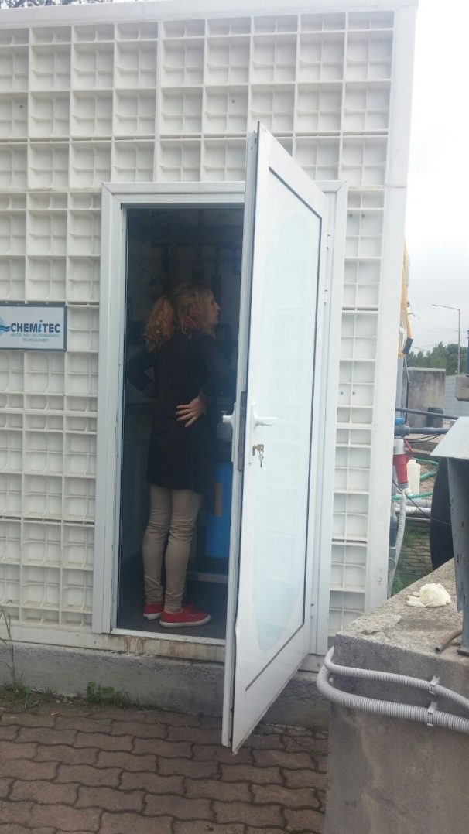
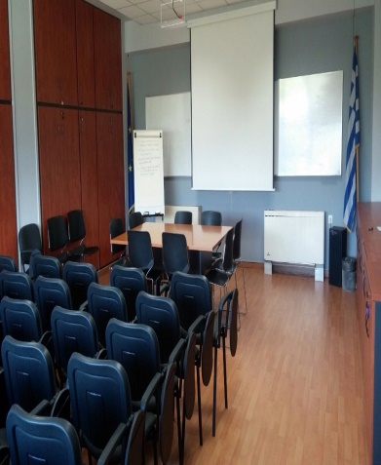
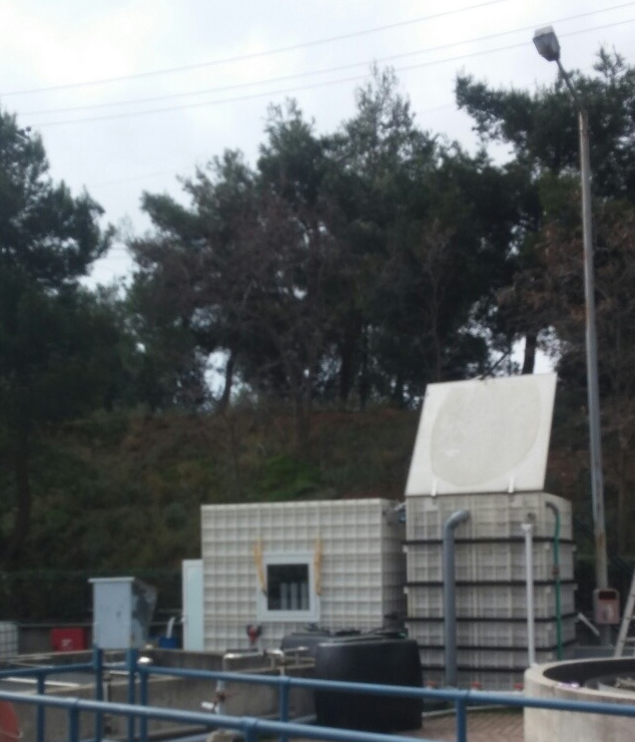
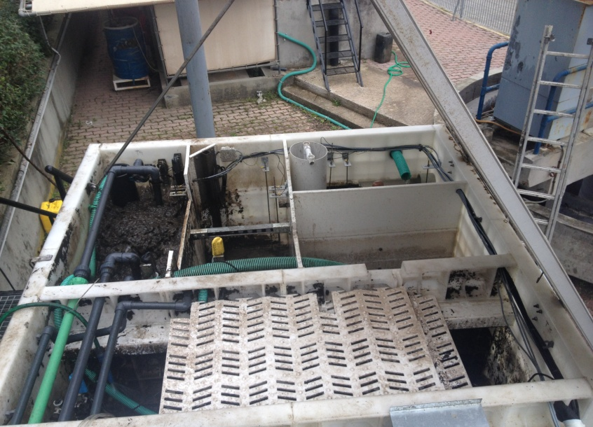
On-site visits
Visits that have already taken place :
TAIPED, in order to give permission for a similar unit (for the SUBSOL program)
Academics and students
Agencies
Future visits:
Municipalities and municipal water companies (DEYAs).
Schools, Universities
Industrial/commercial partners (e.g. SUBSOL)
Organizational structure of visits:
Presentation in R&D’s conference room
Touch and feel observation of the unit and description of the main processes taking place ( in plain words)
Presentation of the control room and explanation of the innovative use of ICT solutions for control and monitoring
Tour on the “heat island” pilot area

Slide 5
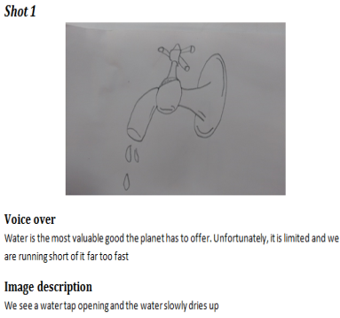
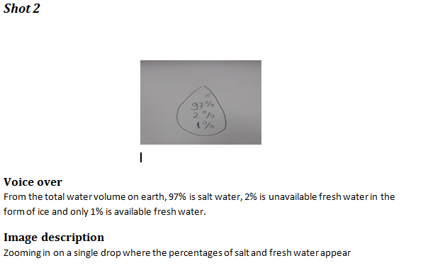
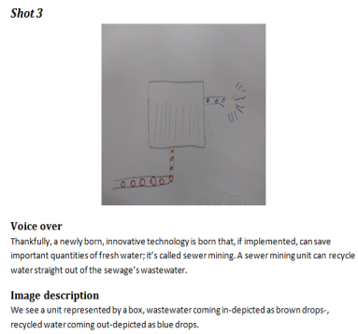
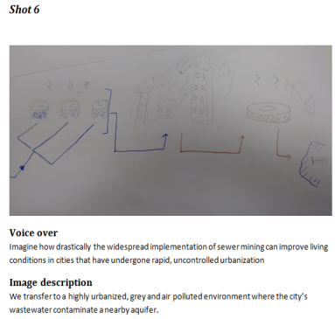
Animation
Broadcasted through popular websites, such as YouTube, thus increasing public awareness
Storyline objectives:
Link SM with the need of solutions on water scarcity
Roughly explain the operation of a SM unit
Inform about how a widespread implementation of SM in highly urbanized cities can improve citizens’ quality of life

Slide 6
Other planned actions
Convert the website into a strong link between the project and the public, by: establishing follow up stories that inform about the results of the project, as well as setting an interactive section where discussions can take place (incl. a counter of the total water recycled from the unit)
Development of a general purpose leaflet with key facts (and performance stats from the unit).
Development of targeted presentations, that include detailed information that future stakeholders have interest in, such as financial evaluation: targets tourist industry and golf courts
Contacting in key people, mainly with authorities in large municipalities (in collaboration with EYDAP).

Slide 7
Draft Timeline
Brochure distribution
Startup contacting in person
Animation storyline, editing, finalization (in collaboration with KWR)
April
May
June
July
Finishing the preparation of the site and (initial) material for organized visits
Further actions
Review of so far actions
Press releases in 5-6 major media
The unit welcomes the first visitors, in organized tours

