Slide 1
Results from Aarhus
DESSIN WP13
Niels Riegels¹
¹DHI

Slide 2
INDEX
Review of Aarhus River restoration project
Results from ESS assessment and valuation
Update on sustainability assessment

Slide 3
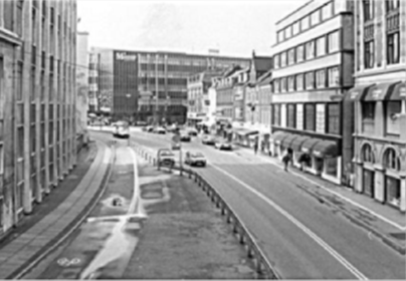
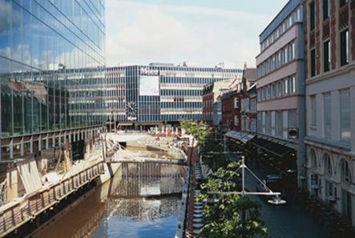
Aarhus river restoration

Slide 4
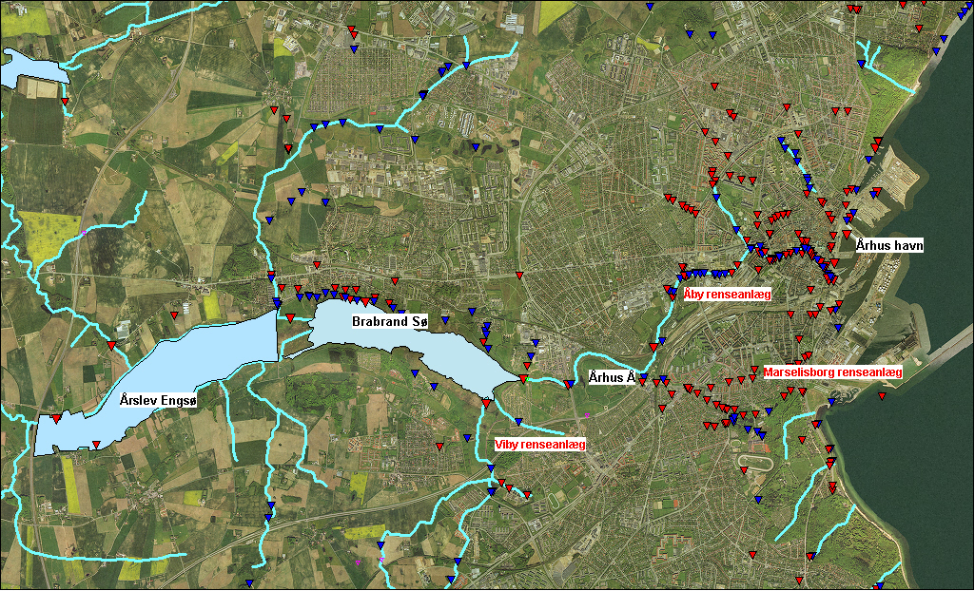
Situation 2006
Lake Brabrand, River Aarhus and Aarhus Harbour are affected by:
75 combined sewer overflows (CSO)
58 storm water drains
50% of the flow in the river is from WWTPs
Aarhus Harbour
Åby WWTP
Lake Brabrand
River Aarhus
Marselisborg WWTP
Lake Årslev
Viby WWTP

Slide 5
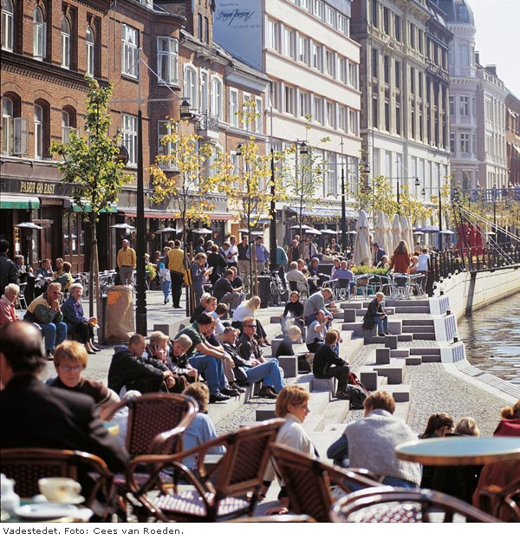

Slide 6
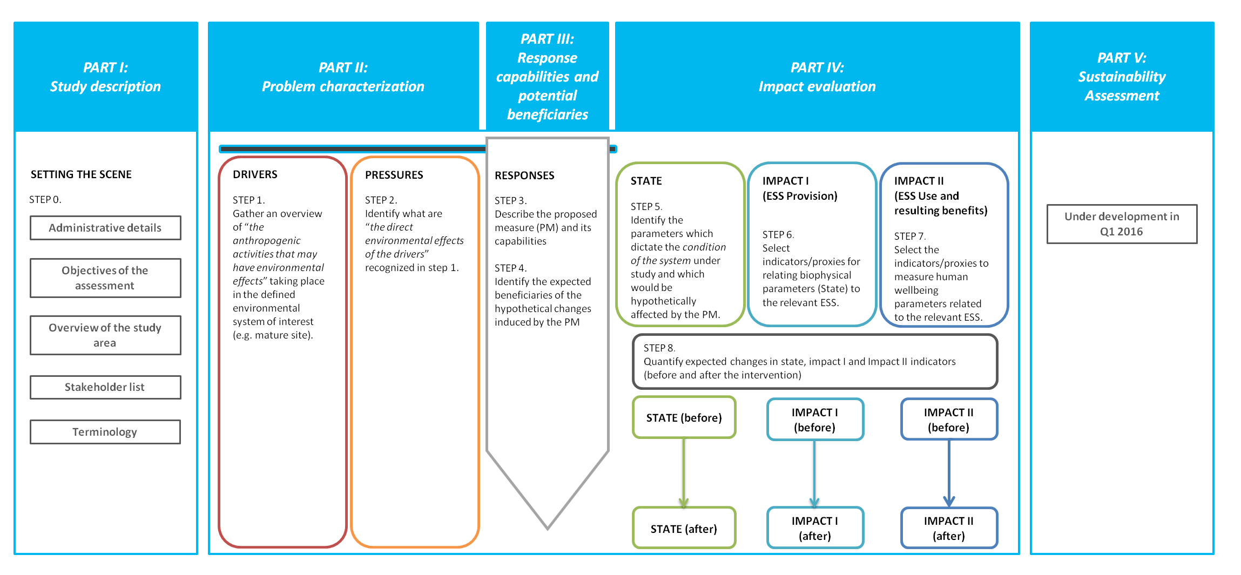
DESSIN “Cookbook”

Slide 7
Aarhus testing
Regulatory service: Degradation of pollutants in the river
CICES service class: Bioremediation/filtration/sequestration/storage/accumulation by ecosystems
FEGS beneficiary: None
Cultural service: Enjoying the restored riverfront area
CICES service class: Experiential use of landscapes in different environmental settings
FEGS beneficiary: Experiencers and viewers

Slide 8
Regulatory ESS: Degradation of pollutants
State indicator
Concentrations of E Coli and Enterococci at various points in the river
No monitoring data available, so will be estimated using MIKE11/ECOLAB
ESS provision indicator
E Coli/Enterococci mass balance
BOD mass balance
Hypothesis: Rate of degradation has increased as a result of project

Slide 9
MIKE 11 model schematic
Two models:
E.Coli, Enterococci
BOD, DO

Slide 10
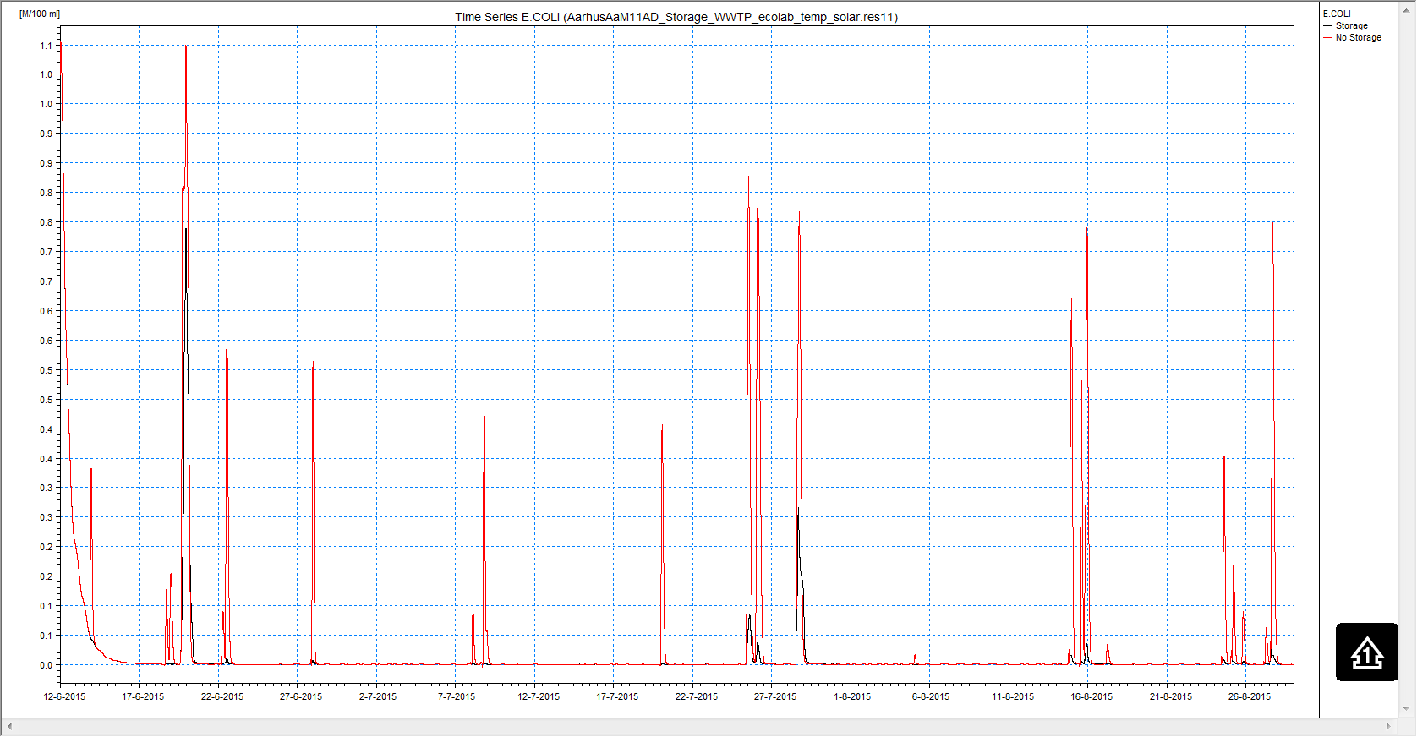
Comparison of E.Coli at river mouth

Slide 11
Cultural ESS: Enjoying the restored riverfront area
State indicators
Presence of surface water
Water clarity status
Extent to which sound of flowing water can be heard
Odor status
Algae status
Probability of water-borne illness from partial body contact with river water
ESS provision indicator
Dimensionless indicator aggregating the above state variables

Slide 12
Cultural ESS: Enjoying the restored riverfront area
ESS use indicator
Number of individuals likely to make day trips to the area (Number living <8 km from riverfront area)
Valuation indicator
Estimated change in house prices resulting from:
Nature areas within 1000m walking distance
More varied shopping and entertainment possibilities within 1200m walking distance
Estimated change in apartment prices resulting from:
Nature areas within 600m walking distance
More varied shopping and entertainment possibilities within 1000m walking distance
More cafés, bars, and restaurants within 100m walking distance

Slide 13
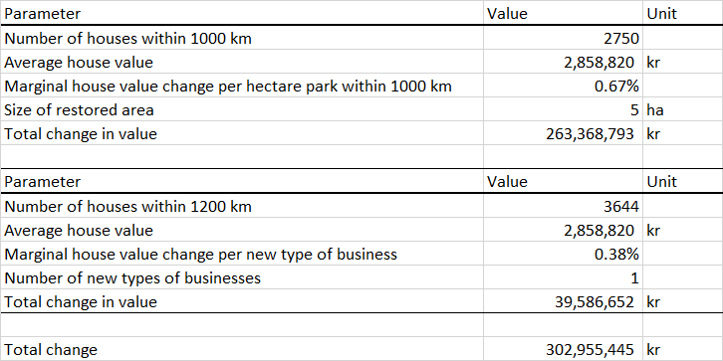
Valuation results: Houses

Slide 14
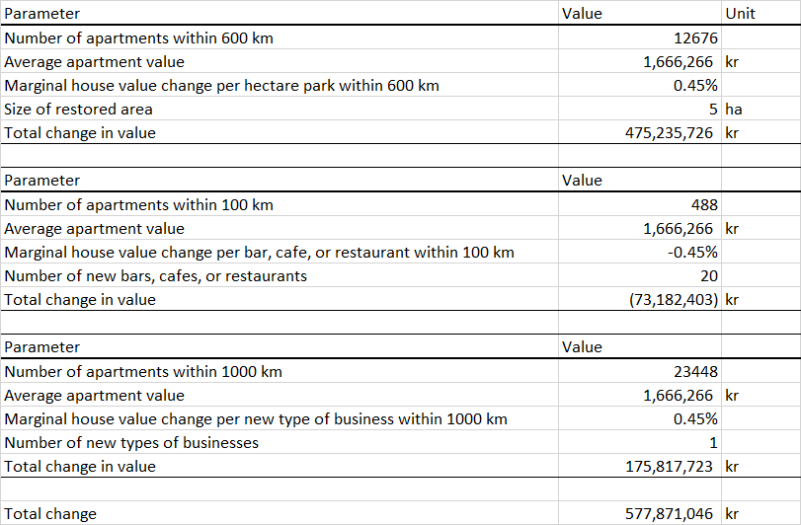
Valuation results: Apartments

Slide 15
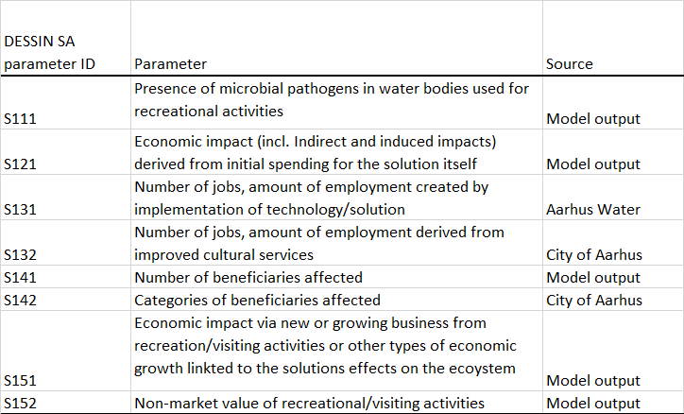
Sustainability assessment: Social

Slide 16
Sustainability assessment: Environmental

Slide 17
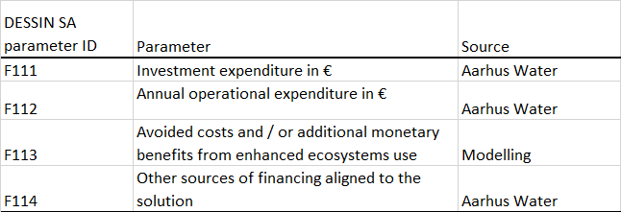
Sustainability assessment: Financial

Slide 18
Sustainability assessment: Governance

Slide 19
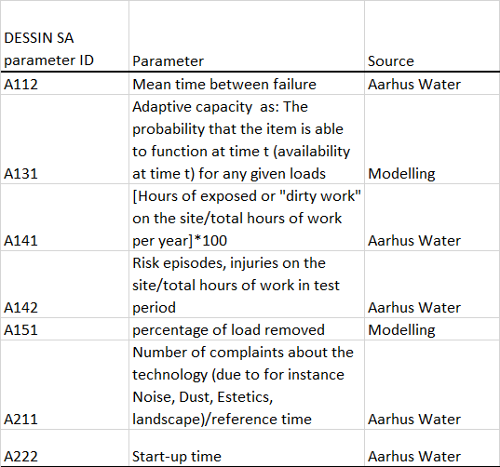
Sustainability assessment: Assets

