Slide 1
WA2-3 coordination meeting Nieuwegein - 17th March 2016
Introduction to sustainability assessment in DESSIN
Clemens Strehl and Kristina Wencki (IWW),
Rita Ugarelli and Sigrid Daman (SINTEF)

Slide 2
Index
Why sustainability assessment?
Structure of the sustainability assessment framework
Process advice from the “cookbook”
Next steps

Slide 3
Why a sustainability assessment?
ESS evaluation and SA in DESSIN
The ESS evaluation is meant to quantify the benefits from ESS enhancement by DESSIN solutions / technologies
SA aims to broaden the scope and give a more holistic view on effects from solution implementation
SA framework can take into account the IMPACT II results as benefits, but can also cover additional effects from solution’s implementation

Slide 4
Why a sustainability assessment?
Scope and goal
Give decision support to decide on solution’s implementation
SA can be conducted for a two different decision cases:
Decide, if one specific solution improves the situation compared to Status Quo
Compare a set of solutions to find out which one is the most efficient one to solve the challenge to be addressed

Slide 5
Why a sustainability assessment?
Generic method
Propose a set of dimensions, objectives, criteria and quantifiable indicators to assess the expectable effects following implementation
SA Indicators try to cover „internal“ effects for the decision maker (e.g. costs to bear, performance improvements to be expected etc.) as well as „external“ effects on society and environment
Proposed set of indicators offer a possibility to quantify case specific advantages (positive changes in indicator values) and disadvantages (negative changes in indicator values)
Propose a multi-criteria framework for assessment
Notes:
Not a fix set of “must have” indicators, but rather a recommendation, what might be fitting, depending on the decision case / case study
For indicator selection we took into account the SME workshop results

Slide 6
Structure of the SA framework
The 5 Dimensions of the SA
Social dimension
Environmental dimension
Sustainability assessment of Dessin solution
Financial dimension
Governance dimension
Assets dimension

Slide 7
Structure of the SA
Objectives for the SA
A DESSIN solution should…
…enhance the quality of live
…be efficient in the use of natural resources
…be environmentally efficient
…be affordable
…comply with regulations
…be an adequate, reliable and resilient solution
…avoid to cause negative external effects
Social dimension
Environmental dimension
Financial dimension
Governance dimension
Assets dimension

Slide 8
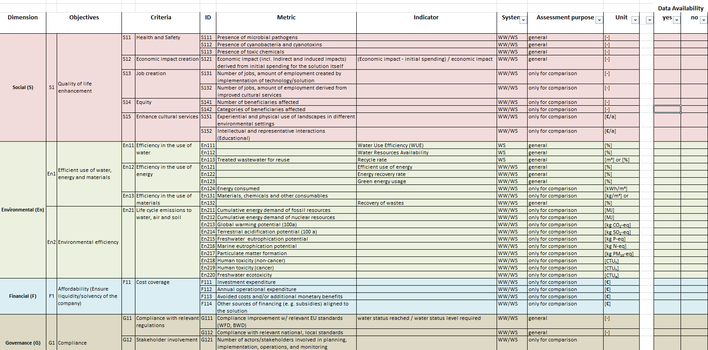
Structure of the SA
Indicator Excel-List
Notes:
Will open the excel quickly to explain the structure and main columns

Slide 9
Process advice from the “cookbook”
Steps to follow for a sustainability assessment
Step A: Define the assessment frame and decision case
Step B: Choose appropriate sustainability indicators from DESSIN indicator list
B.1: Filter and select appropriate indicators from full list
B.2: Go through selected indicator list and check for data availability
B.3: Check remaining list, if you have further data helpful for the assessment which is not covered yet by an indicator continue with Step C, otherwise go through Step D
Step C: Eventually try to define additional indicators to fill the „gap“
Step D: Data collection and assessment
Notes:
Straitforward process
Step A: define case study spacial scale (e.g. as in ESS Evaluation) and temporal scale, usually assess indicators per anno until end of lifetime
Step B: filter options in DESSIN SA table available, to filter for indicators only relevant when more than one solution is to be assessed and to filter for indicators relevant for measures affecting drinking, waste water or both type of systems
Step C:
Step D: Not fully developed yet, reccomondations will be condesed after mature case testing is finished….End of April….

Slide 10
Next steps
Finish ongoing mature case tests
Finalize cookbook chapter
Finalize companion document chapter
collaborate with DHI to define how to implement the SA in the decision support software in WP 23
Emscher | Llobregat | Aarhus
70% | 60% | 10%

Slide 11
Thank you for your attention

