Slide 1
DESSIN WA2/3 Meeting – Nieuwegein – 16-17 Mar 2016
WP31 – Emscher demo case
Timo Wortberg (UDE), Nadine Gerner (EG)

Slide 2
Report Emscher demo cases
I) Status, experience, and outlook WP31.1 - Improved CSO treatment
II) Status, experience, and outlook WP31.2 - RTC of sewer system
III) ESS in the 2 Emscher demo cases

Slide 3
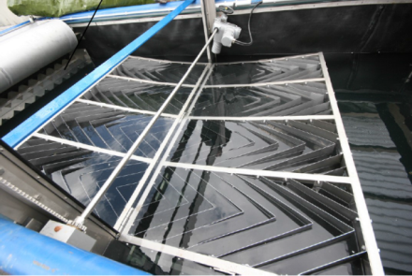
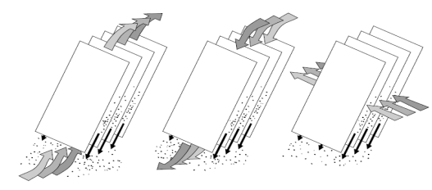
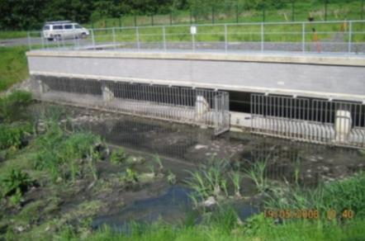
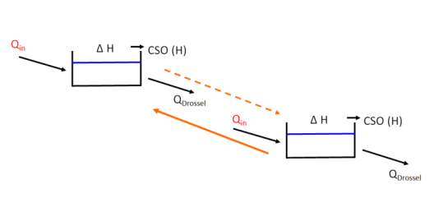
Report Emscher demo cases
WP31.1 – Improved CSO treatment
WP 31.2 – Real Time Control of sewer network
Notes:
Decrease in CSO discharge amount, load and times per year → improvement of water quality → indicator: macroinvertebrates, chemical status, saprobic level
→ less hydraulic pressure → indicator: macroinvertebrates

Slide 4
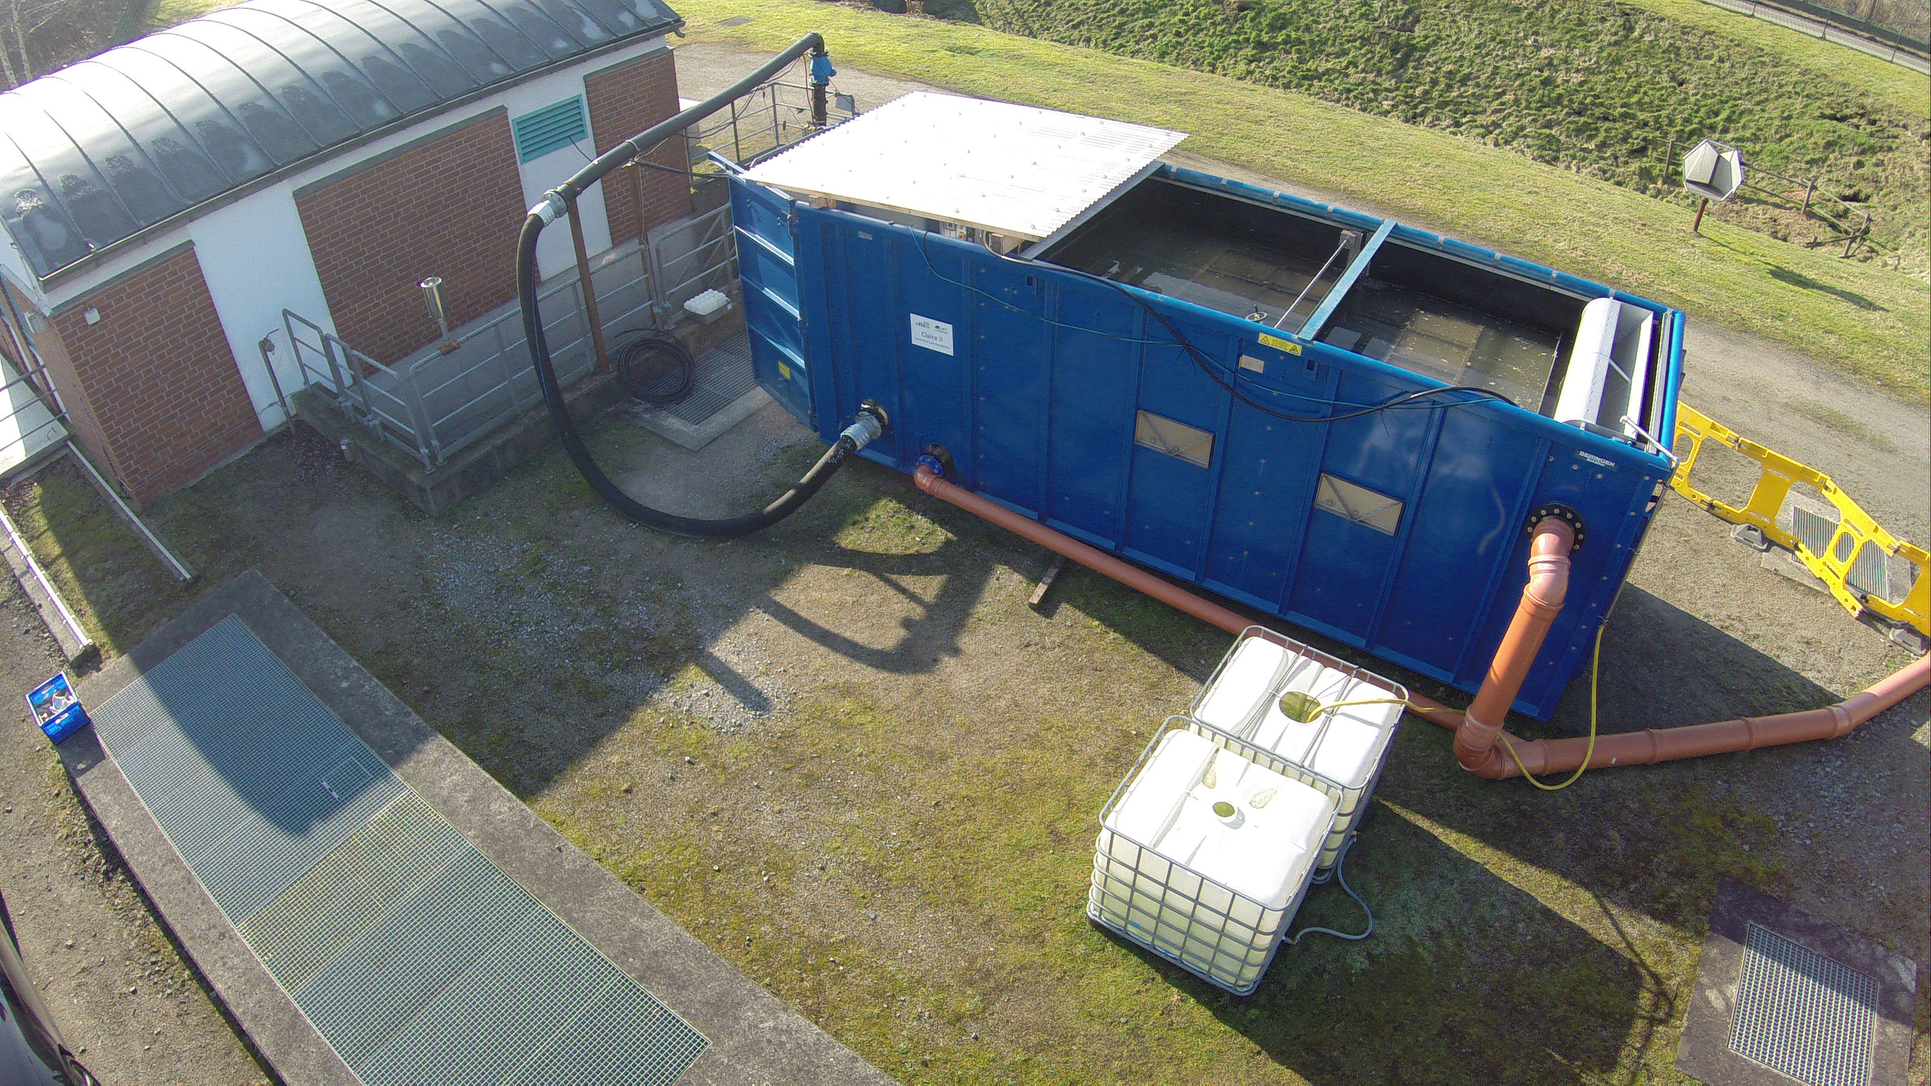
Cross flow lamella settler
Located in Castrop-Rauxel at a CSO in parallel to a combined sewer and near by a pumping station
First setup in summer 2015
Equipment:
two sample taking devices (à 24 bottles) including control device
Two spectrometer probes (S::CAN)
Inflow water is pumped from the sump hole into the inflow structure of the container. Water flows through lamellas and exits the container via a spill way.
Samples are taken near to the inflow structure and inside the spill way

Slide 5
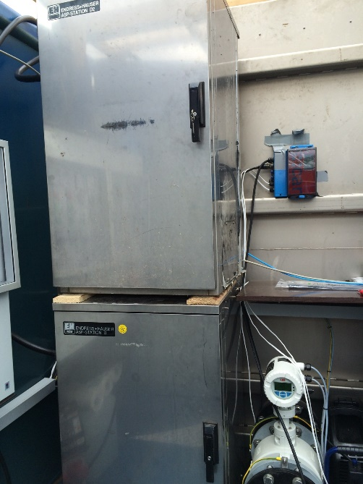
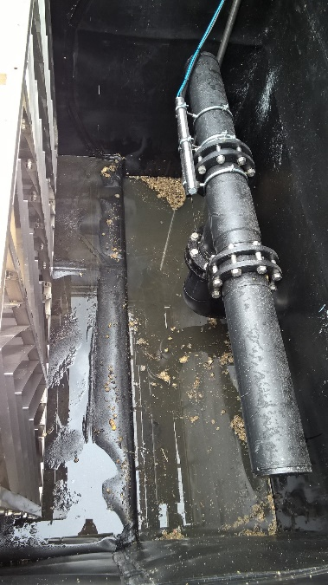
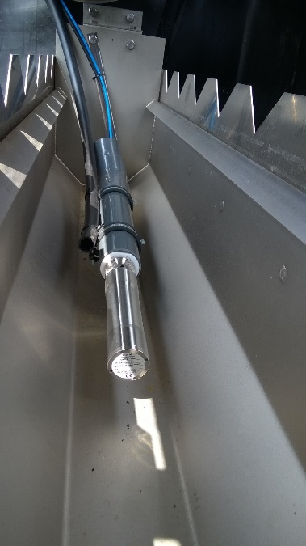
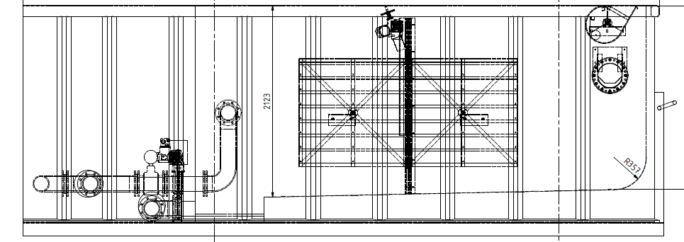
Cross flow lamella settler
Setup:
During heavy rain events the pump sump is filling due to higher inflow than outflow
Inflow pump of the container start operating at rain events when pump sump water level reaches 40cm over the pump. Turn of at 30cm over the pump.
Samples are taken every 10 minutes. Two samples filling one bottle.
Samples are stored cooled and dark
Main Parameters that are measuered:
TSS
Fine TSS (0,45-0,63µm)
COD
TOC
Spectrometer probes measuring every 15 seconds (first DOC and TOC, later CSB and TSS)

Slide 6
Technical problems / experiences during test phase:
Inflow pump was regulating strongly. Discharges were varying between 20 and 40 l/s by a set point of 30 l/s
Adjustment of pump control
Failure of cleaning mechanism of spectrometer probes
No trustworthy results, mechanical manual cleaning necessary
Clogging of inflow pump
Repair done by EGLV
Freezing of tubes from sampling devices
Almost no operation in January 2016
Catchment is influenced by groundwater infiltration (roughly 50% of dry weather flow)

Slide 7
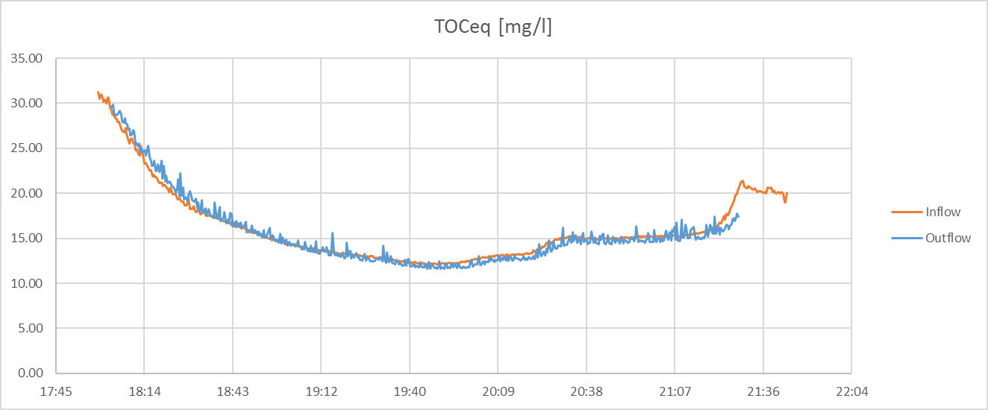
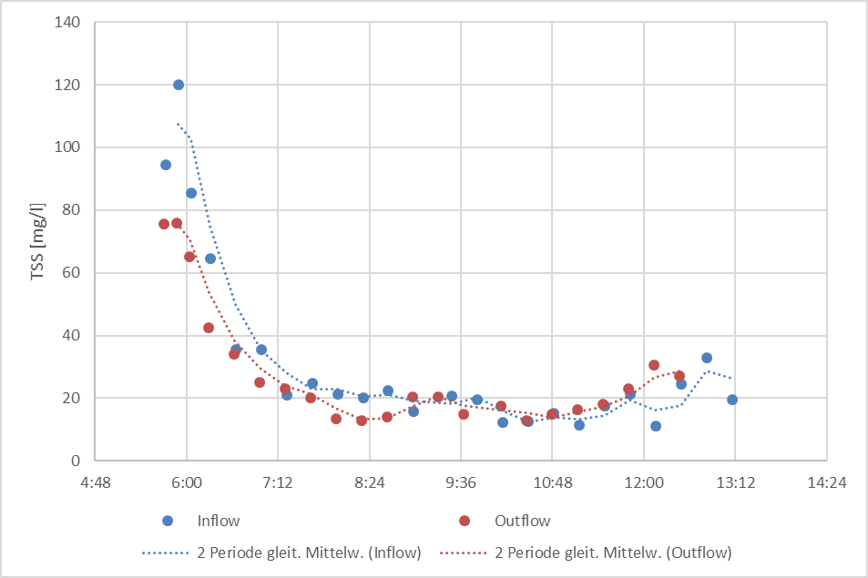
Preliminary Results
First results were not satisfactory.
Almost no differences between inflow and outflow concentrations
Lowering the discharge to 20 l/s, later to 10 l/s
Look on hydraulic conditions
Relatively low concentrations in storm water
Use of dry weather flow
Indication of a higher sedimentation performance at higher inflow concentrations
Example of probe measurement of first storm water event
Example of Lab measurement of storm water event from November 2015

Slide 8
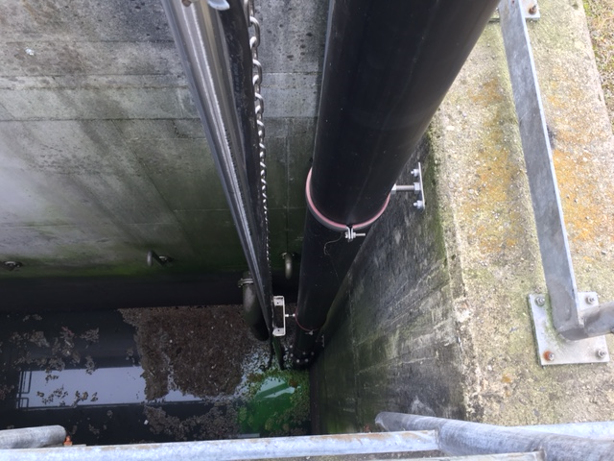
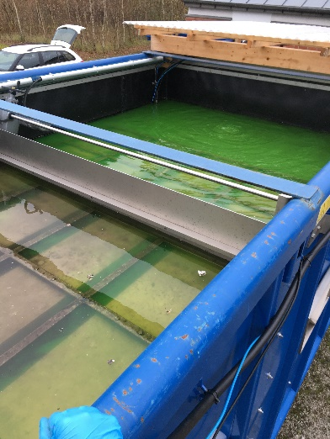
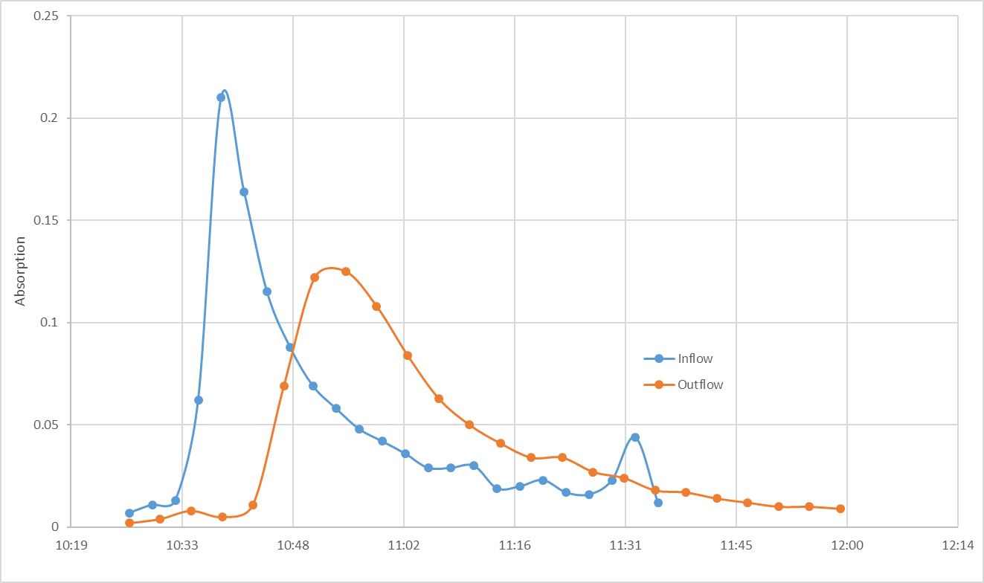
Uranine Tracer Test
To compare inflow and outflow results the residence time of the water inside the container needs to be considered
Therefore, tests using Uranin tracer were performed
Tracer is introduced in the pump sump near the inflow pump of the container
Sample taking devices take samples at the Inflow and outflow inside the container every 1 minutes
Uranin is later detected by measuring the absorption at 491nm wavelength
→ Different test show residence time of 13 to 16 Minutes, by 10 l/s inflow discharge → adjustment of outflow results
residence time

Slide 9
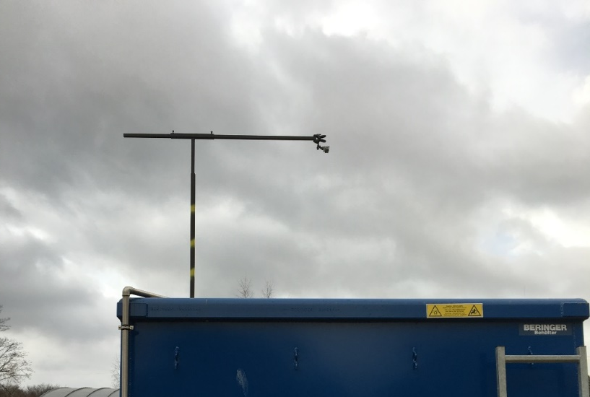
Uranine Tracer Test
to gain an optical impression the to flow distribution inside the container a camera was installed to monitor the uranin tracer
Identification of a bypass current on the left side (in flow direction)
Sample taking device and spectrometer probe were installed inside the spillway on the left side
Modification of devices to right side

Slide 10
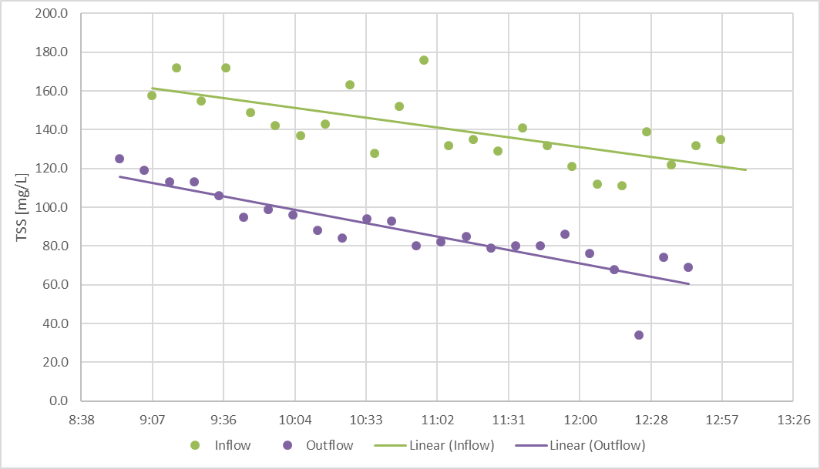
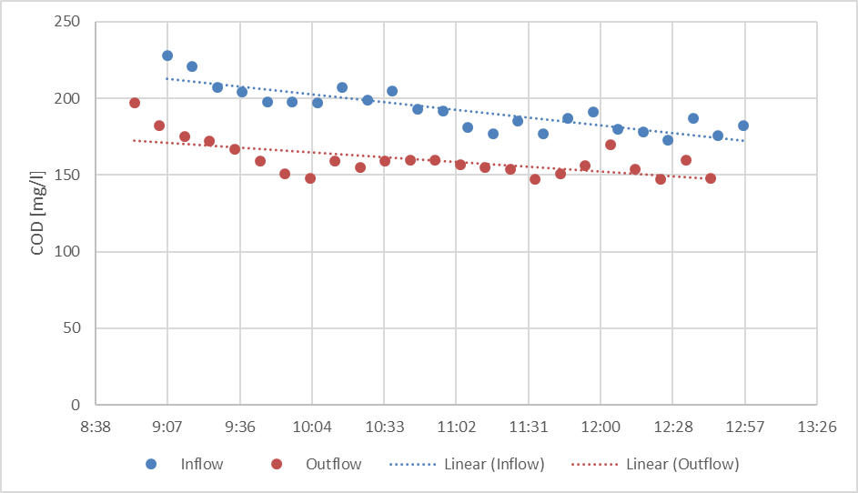
Latest Results of test with new location of sample taking device and spectrometer probe
First test using dry weather flow
After modifications results show a better sedimentation efficiency (roughly 20 to 30 %)
More tests needed to confirm results
Outlook:
Collecting samples using dry weather flow
varying discharge
Performing uranin tracer tests
Varying discharge
Performing tests without lamellas
Moving of container to Norway end of May

Slide 11
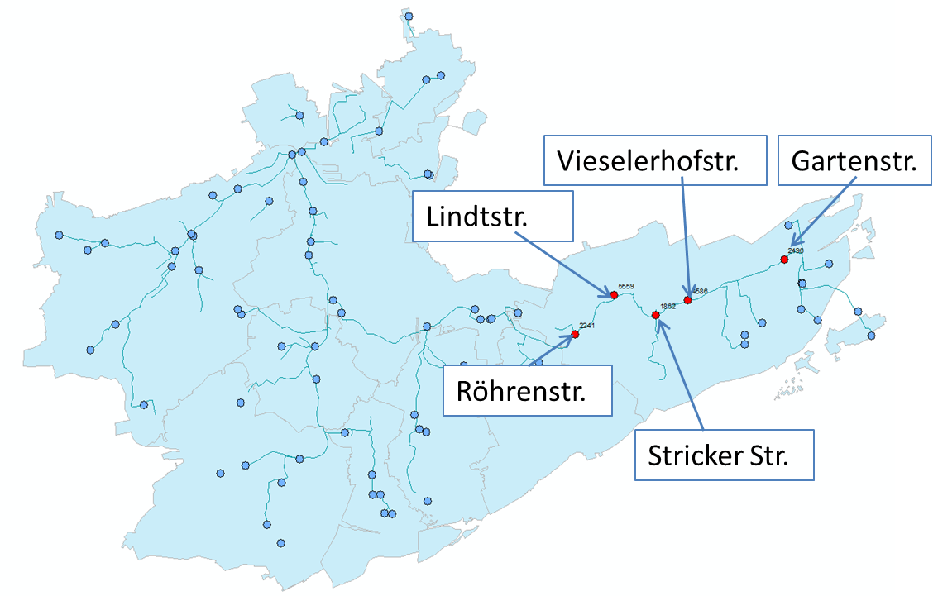
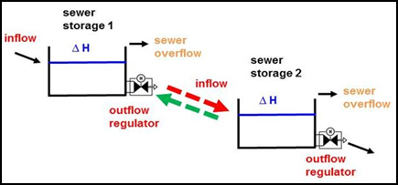
RTC of Sewer Systems
Catchment under focus: Oberlauf Emscher
5 Storm water treatment tanks connected in series
Simulating the effectivity of the ADESBA control algorithm
Gartenstr. (3341 m³ ; Qd = 300 l/s)
Vieselerhofstr. (3349 m³ ; Qd = 465 l/s)
Stricker Str. (2658 m³ ; Qd = 540 l/s)
Lindtstr. (6296 m³ ; Qd = 710 l/s)
Röhrenstr. (2372 m³ ; Qd = 780 l/s)

Slide 12
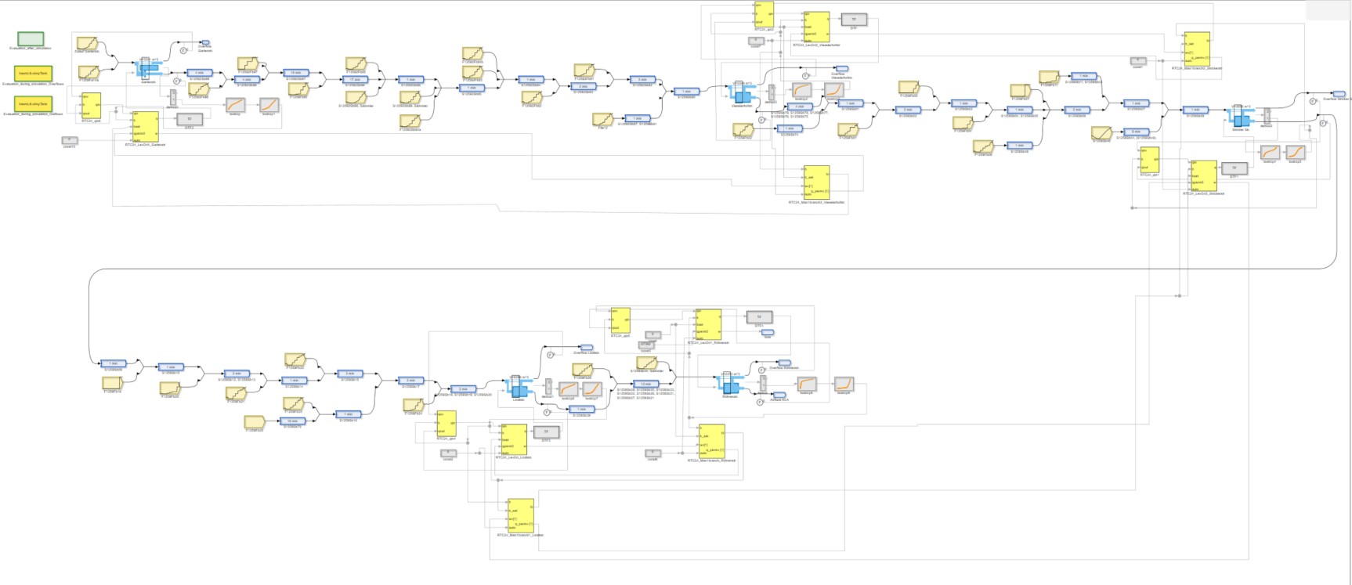
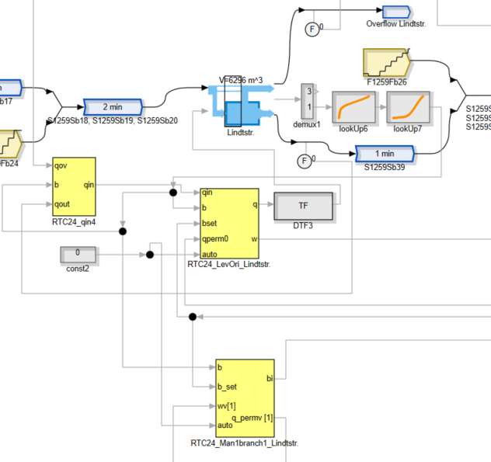
RTC of Sewer Systems
Implementation of the catchment into SIMBA (a simulation software developed by IFAK - Institut für Automation und Kommunikation e. V.)
Inflow discharges delivered by EGLV from the pollution load model MOMENT (25 years)
Two Workshops on Simba and ADESBA in Magedeburg
Handing over of ADESBA Blocks for SIMBA
Structure information delivered by EGLV
Throttle flow (min, max, nominal)
storage volume
Water level / Volume relation

Slide 13
RTC of Sewer Systems
Tests perfomed:
Running the Simulation with ADESBA on and off
Using different throttle ranges
Testing effectivity with control of single facilities turned off

Slide 14
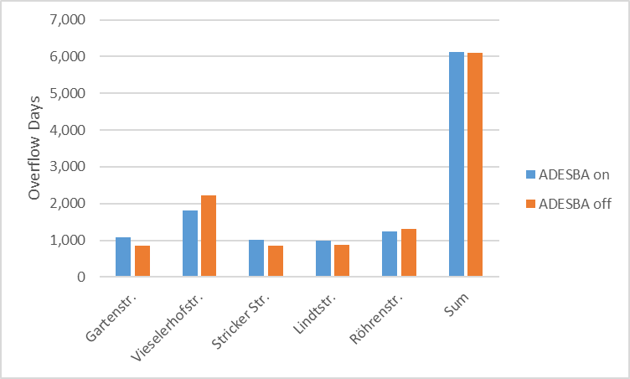
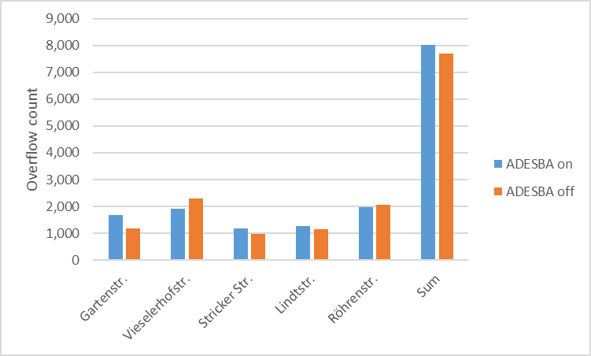
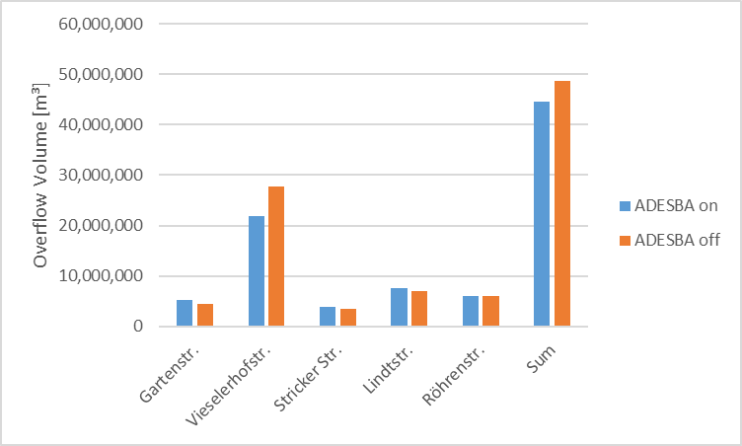
RTC of Sewer Systems
Simulation results using ADESBA / without ADESBA, Simulating 25 years
Results differ from tank to tank
The count of overflows can be higher using ADESBA than without
Total overflow volume is reduced by 8,7%
The tank at Vieselerhofstr. is of main importance due to its high saving of spilled water

Slide 15
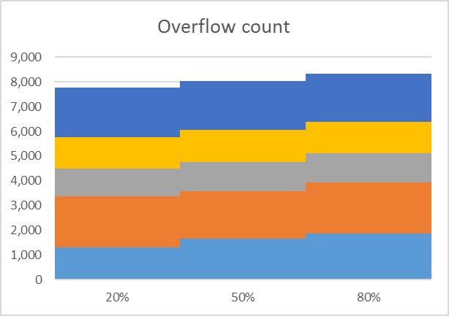
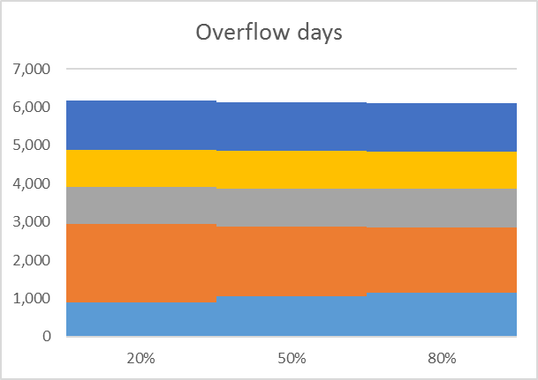
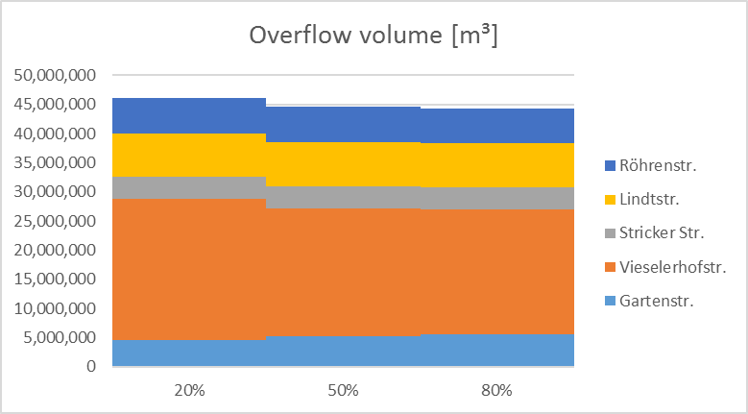
RTC of Sewer Systems
Simulation results using ADESBA and varying the throttle range in which ADESBA operates, Simulating 25 years
Qmax
80%
50%
20%
Qnom
20%
Overflow counts increase with increasing throttle range
Total overflow volume is reduced
The tank at Vieselerhofstr. is of main importance due to its high saving of spilled water
50%
80%
0

Slide 16
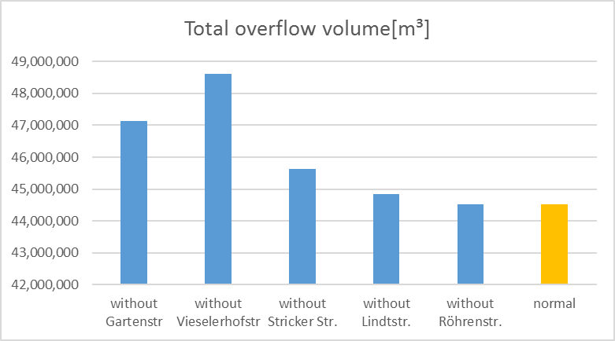
RTC of Sewer Systems
Simulation results using ADESBA with single tanks excluded from ADESBA control , Simulating 25 years
Overflows of the System are depending on controlled tanks
Shows the importance of different tanks
Tank at Vieselerhofstr. has most the most impact on the spilled volume
Outlook:
Real implementation of the ADESBA control to CSO facilities
Test phase of 6 months
Simulating the catchment of Dortmund Deusen
Evaluation of recorded operational data

Slide 17
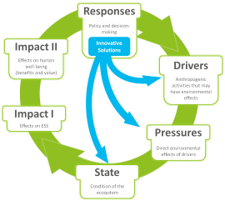
Emscher demo cases: Ecosystem services
RESPONSE
DRIVERS
WP31.1
PRESSURES
Point source
- Urban wastewater ↓
- Storm overflows ↓
Measurements:
sedimentation efficiency
not affected
IMPACT II – USE & BENEFIT
IMPACT I - PROVISION
STATE
FESS Cultural ESS:
- Use ↑
- adequate offer regarding WTP for
recreation, GEP, ...
- IESS Self-purification (N, P, C) ↑
- IESS Biodiversity (algae,
macrophytes, invertebrates) ↑
- FESS Cultural ESS ↑
Calculations:
nutrient retention (Excel-tool, ECOLAB water quality model)
Physicochemical
- Transparency ↓
- Nutrient conditions ↓
- hazardous substances ↓
Measurements:
TOC, BOD, P, N, filterable substances
SUSTAINABILITY ASSESSMENT
- lifetime
- energy consumption
- investment & maintenance costs
- ....
Notes:
STATE:
Hydromorphology – Morphology
Depth and width variation
Structure of the water body shoreline
Physiochemical - General
Transparency
(Thermal conditions)
Oxygenation conditions
(Salinity)
Nutrient conditions
(Acidification status)
Physiochemical - Priority hazardous substances
Pollution by all priority substances identified as being discharged into the body of water
Physiochemical – Other pollutants
Pollution by other substances identified as being discharged in significant quantities into the body of water
Biological
Macrophytes + Phytobenthos
Benthic invertebrates
------------------------------------
IMPACT 2:
Avoided costs
(WWTP)
Ecosystem stability
*qualitative
Avoided renaturation costs
Real estates
Symbolic
Welfare
Aesthetic
Fisheries
Local recreation
*several qualitative

Slide 18
Emscher demo cases: Ecosystem services
RESPONSE
WP31.2
DRIVERS
PRESSURES
Point source
- Urban wastewater ↓
- Storm overflows ↓
Simulations:
number & volume of overflow
not affected
IMPACT II – USE & BENEFIT
IMPACT I - PROVISION
STATE
FESS Cultural ESS:
- Use ↑
- adequate offer regarding WTP for
recreation, GEP, ...
- IESS Self-purification (N, P, C) ↑
- IESS Biodiversity (algae,
macrophytes, invertebrates) ↑
- FESS cultural services ↑
Calculations:
nutrient retention (Excel-tool, ECOLAB water quality model);
peak flow (MIKE, discharge
modelling)
Physicochemical
- Transparency ↓
- Nutrient conditions ↓
- hazardous substances ↓
Hydromorphology/Hydrology
- Quantity + dynamics of water flow ↓
- Water residence time ↑
Simulations:
nutrients, flow velocity
SUSTAINABILITY ASSESSMENT
- lifetime
- energy consumption
- investment & maintenance costs
- ....
Notes:
STATE:
Hydromorphology – Hydrology
Quantity + dynamics of water flow
Water residence time
Hydromorphology – Morphology
Depth and width variation
Structure and substrate of the water body bed
Structure of the water body shoreline
Physiochemical - General
Transparency
(Thermal conditions)
Oxygenation conditions
(Salinity)
Nutrient conditions
(Acidification status)
Physiochemical - Priority hazardous substances
Pollution by all priority substances identified as being discharged into the body of water
Physiochemical – Other pollutants
Pollution by other substances identified as being discharged in significant quantities into the body of water
Biological
Macrophytes + Phytobenthos
Benthic invertebrates
IMPACT2:
Avoided costs
(WWTP)
Ecosystem stability
*qualitative
Avoided renaturation costs
Real estates
Symbolic
Welfare
Aesthetic
Fisheries
Local recreation
*several qualitative

