Slide 1
Llobregat mature site
Progress of work
M. Hernández, J. Amorós
Cetaqua

Slide 2
Llobregat ESS - PART I: Reporting tables of Llobregat mature case
Element of Part I | Instructions | User entries
Administrative details | 1. Provide general information about: - the entity/ies involved in carrying out the assessment - the provider/s of information for the assessment - the provider/s of funding for the assessment | Cetaqua Cetaqua, CUADLL, DAMM, ACA EU FP7 project
Objectives of the assessment | 2. Define the intended audience of the results (Who will be the main recipient of the outcome report?) Define and explain the specific purpose and the expected outcomes of carrying out the assessment (What do you want to achieve by assessing changes in ESS in your area?). | Intended audience: Researchers Objectives: The assessment is conducted with the aim of (i) testing the ESS Evaluation Framework proposed and (ii) identifying the benefit resulting from the ponds construction.
Overview of the study area | 3. Provide a detailed description of the study area considering: geographical location (e.g. Mediterranean region, Western Europe, Nordic region) spatial extent environmental attributes (e.g. climate type, topography, water quality levels, water availability) economic activities taking place in the area (e.g. land use, land use transitions, comparison of activities by share of GDP) socioeconomic profile (e.g. population density, average household income, age profile) sociocultural aspects (e.g. value systems, role of landscape and land use in identity formation). | Mediterranean region Aquifer area (115 km2) Typical Mediterranean climate regime,… Agriculture 0,075%, Industry 22,78%, Construction 6,43% and Services 70,72% (2012 data). 5.093 inh/km2, …
Stakeholder list | 4. Elaborate an exhaustive list of the stakeholders present in the area. | People living in the area; Industry; AB, ACA, ACC1Ó, Agbar, Agència de Salut Pública, City Councils, AMB, Aquadom, Aqualogy, AQUATEC, CDTI, CSIC, CUADLL
Notes:
For those of you not familiar with the Llobregat site I would like to highlight the context ans what we want to assess.
We want to assess mainly chemico-physical changes in the aquifer and also socio-economic impacts using the evaluation of the ESS related.
Cross section: has been produced recently using the existing information of each pumping well. 50 meters depth. 20 meters of screen: gravel and sand (main aquifer).

Slide 3
Llobregat ESS - PART II: Tables of drivers and pressures
1. Characterisation Table for Drivers
The list of drivers is based on MARS, 2014.
DRIVER | SPECIFICATION (to be input by the user) | RANKING (OPTIONAL) (to be input by the user)
Industry | Industrial bad practices in the past: solvents and PAHs in groundwater and river. Industris increase in the metropolitan area: WWTP discharge.
Urban development | Inhabitants increase in the metropolitan area: WWTP discharge, intensive use of the river.
2. Characterisation Table for Pressures
The relation between the pressure categories and the drivers is based on IMPRESS Guidance No. 3 and MARS, 2014
DRIVER IDENTIFIED IN THE STUDY AREA | PRESSURE CATEGORY | SPECIFICATION
Industry | Diffuse source | Contaminated sites/abandoned industrial sites. Groundwater pollution (solvents, PAHs, industrial pollutants).
Industry | Point source | Industrial waste water.
Industry | Abstraction | Abstraction from industry.
Urban development | Diffuse source | Discharges not connected to sewerage network: River water pollution (pesticides, pharmaceuticals, TOC, ammonium).
Urban development | Point source | Urban waste water.
Urban development | Abstraction | Abstraction urban development
Other | Hydrological alteration | Reduction of permeable surface for precipitation infiltration.
Notes:
For those of you not familiar with the Llobregat site I would like to highlight the context ans what we want to assess.
We want to assess mainly chemico-physical changes in the aquifer and also socio-economic impacts using the evaluation of the ESS related.
Cross section: has been produced recently using the existing information of each pumping well. 50 meters depth. 20 meters of screen: gravel and sand (main aquifer).

Slide 4
Llobregat ESS - PART III: RESPONSE CAPABILITIES AND POTENTIAL BENEFICIARIES
Proposed measure | Claimed / expected capability | Qualitative description | Quantitative description
Construction and equipment of infiltration ponds | Enhancing water infiltration by additional permeable surface | Increase of infiltration surface available for the infiltration processes. | 56,300 m² 1 m³/m²/day
 | Increasing groundwater resources in the aquifer | River water is disconnected of the aquifer due to fine particles acting as clogging in the river bed. Infiltration ponds will increase groundwater resources by the infiltration of river water and/or reclaimed water. Periodic maintenance will allow maintaining infiltration surface available. | 10 Mm³/year
 | Improving water quality via soil-aquifer treatment | It has been proved an effective reduction of turbidity (sediment retention) and a reduction in chemical compounds. | Sediment retention Denitrification Organic matter reduction Micropolluntants degradation (See PART III for specific evaluation of water quality improvement)
 | Reducing pollutants in the aquifer | Antropogenic substances as chlorinated solvents are present in groundwater. By the infiltration of non-polluted water, a plume of clen water is expected to dilute undesirable substances. | (See PART III for specific evaluation of water quality improvement)
 | Creation of a new surface water body (aquatic ecosystem) | The implementation of infiltration system (sellting ponds and infiltration ponds) in a dry area will generate several impacts in terms of new ecosystem creation. | 13 Ha
Notes:
For those of you not familiar with the Llobregat site I would like to highlight the context ans what we want to assess.
We want to assess mainly chemico-physical changes in the aquifer and also socio-economic impacts using the evaluation of the ESS related.
Cross section: has been produced recently using the existing information of each pumping well. 50 meters depth. 20 meters of screen: gravel and sand (main aquifer).

Slide 5
Llobregat ESS – PART IV: RESPONSE EVALUATION
Infiltration ponds system in Llobregat area
Measure | Capability | ESS affected (use CICES and US EPA catalogue!) |  |  |  |  | Beneficiaries (use US EPA categorization!)¹
 |  | CICES section | CICES division | CICES group | CICES class | DESSIN ESS (use US EPA nomenclature where applicable)² | (no beneficiary = only intermediate service)
Construction and equipment of infiltration ponds | - enhancing water infiltration by additional permeable surface - increasing groundwater resources in the aquifer - improving water quality via soil-aquifer treatment - reducing pollutants in the aquifer - aquatic ecosystem creation | Provisioning services | Nutrition | Water | Groundwater for drinking | Water suitable for processing by a municipal drinking water treatment plant (DWTP). FEGS Fact sheet # 1 | Municipal Drinking Water Treatment Plant Operators
 |  |  | Materials | Water | Groundwater for non-drinking purposes | Water suitable for cooling or processing industrial products. FEGS Fact sheet # 2 | Industrial processors
 |  | Cultural services | Physical and intellectual interactions with biota, ecosystems, and land-/seascapes [environmental settings] | Intellectual and representative interactions | Educational | Research opportunities. FEGS Fact sheet # 3 | Researchers
 |  |  |  | Physical and experiential interactions | Experiential use of landscapes in different environmental settings | (1) Opportunity to view the environment and organisms* within it, and groundwater phenomena. (2) Landscape that provides a sensory experience. (3) Sounds and scents that provide a sensory experience. * Organisms (i.e., flowers, plants, birds, mammals, reptiles, etc.) that can be viewed. FEGS Fact sheet # 4 | Experiencers and Viewers
Notes:
For those of you not familiar with the Llobregat site I would like to highlight the context ans what we want to assess.
We want to assess mainly chemico-physical changes in the aquifer and also socio-economic impacts using the evaluation of the ESS related.
Cross section: has been produced recently using the existing information of each pumping well. 50 meters depth. 20 meters of screen: gravel and sand (main aquifer).

Slide 6
Llobregat ESS - PART V: SUSTAINABILITY ASSESSMENT
scope and goal: evaluate effects of a single solution
timeframe: lifetime of the solution
spatial scale: MAR system
system: water supply (WS)
Data from ESS evaluation:
direct treatment of river water
MAR system in place
 | DESSIN ESS | unit | before | after
Imp II | Economic impact of educational excursions | [€/a] | tbc | tbc | → S152
Notes:
For those of you not familiar with the Llobregat site I would like to highlight the context ans what we want to assess.
We want to assess mainly chemico-physical changes in the aquifer and also socio-economic impacts using the evaluation of the ESS related.
Cross section: has been produced recently using the existing information of each pumping well. 50 meters depth. 20 meters of screen: gravel and sand (main aquifer).

Slide 7
Llobregat ESS - PART V: SUSTAINABILITY ASSESSMENT
direct treatment of river water
MAR system in place
Further information available:
 | indicator/metric | unit | before | after | source
S111 | Coliform bacteria (distance to reg. threshold) | [MPN] | 322,880 | 6.8 | Cetaqua
S111 | Escherichia coli (distance to reg. threshold) | [MPN] | 64,287 | 0.5 | Cetaqua
S111 | Clostridium perfringens (distance to reg. threshold) | [CFU/100ml] | 18,886 | 0 | Cetaqua
S111 | Colonies count 22ºC (distance to reg. threshold) | [CFU/ml] | 251,831 | 7 | Cetaqua
En111 | Water Use Efficiency (due to evaporation) | [%] | 0 | 99.63 -99.78 | Cetaqua
F111 | Investment expenditure | [€] | 0 | 8,000,000 | ACA
F112 | Annual operational expenditure (additional pumping) | [€/a] | 0 | Tbc AB | Cetaqua
F113 | Annual avoided costs for water treatment | [€/a] | 0 | 269,600 | Cetaqua
A111 | MTTF (= lifetime of the facility) | [a] | - | 18 | Cetaqua
A112 | MTBF (= interval for sediment layer removal) | [a] | - | 2 | DEMEAU
A131 | Adaptive capacity (= share of days per year at which solution is in use) | [%] | 0 | 75 | Cetaqua
A221 | lifetime of solution/start up time | [a] | - | 18 | Cetaqua
Notes:
For those of you not familiar with the Llobregat site I would like to highlight the context ans what we want to assess.
We want to assess mainly chemico-physical changes in the aquifer and also socio-economic impacts using the evaluation of the ESS related.
Cross section: has been produced recently using the existing information of each pumping well. 50 meters depth. 20 meters of screen: gravel and sand (main aquifer).

Slide 8
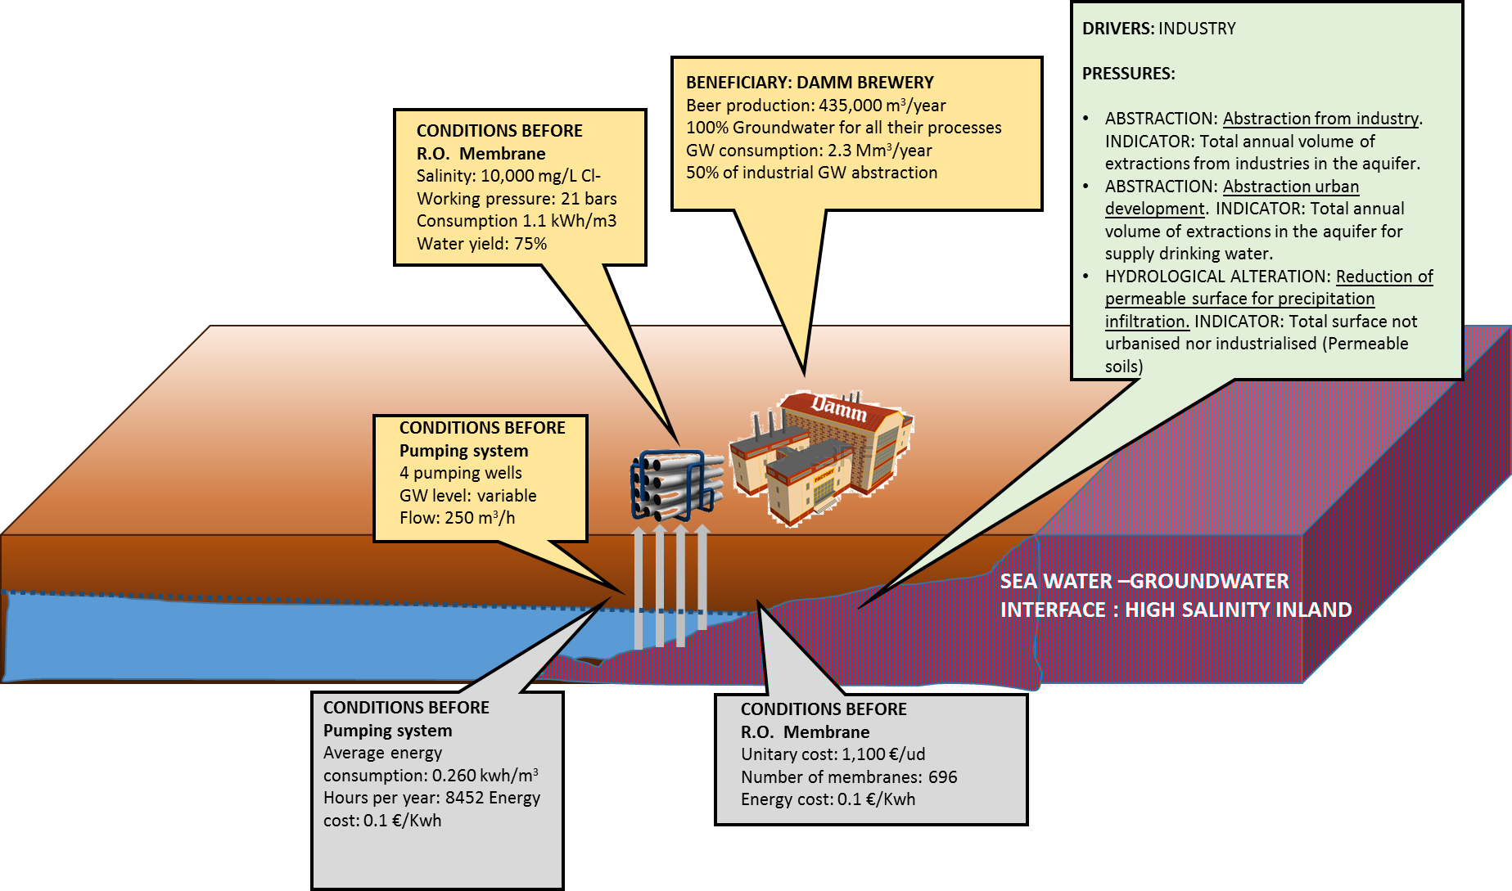
Llobregat ESS – Damm example
Notes:
For those of you not familiar with the Llobregat site I would like to highlight the context ans what we want to assess.
We want to assess mainly chemico-physical changes in the aquifer and also socio-economic impacts using the evaluation of the ESS related.
Cross section: has been produced recently using the existing information of each pumping well. 50 meters depth. 20 meters of screen: gravel and sand (main aquifer).

Slide 9
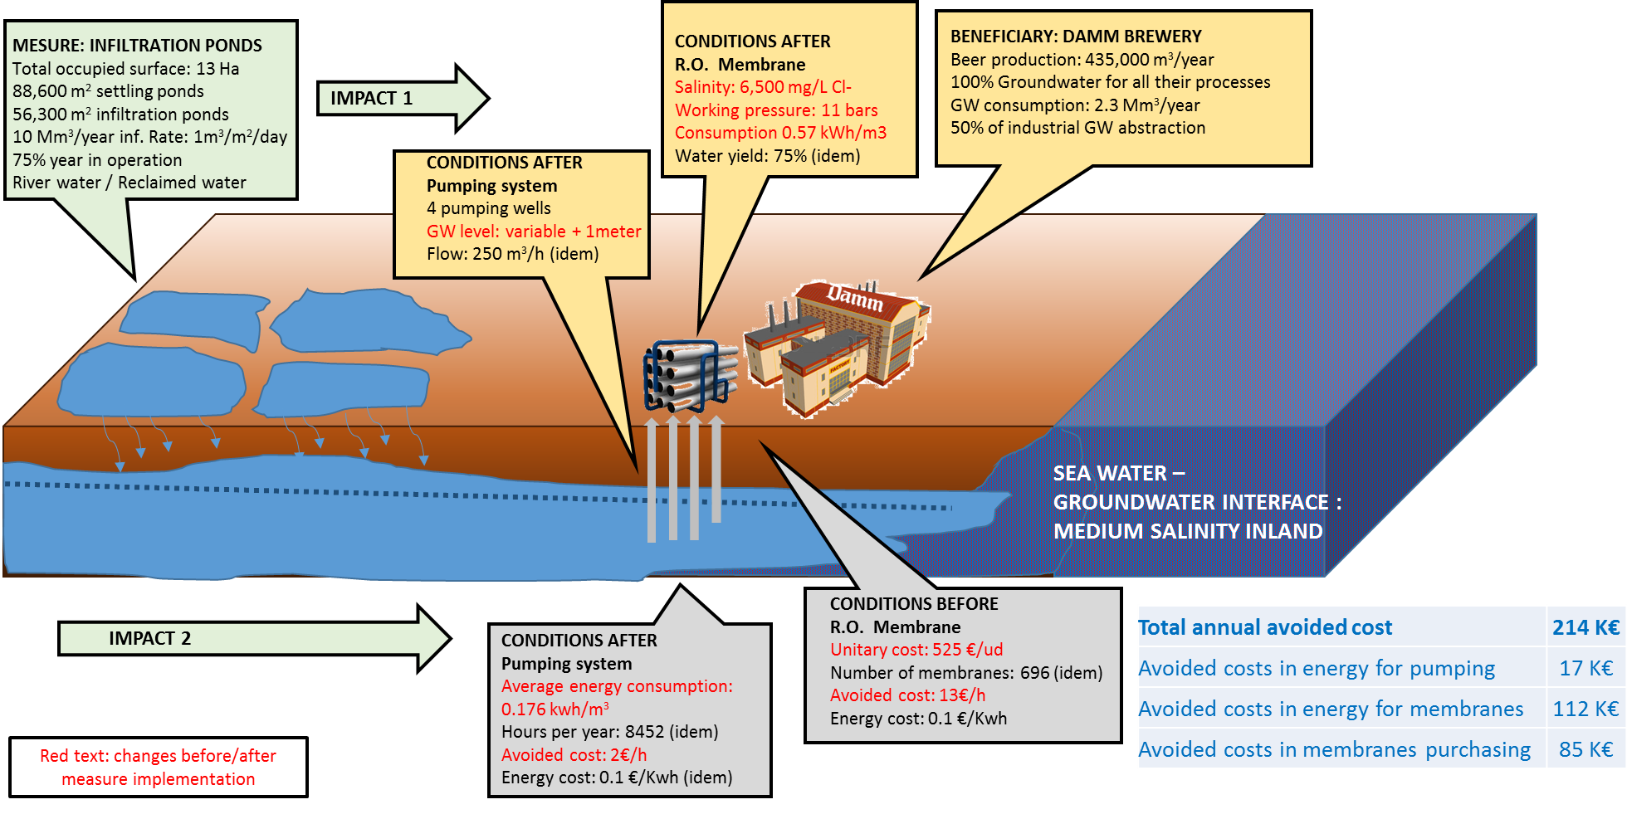
Llobregat ESS – Damm example
Notes:
For those of you not familiar with the Llobregat site I would like to highlight the context ans what we want to assess.
We want to assess mainly chemico-physical changes in the aquifer and also socio-economic impacts using the evaluation of the ESS related.
Cross section: has been produced recently using the existing information of each pumping well. 50 meters depth. 20 meters of screen: gravel and sand (main aquifer).

Slide 10
THANKS FOR YOUR ATTENTION
… Questions? Comments?

