Slide 1
WA2&3: Westland Case
Aquifer storage and recovery and reverse osmosis
K. Zuurbier¹, M. Paalman¹, G. v.d. Berg¹, K. Haas²
¹KWR Watercycle Research Institute, ²Bruine de Bruin

Slide 2
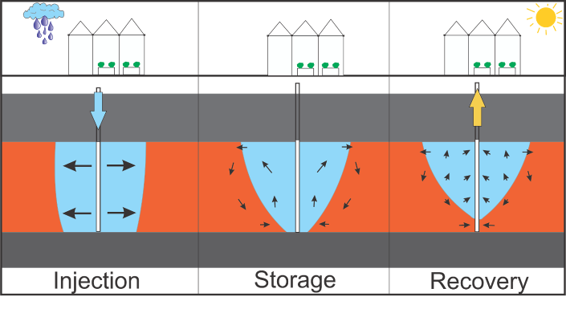
INTRODUCTION
Specific problem
Variation in precipitation
ρ(freshwater) < ρ(brackish water)
Water is stored but not recovered unmixed
+
ASR is unreliable as a freshwater source
Westland: average water availability and demand
Aquifer storage and recovery (ASR)

Slide 3
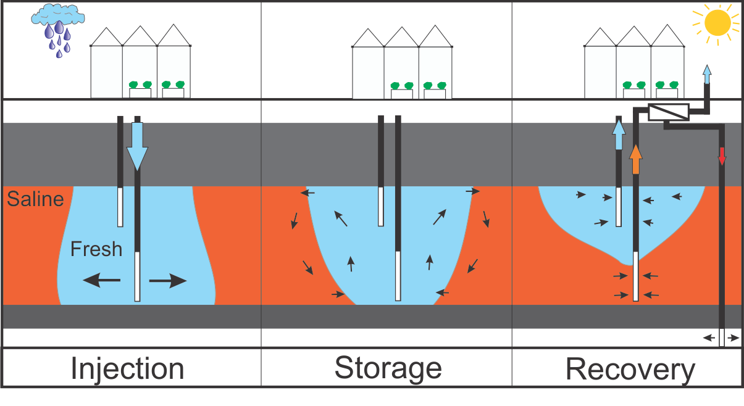
INTRODUCTION
Solution to the specific problem
Make ASR more robust/efficient:
Apply Freshkeeper to increase freshwater recovery (unmixed)
Enlarge freshwater recovery via treatment (reverse osmosis, RO) of mixed water
Rel. to brackish water RO:
Freshwater out =
freshwater in
Less RO =
< energy demand < investments (?)

Slide 4
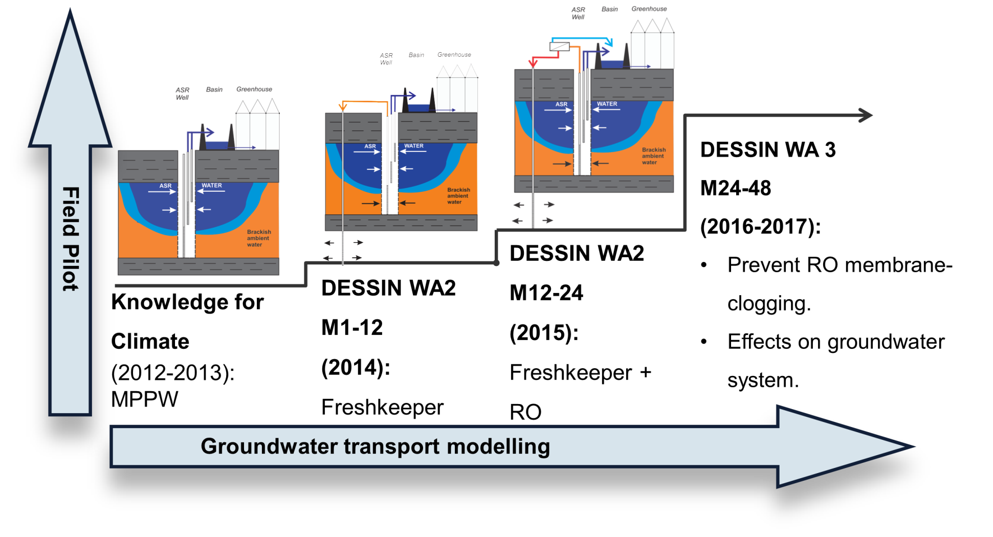
Westland Case

Slide 5
OBJECTIVES WA2
Task | Task description | Approach | Methodology
22.2.1 (Part I) | Quantification of the freshwater recovery increase by an innovative well design | 1. Field testing ASR-cycle 2012/2013: use of MPPW only; 2. Field testing ASR-cycle 2013/2014: addition of the Freshkeeper (no RO); 3. Modelling the performance of a conventional (fully-penetrating) ASR-well instead of a MPPW; 4. Modelling and evaluation of the MPPW-benefits in various hydrogeological settings. | 1. Recording of injected/recovered volumes and EC; 2. Lab analysis on (ground)water samples; 3. SEAWAT groundwater transport modelling; 4. SEAWAT groundwater transport modelling.
22.2.2 (Part II) | Assessment of membrane clogging by varying redox conditions of the feedwater. | Field testing of the Freshkeeper including desalination of saltwater recovered by the Freshkeeper to increase freshwater production | 1. Analysis of the data obtained during ‘BWRO’ cycle in 2013. 2. Use of ‘BWRO’ and ‘ASRO’ 2015 3. Hydrochemical analyses 4. Geochemical analyses on filter residues.
Emscher, June 2015
Today
Potential ‘showstopper’ for ASRO

Slide 6
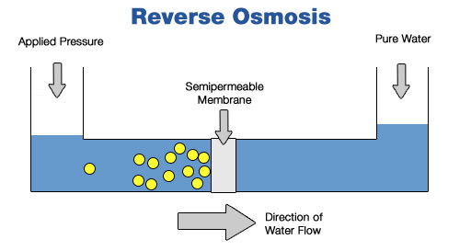
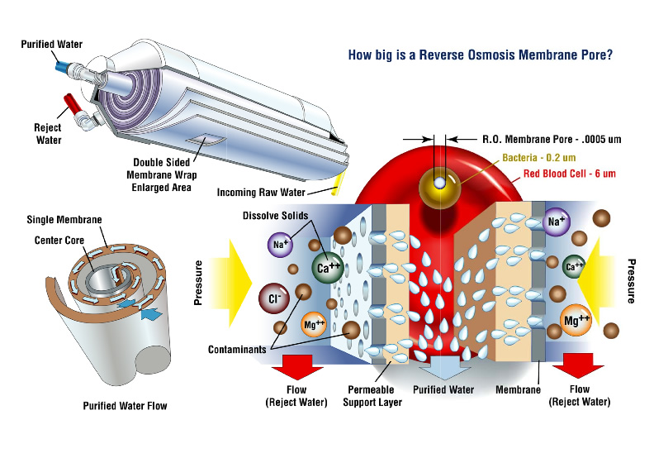
RESULTS WA2 – Part II: Assessment of membrane clogging

Slide 7
RESULTS WA2 – Part II: Assessment of membrane clogging
From abstraction well
(groundwater)
To deep disposal well
(groundwater)
Brackish
feed water
Membrane concentrate
Membrane clogging
Controls membrane clogging!
Freshwater (permeate)
Irrigation

Slide 8
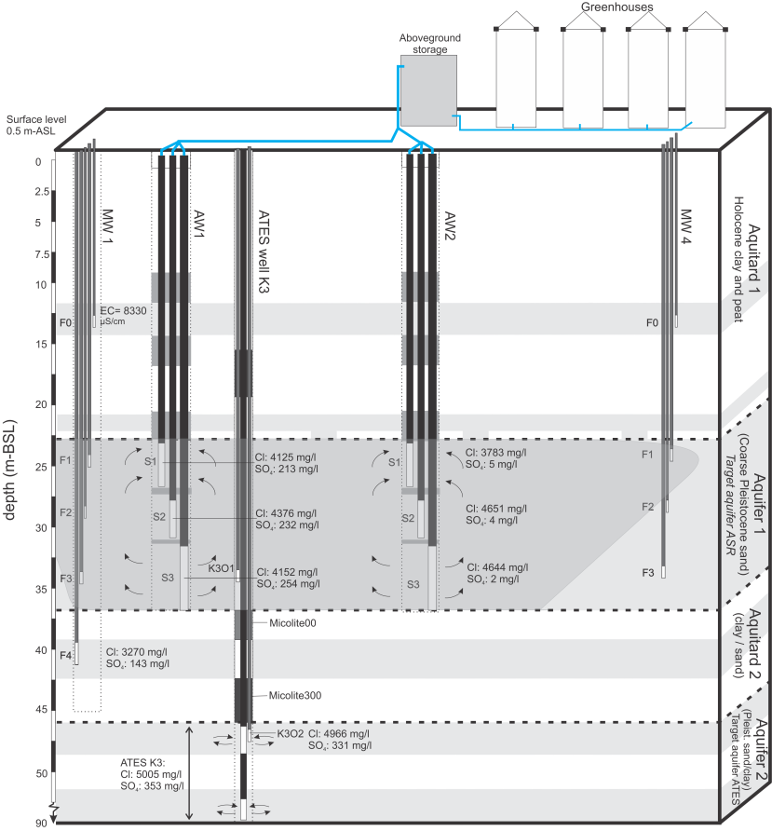
RESULTS WA2 – Part II: Assessment of membrane clogging
To ASRO-plant
‘Dynamic water quality’!
Rainwater (oxic, very fresh)
Mixed water
Ambient groundwater (saline, deeply anoxic)
Brackish
no SO₄
~ 1% clay
Fe, Mn
Target aquifer ASR
Separating clay layer
(having man-made conduits)
Target aquifer concentrate disposal
Brackish-saline
high SO₄
Fe, Mn

Slide 9
RESULTS WA2 – Part II: Assessment of membrane clogging
Normal BWRO:
Constant quality (brackish groundwater, deeply anoxic)
ASRO:
‘Dynamic water quality’!
Rainwater (oxic, very fresh)
Mixed water
Ambient groundwater (brackish groundwater, deeply anoxic)

Slide 10
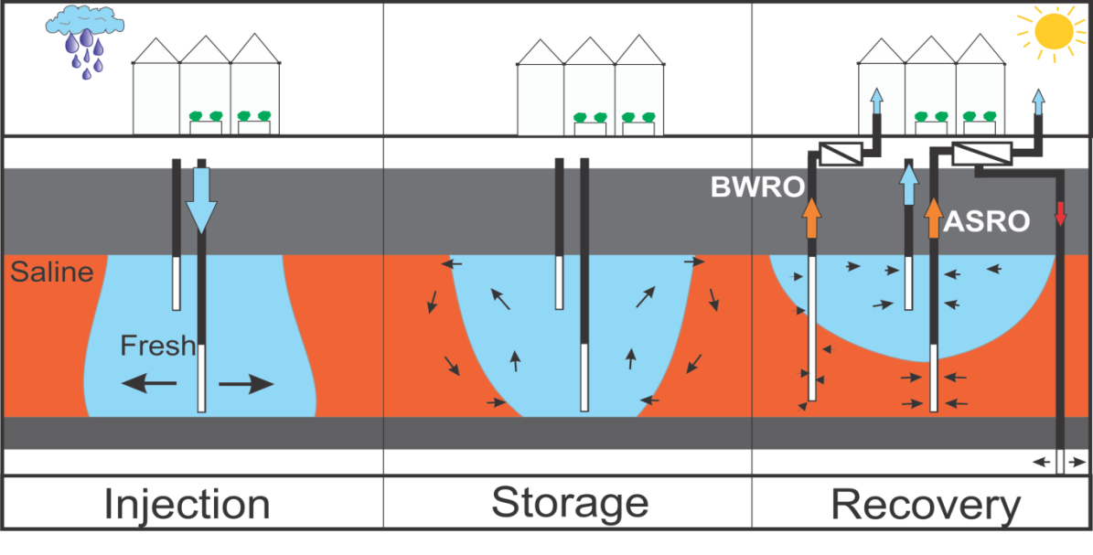
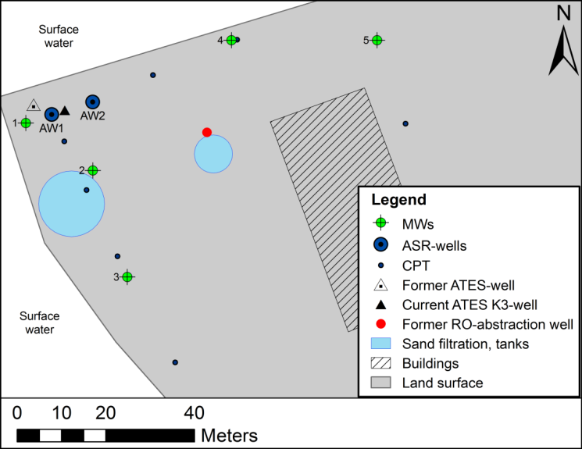
RESULTS WA2 – Part II: Assessment of membrane clogging
‘ASRO’:
New (DESSIN)
Abstracts from dedicated aquifer section
Below injected freshwater
Less chance of distinct water qualities mixing in abstraction well
Similar design
(former) ‘BWRO’:
Desalinated brackish groundwater (2007-2012)
Abstracts from full aquifer thickness
At fringe of injected freshwater body
(since 2013)
Mixing of distinct water qualities in the abstraction well
Similar design

Slide 11
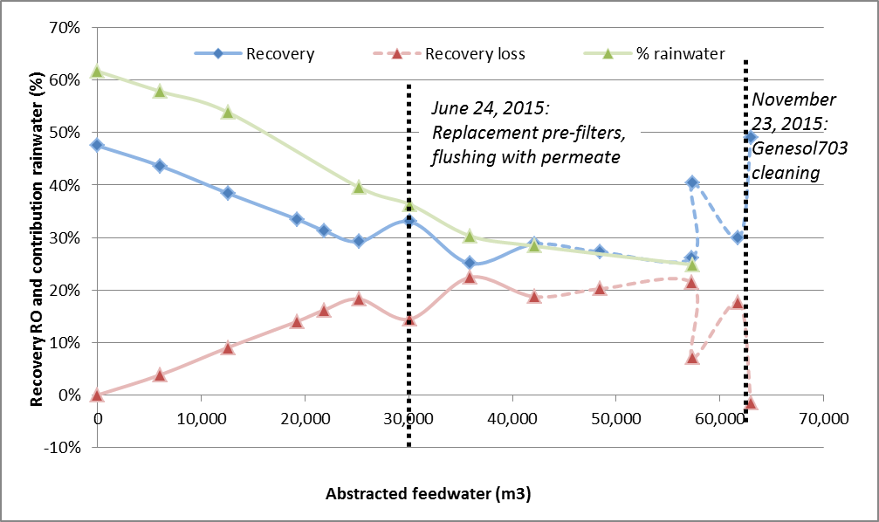
RESULTS WA2 – Part II: Assessment of membrane clogging
BWRO-plant
Severe clogging since introduction of rainwater! (60-30% admixed)
Recovery 48 → 25% in two months (linear decrase)
Unacceptable loss of freshwater production
Chemical treatment successfully restores recovery
All data suggests cake layer formation (particle clogging)
Not the way to go…

Slide 12
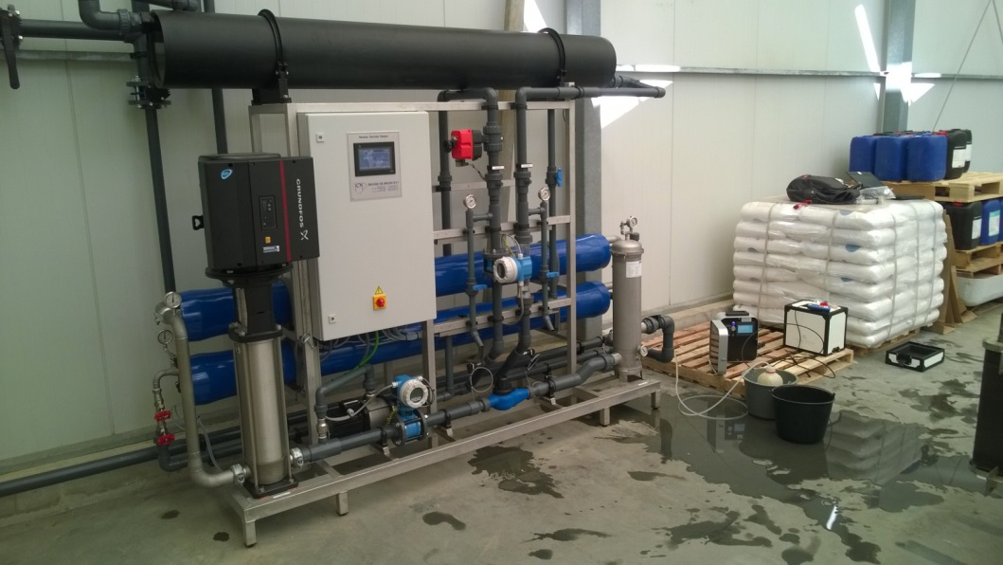
RESULTS WA2 – Part II: Assessment of membrane clogging
2015
Dedicated ASRO on water from the Freshkeeper
Completed May 2015

Slide 13
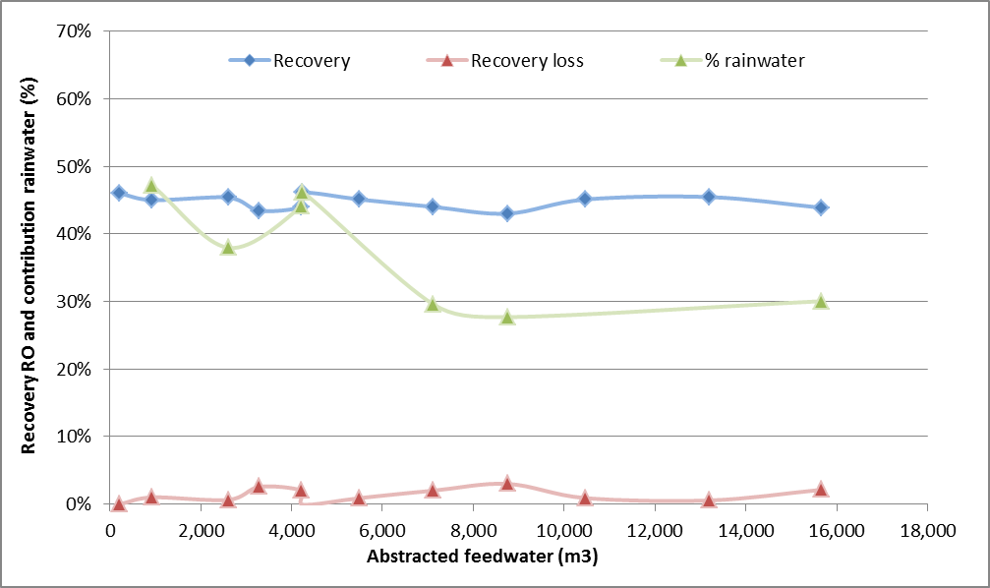
RESULTS WA2 – Part II: Assessment of membrane clogging
ASRO-plant
No clogging in 3 months despite admixing rainwater! (47-28% admixed)
Better way to go…

Slide 14
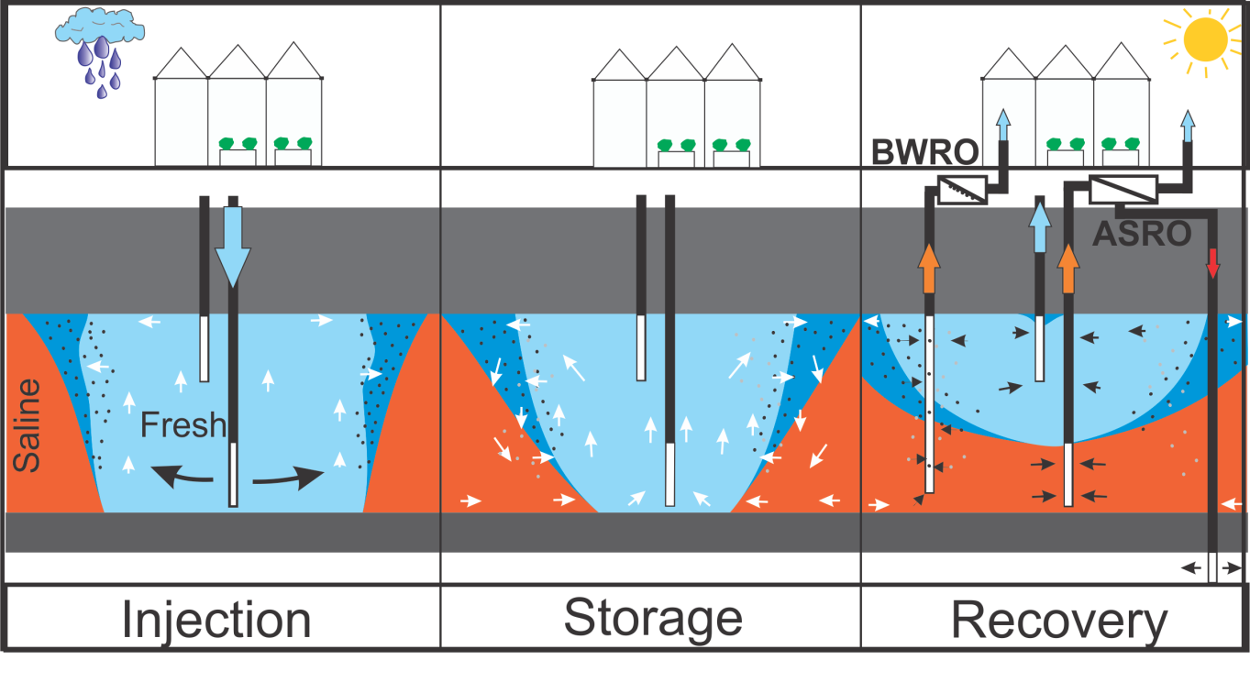
RESULTS WA2 – Part II: Assessment of membrane clogging
Difference between ASRO and BWRO
Clay (Al-silicates) mobilized during freshening (winter injection)
Fe-colloids by oxidaton of adsorbed Fe(II) by oxygen in injected rainwater
All particles move to fring of freshwater body ánd the top of the aquifer
Particles in the zone of BWRO abstraction…

Slide 15
RESULTS WA2 – Part II: Assessment of membrane clogging
Conclusions, recommendations
Membrane clogging can be an ASRO showstopper
Freshening (clay mobilisation) and redox reactions (Fe-colloids) control particle formation
Controlling factor for particles in the feed water: where is the feed water being abstracted?
Mitigation?
Filtrate the RO feed water (expensive: 0.11 to 0.44 euro/m³)
Prevent formation of suspended particles by CaCl₂ dosage to injection water (requires further study in 2016)
Regular flushing during RO-operation for early removal of cake layer (low-cost, requires testing; Spring/Summer 2016)
Only abstract at the deep wells of the ASRO system to abstract a better water quality (long-term, requires modification of BWRO system)

Slide 16
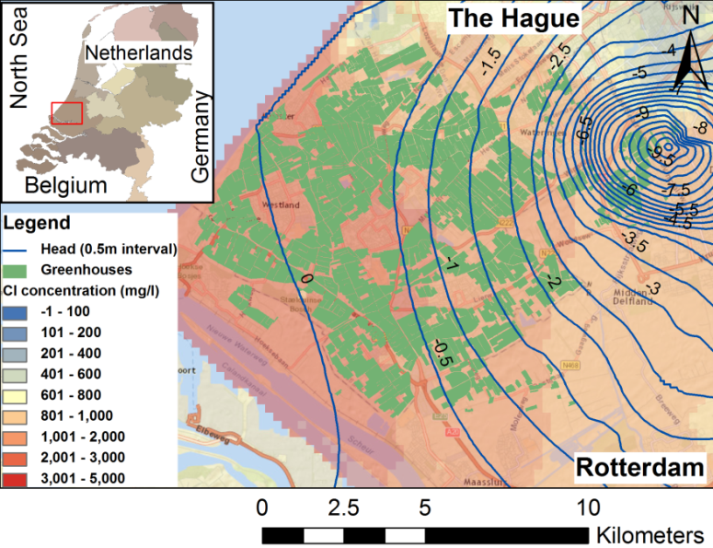
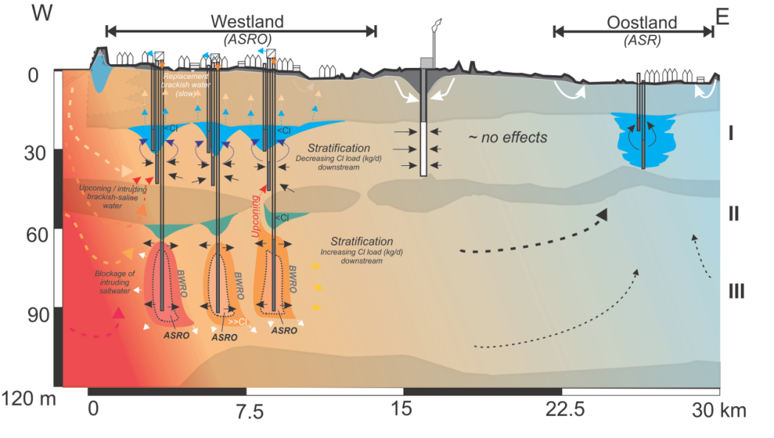
RESULTS WA2 – Part II: Assessment of membrane clogging
Any Questions?
Next time: WA3 (T33) ‘Impacts of ASRO on a groundwater system’

