Slide 1
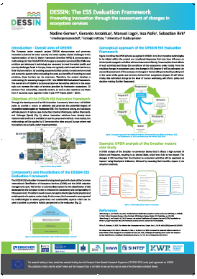
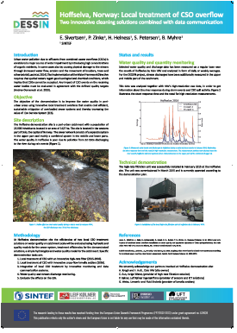
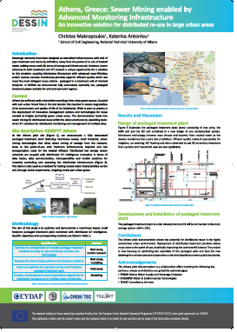
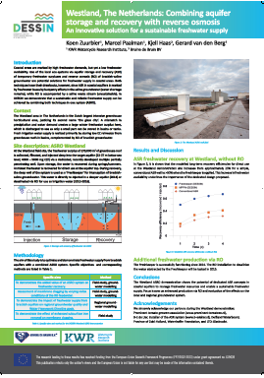
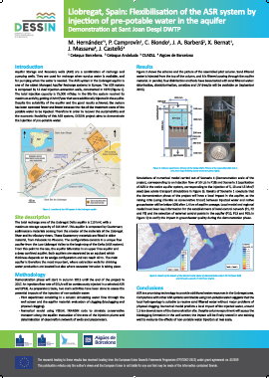
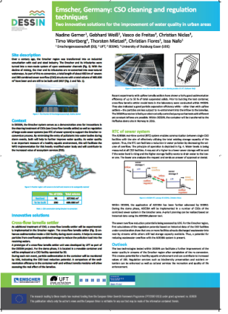
DESSIN Showcase development
Showcases will be established for each of the (5) DESSIN demo sites
Goals:
To create a meeting place, and thus a platform for DESSIN solutions
To realise a lasting exploitation of showcases and innovative technologies
Setup at the Westland case (as example for the other sites):
A guided tour along the different objects of the facilities at the pilot site
A mobile banner exposition of the different technologies applied at the site
Potential for extension of the showcase with additional components
Components:
Official opening
Promotional material (videos, banners, posters, publications, attractive illustrations, etc.)
Coupling showcase with other (regional, national, international)
initiatives
Opportunities to demonstrate related innovations
A scale model of the pilot and/or technologies applied
Walking route with information boards
Information supply through relevant website(s)
Invitation of delegates, visitors

Slide 2
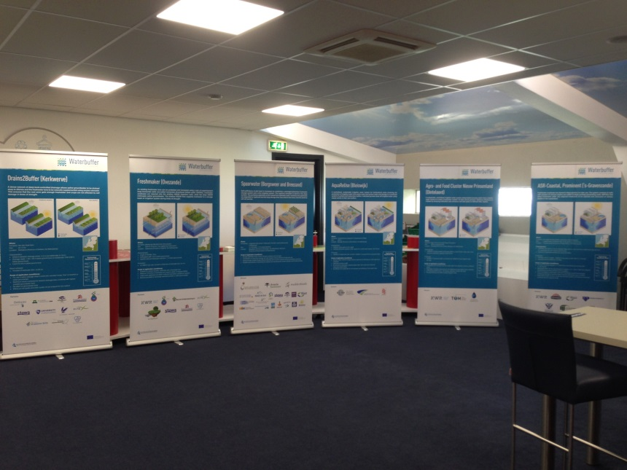
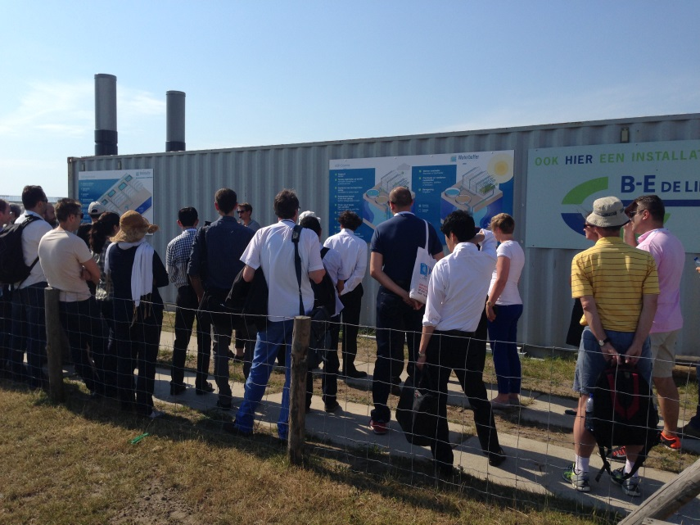
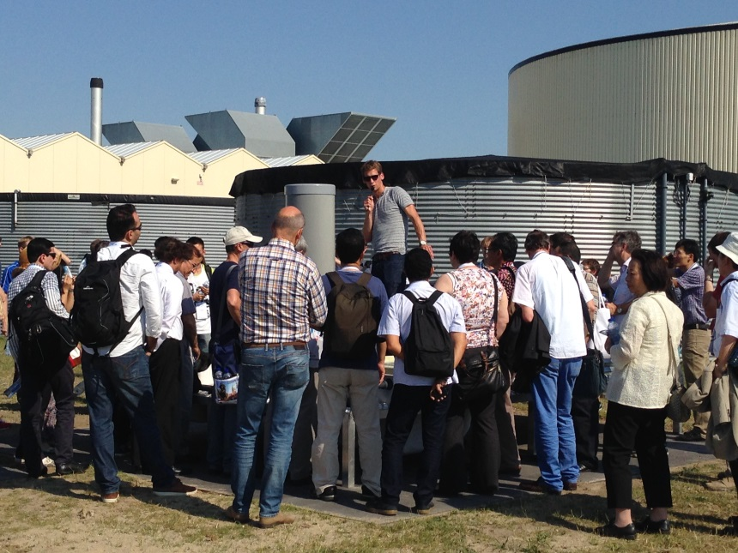
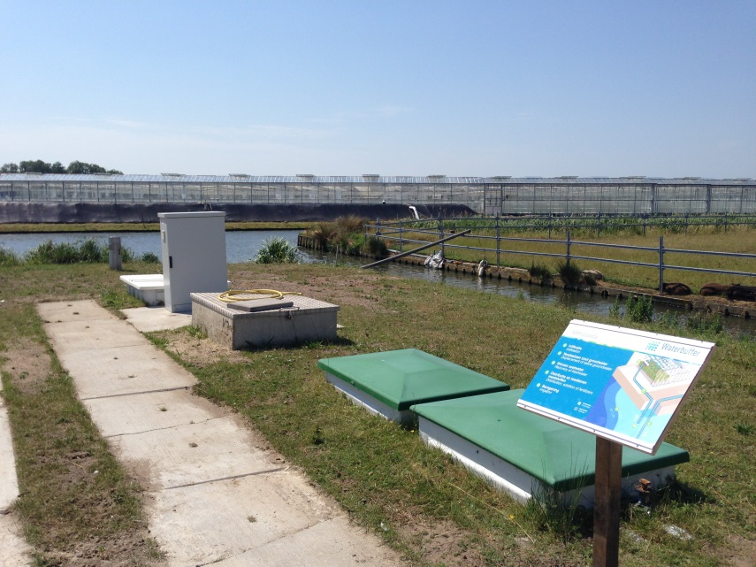
Showcases: Guiding visitors, information boards

Slide 3
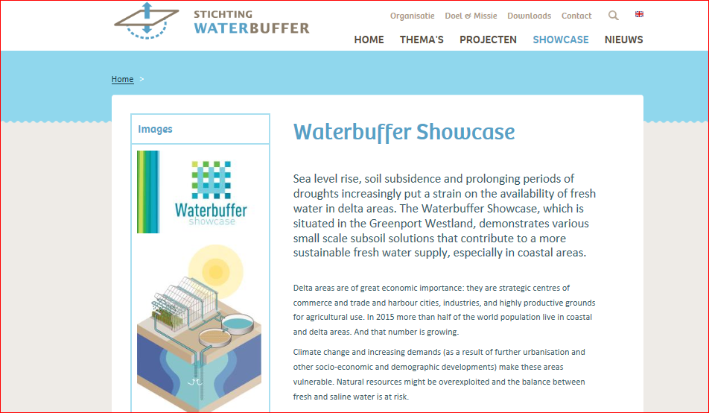
Showcases: link up with other initiatives

Slide 4
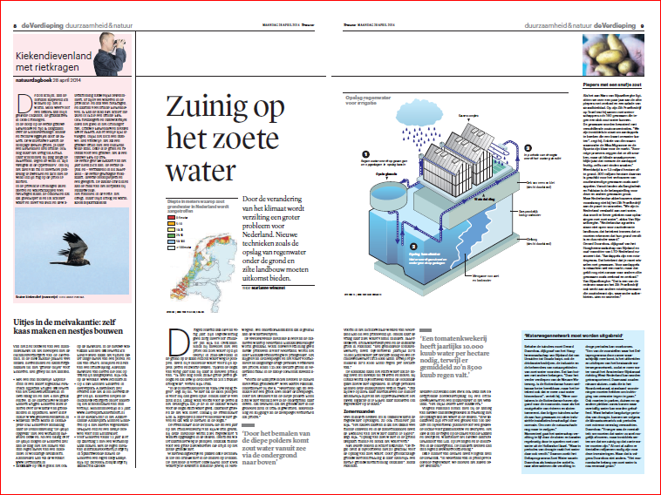
Showcases: show the broader perspective in the media

