Slide 1
The DESSIN ESS Evaluation Framework
Anzaldúa, G. (EI), Gerner, N. (EG), Hinzmann, M. (EI), Beyer, S. (EI), Lago, M. (EI), Birk, S. (UDE), Winking, C. (UDE), Riegels, N. (DHI), Krogsgaard, J. (DHI), Termes, M. (CETaqua), Amorós, J. (CETaqua), Wencki, K. (IWW), Strehl, C. (IWW), Ugarelli, R. (SINTEF), Hasenheit, M. (EI), Abhold, K. (EI), Nafo, I. (EG), Hernandez, M. (CETaqua), Vilanova, E. (Amphos21), Damman, S. (SINTEF), Brouwer, S., (KWR), Rouillard, J. (EI).
Gerardo Anzaldúa (Ecologic Institute) & Nadine Gerner (Emscher Genossenschaft)

Slide 2
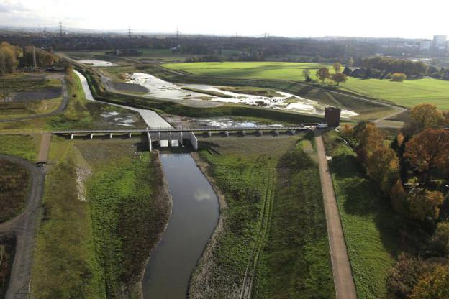
Agenda
DESSIN Project Overview
Introduction to the framework
Practical steps for the application of the framework
First Q&A (on the conceptual setup)
Overview of practical applications
Application of the framework on the Emscher River case study
Second Q&A (on practical application issues)

Slide 3
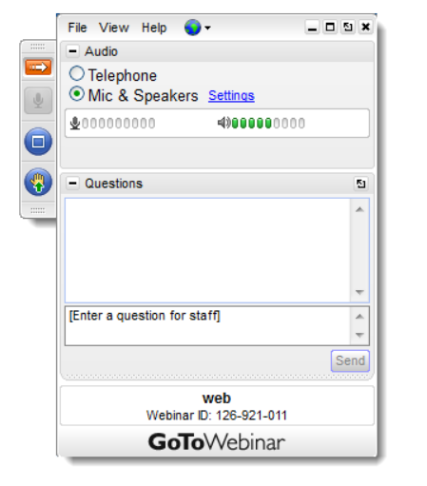
Housekeeping rules
Check your audio settings
to make sure your microphone
and speakers are ready
Please mute your microphone
when not speaking
Enter your questions
at any time during the presentation
(these will be sorted and
addressed during the Q&A)

Slide 4
Agenda (progress)
DESSIN Project Overview
Introduction to the framework
Practical steps for the application of the framework
First Q&A (on the conceptual setup)
Overview of practical applications
Application of the framework on the Emscher River case study
Second Q&A (on practical application issues)

Slide 5
DESSIN: Project Overview
Demonstrate Ecosystem Services Enabling Innovation in the Water Sector
Funded through the 7th Framework Programme of the EU
Time frame: Jan. 2014 – Dec. 2017
Project lead: IWW Rheinisch-Westfälisches Institut für Wasserforschung
20 partners from 7 EU countries
Structured into 5 Work Areas

Slide 6
Introduction of Work Area 1
Objective: to develop “a new framework to facilitate decision-making that holds the ESS concept at the forefront.”
Based on three main aims:
Potentiating the state-of-the-art in ESS research and adopting a vision of application
Providing concrete guidance for business, practitioners and policy makers in enabling change to happen
Testing and fine-tuning the “new framework” in several case studies

Slide 7
Agenda (progress)
DESSIN Project Overview
Introduction to the framework
Practical steps for the application of the framework
First Q&A (on the conceptual setup)
Overview of practical applications
Application of the framework on the Emscher River case study
Second Q&A (on practical application issues)

Slide 8
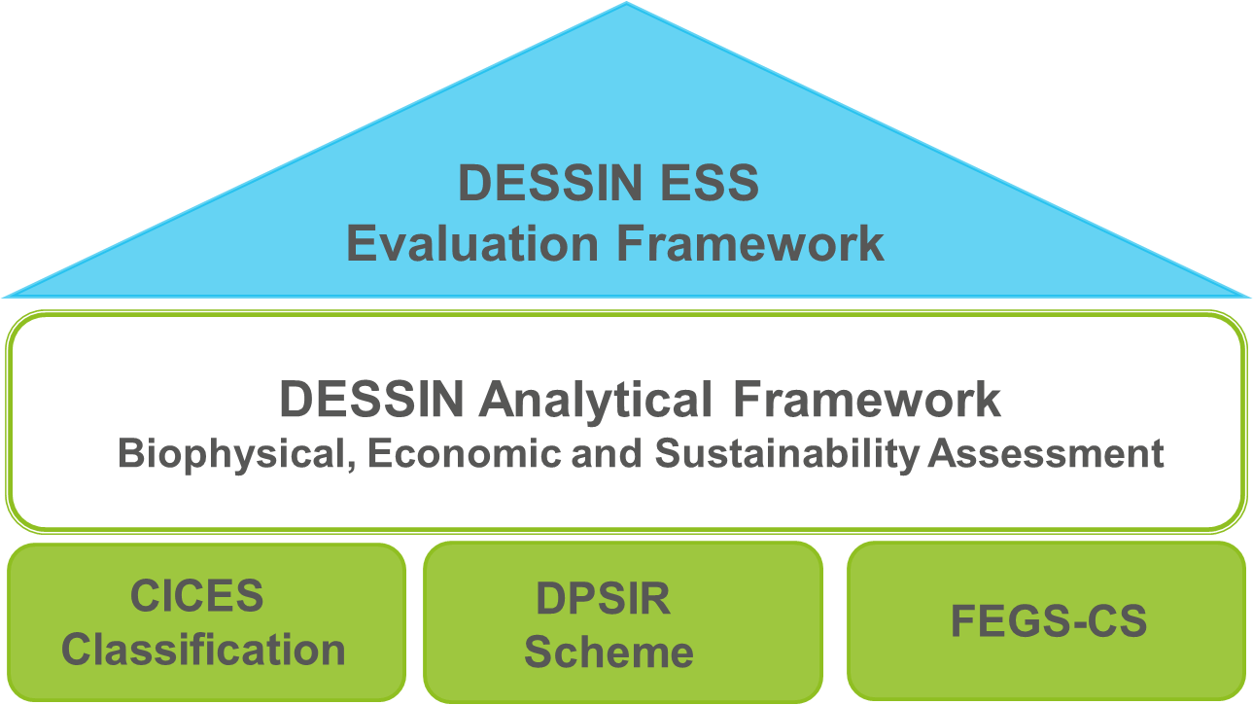
Components and foundations of the DESSIN ESS Evaluation Framework

Slide 9
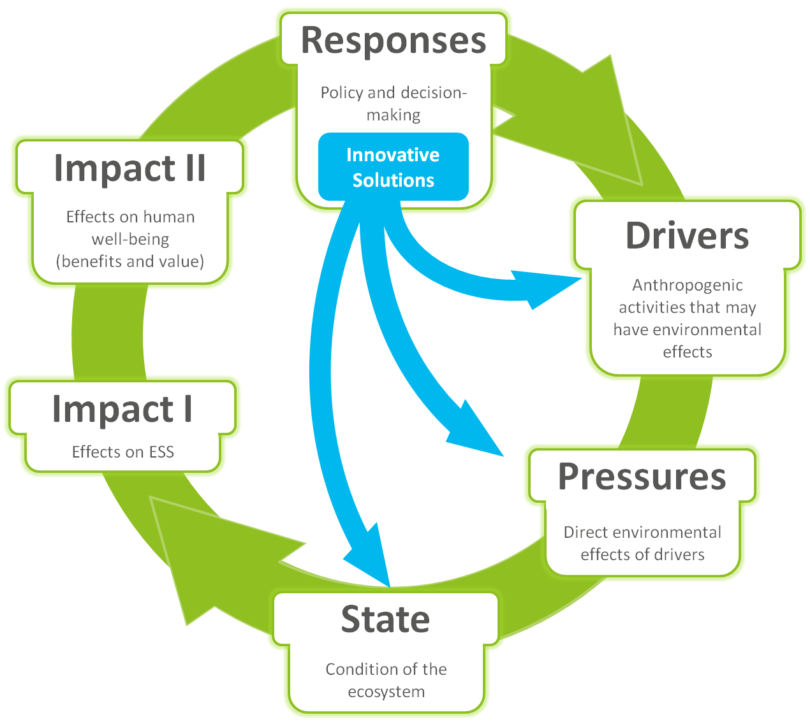
Conceptual approach of the DESSIN ESS Evaluation Framework
(based on Müller and Burkhard, 2012, Van Oudenhoven et al., 2012 and Haines-Young and Potschin, 2010; 2013).

Slide 10
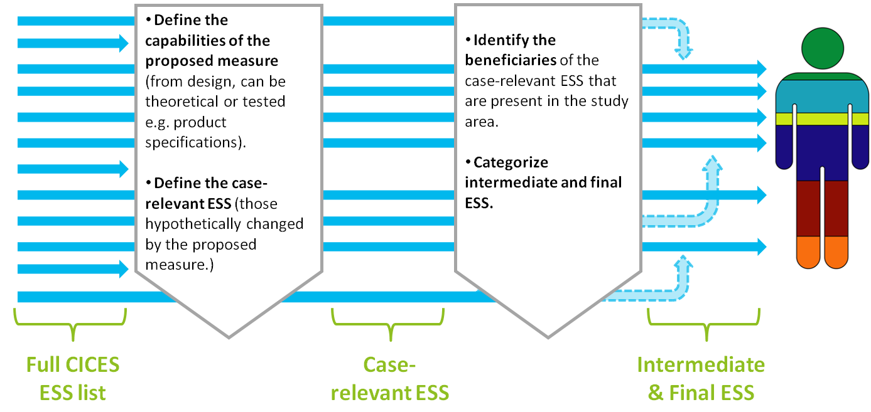
Linking the capabilities of responses to final ESS through the identified beneficiaries…

Slide 11
Agenda (progress)
DESSIN Project Overview
Introduction to the framework
Practical steps for the application of the framework
First Q&A (on the conceptual setup)
Overview of practical applications
Application of the framework on the Emscher River case study
Second Q&A (on practical application issues)

Slide 12
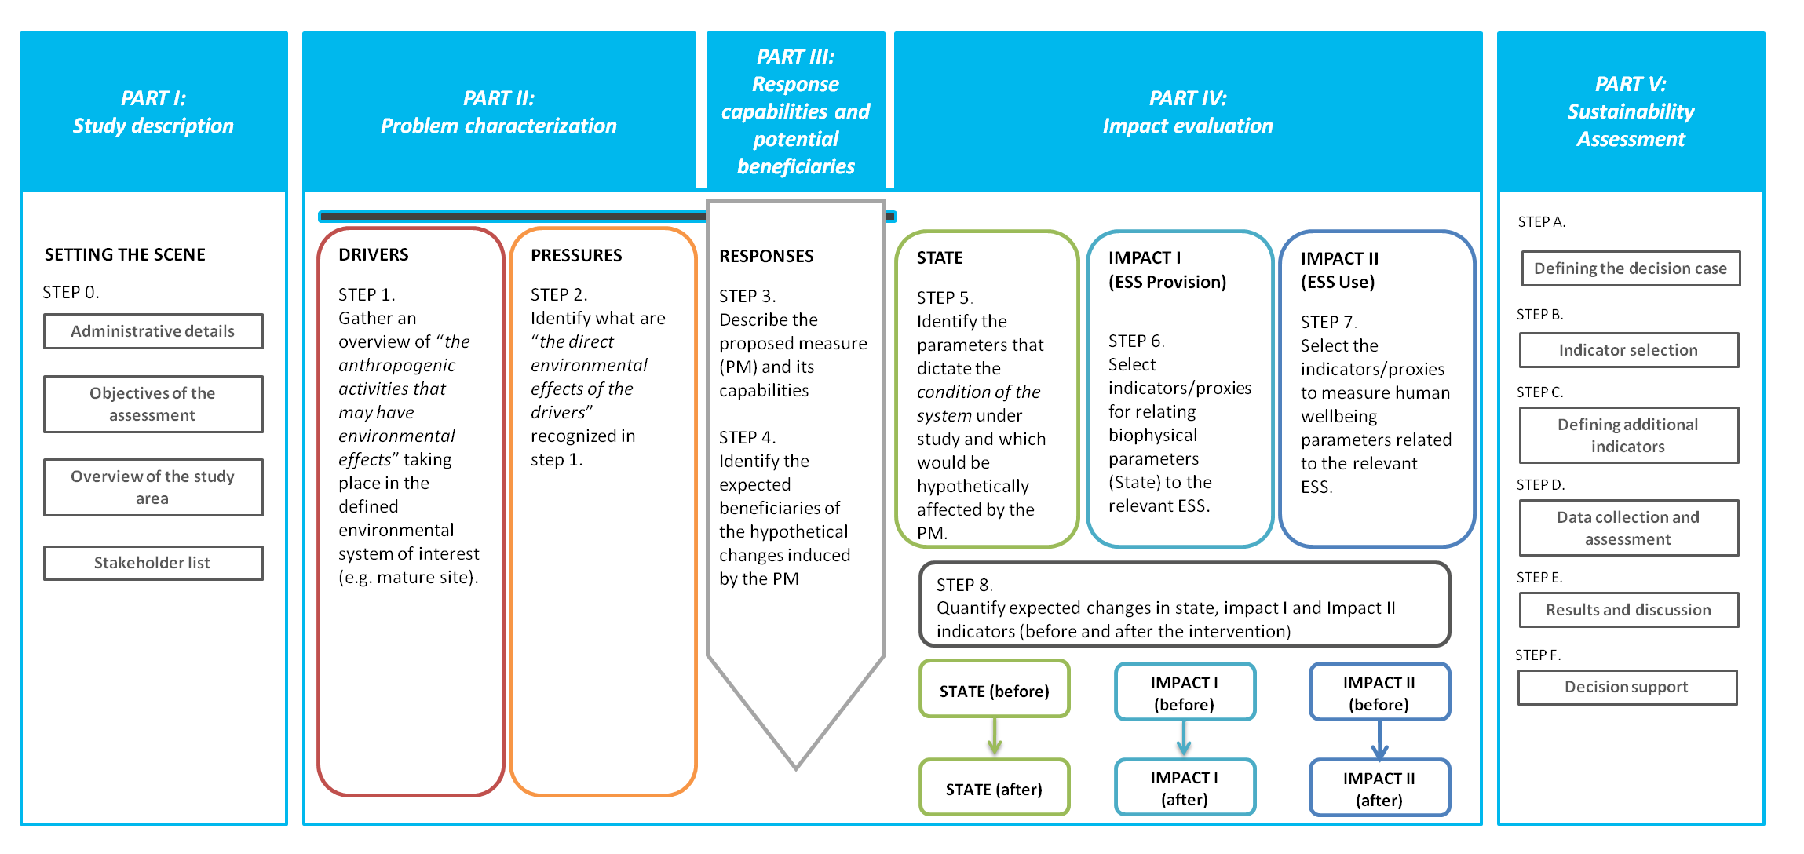
Practical steps for the application of the DESSIN ESS Evaluation Framework – Overview

Slide 13
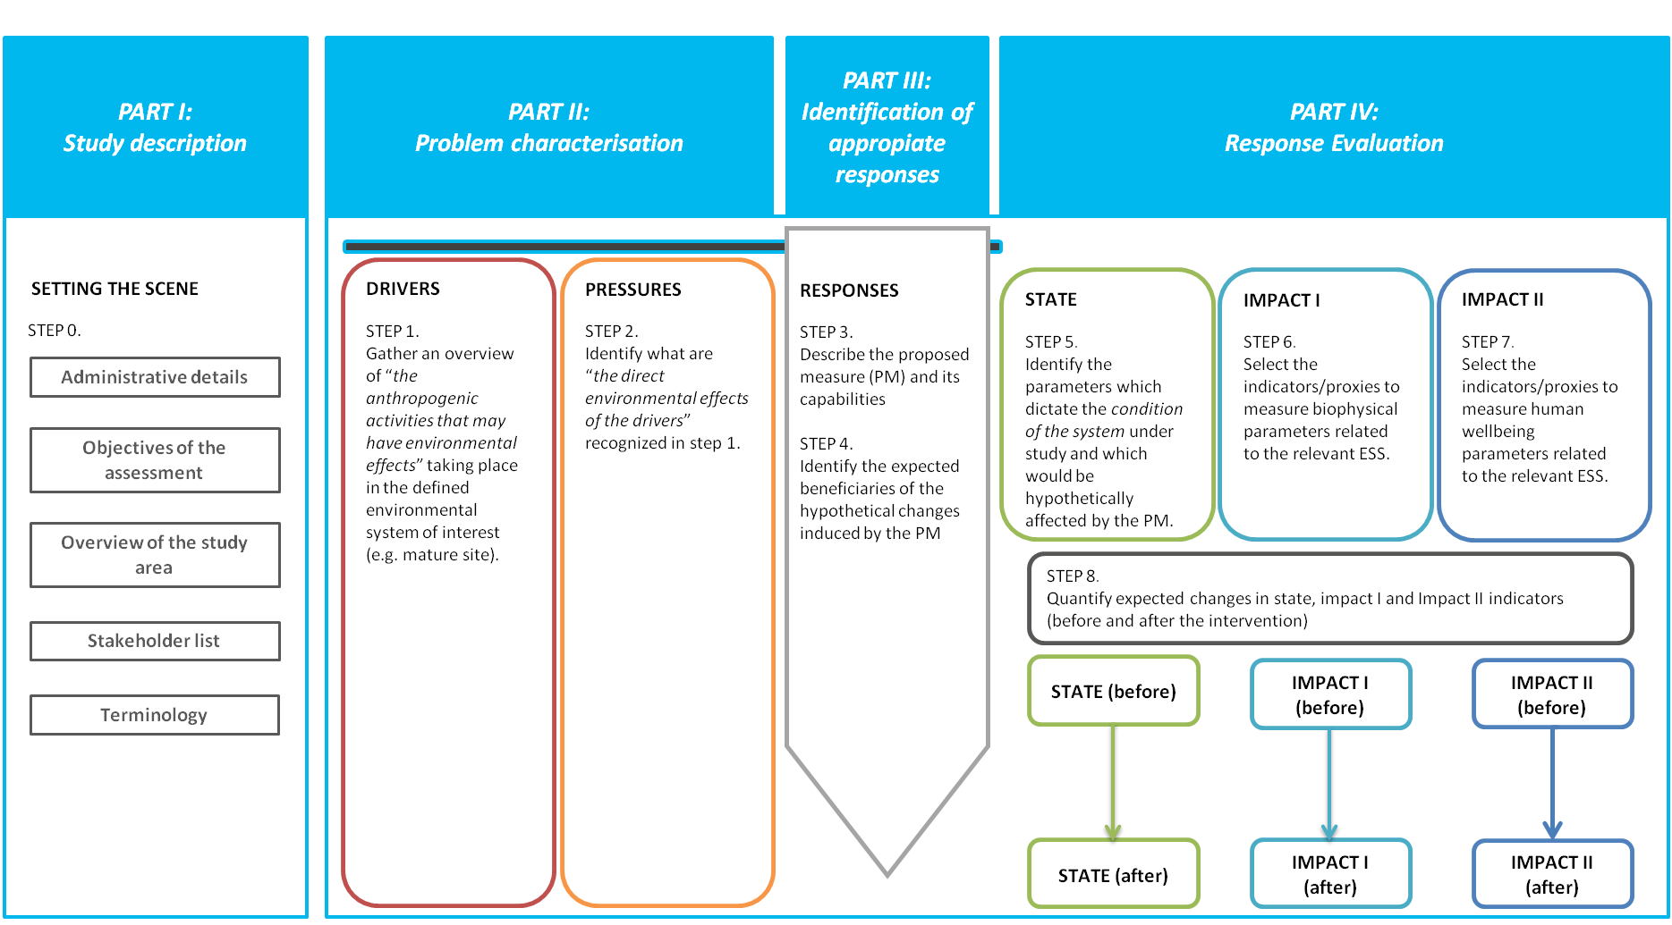
Practical steps for the application of the DESSIN ESS Evaluation Framework – Part I
PART I:
Study description
SETTING THE SCENE
STEP 0.
Administrative details
Objectives of the assessment
Overview of the study area
Stakeholder list

Slide 14
Practical steps for the application of the DESSIN ESS Evaluation Framework – Part II
PART II:
Problem characterisation
DRIVERS
STEP 1. Gather an overview of “the anthropogenic activities that may have environmental effects” taking place in the defined environmental system of interest (e.g. mature site).
PRESSURES
STEP 2. Identify what are “the direct environmental effects of the drivers” recognized in step 1.

Slide 15
Practical steps for the application of the DESSIN ESS Evaluation Framework – Part III
PART III:
Response capabilities and potential beneficiaries
RESPONSES & BENEFICIARIES
STEP 3. Describe the proposed measure (PM) and its capabilities
STEP 4.
Identify the expected beneficiaries of the hypothetical changes induced by the PM

Slide 16
Practical steps for the application of the DESSIN ESS Evaluation Framework – Part IV
PART IV:
Impact evaluation
STATE
STEP 5. Identify the parameters which dictate the condition of the system under study and which would be hypothetically affected by the PM.
IMPACT I (ESS Provision)
STEP 6. Select indicators/proxies for relating biophysical parameters (State) to the relevant ESS.
IMPACT II (ESS Use and resulting benefits)
STEP 7. Select the indicators/proxies to measure human wellbeing parameters related to the relevant ESS.
STEP 8. Quantify expected changes in state, impact I and Impact II indicators (before and after the intervention)
STATE (before)
IMPACT I (before)
IMPACT I (before)
STATE (after)
IMPACT I (after)
IMPACT I (after)

Slide 17
Practical steps for the application of the DESSIN ESS Evaluation Framework – Part V
PART V:
Sustainability Assessment
Defining the decision case
Indicator selection
Defining additional indicators
Data collection and assessment
Results and discussion
Decision support

Slide 18
Agenda (progress)
DESSIN Project Overview
Introduction to the framework
Practical steps for the application of the framework
First Q&A (on the conceptual setup)
Overview of practical applications
Application of the framework on the Emscher River case study
Second Q&A (on practical application issues)

Slide 19
First Q&A: Conceptual setup of the framework
Further questions welcome!
Please ask your questions by:
Raising your hand
Entering your question
in the text box

Slide 20
Agenda (progress)
DESSIN Project Overview
Introduction to the framework
Practical steps for the application of the framework
First Q&A (on the conceptual setup)
Overview of practical applications
Application of the framework on the Emscher River case study
Second Q&A (on practical application issues)

Slide 21
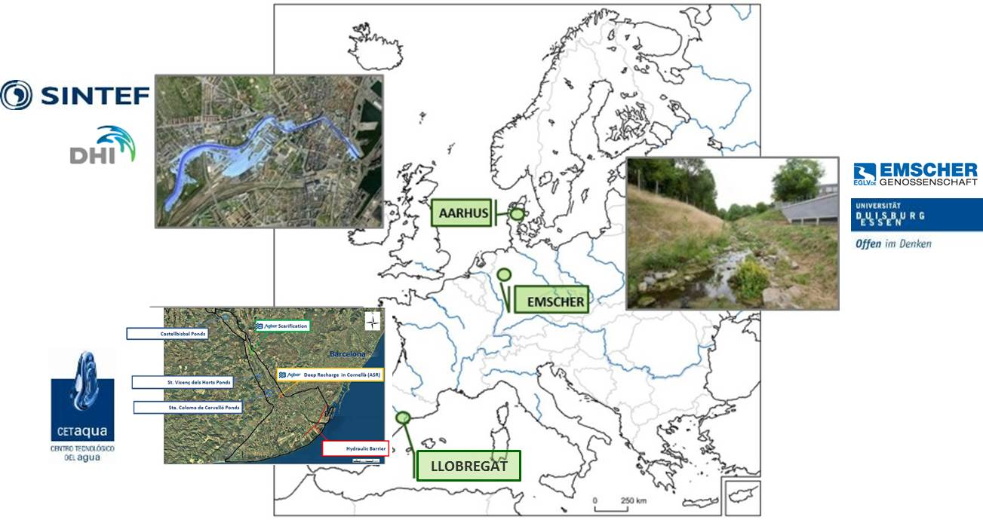
Applying the DESSIN ESS Framework in case studies

Slide 22
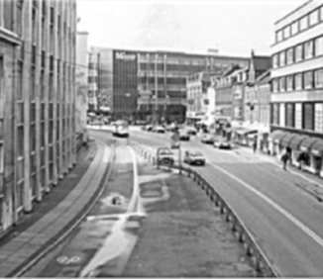
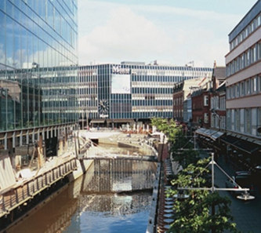
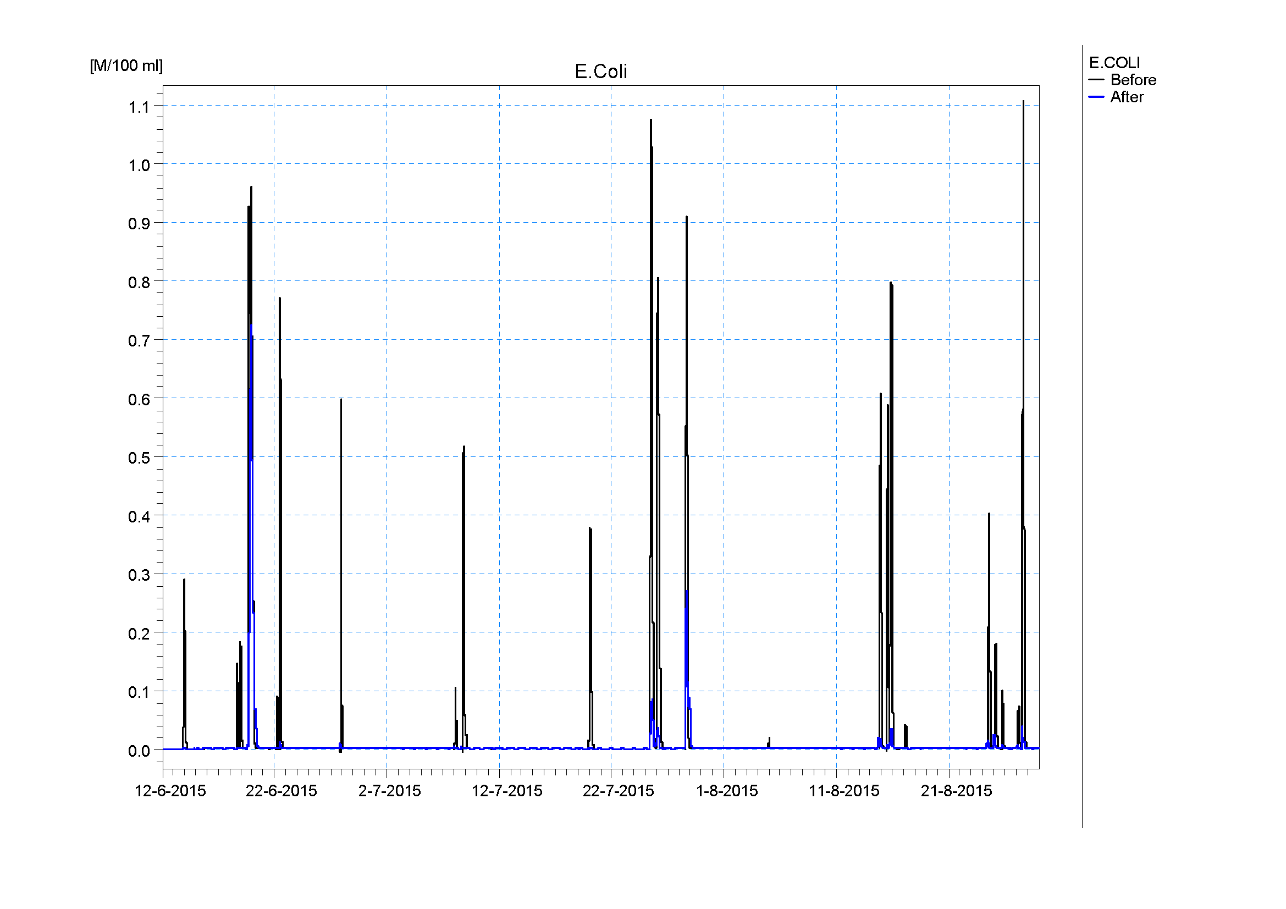
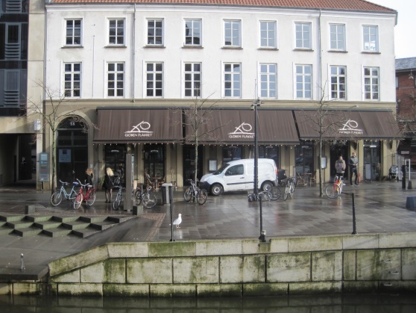
Case study 1: Aarhus (Denmark)
RESPONSE IMPACT I + II
River restoration & RTC of combined sewer overflows
Degradation
of pollution
by microorganisms
Experiential use/ Recreation
Notes:
Monetization: house prices, taking into account distances to riverfront, etc.

Slide 23
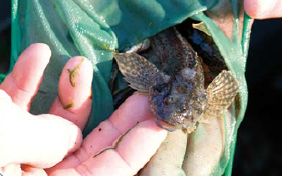
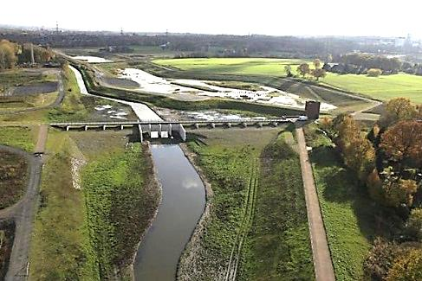
Case study 2: Emscher (Germany)
RESPONSE IMPACT I + II
River restoration
Biodiversity/
Habitats
Self-purification/
Nutrient retention
Flood protection
Recreation
Notes:
Monetization: Avoided flooding costs, Increase in housing prices, WTP for Good River Quality, Expenses for biking and boating

Slide 24
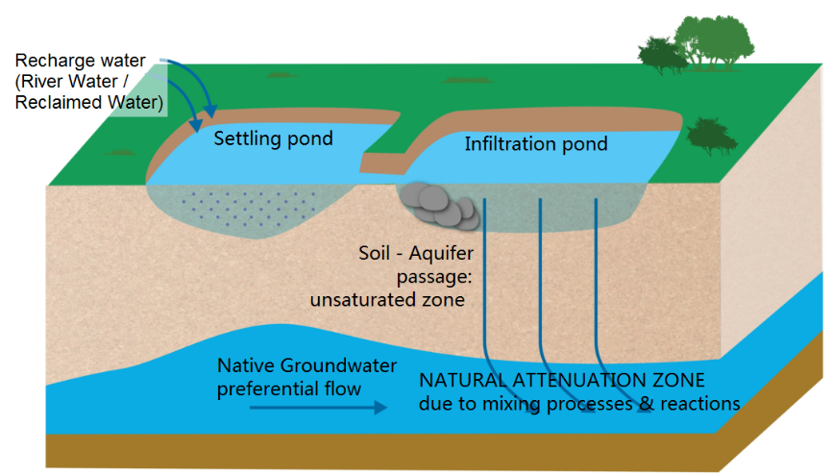
Case study 3: Llobregat (Spain)
RESPONSE IMPACT I + II
Enhancing water infiltration
Increasing groundwater resources
Improving groundwater quality
Infiltration ponds
BENEFICIARIES
Industries using groundwater
Drinking water operators
Notes:
Monetization: Decreased pumping and filtration costs for groundwater usage

Slide 25
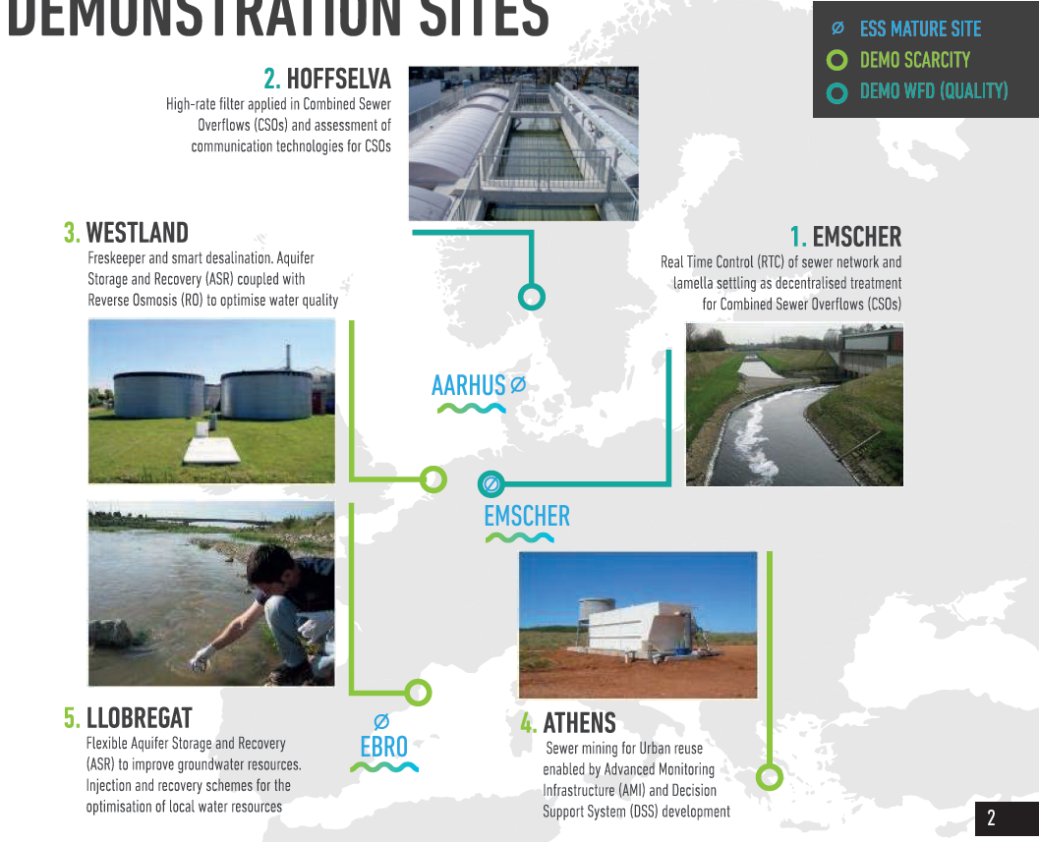
Applying the DESSIN ESS Framework in case studies
Filtration & treatment
in combined sewer overflows
Aquifer storage and recovery
RTC of sewer network
& treatment in combined sewer overflows
Aquifer storage and recovery
LLOBREGAT
Sewer mining &
water reuse

Slide 26
Agenda (progress)
DESSIN Project Overview
Introduction to the framework
Practical steps for the application of the framework
First Q&A (on the conceptual setup)
Overview of practical applications
Application of the framework on the Emscher River case study
Second Q&A (on practical application issues)

Slide 27
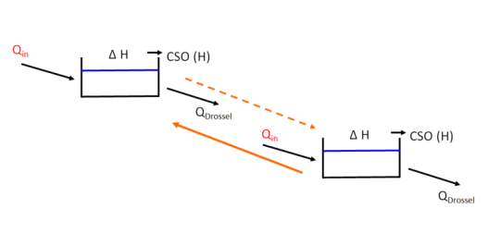
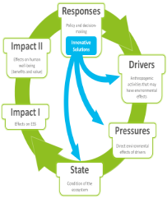
Example: RTC of sewer network (Emscher)
RESPONSE
DRIVERS
PRESSURES
not affected
Point source:
- Urban wastewater ↓
- Storm overflows ↓
IMPACT II – USE & BENEFIT
IMPACT I - PROVISION
STATE
FESS Cultural ESS:
- Offer ↑
(regarding WTP for recreation, GEP)
- Use ↑
Physicochemical:
- Transparency ↑
- Nutrient conditions ↓
- hazardous substances ↓
Hydromorphology/ Hydrology:
- Water flow quantity/dynamics ↓
- Water residence time ↑
Intermediate ESS:
Self-purification ↑
Biodiversity ↑
Final ESS:
Cultural services ↑
SUSTAINABILITY ASSESSMENT
- lifetime
- energy consumption
- investment & maintenance costs
Notes:
STATE:
Hydromorphology – Hydrology
Quantity + dynamics of water flow
Water residence time
Hydromorphology – Morphology
Depth and width variation
Structure and substrate of the water body bed
Structure of the water body shoreline
Physiochemical - General
Transparency
(Thermal conditions)
Oxygenation conditions
(Salinity)
Nutrient conditions
(Acidification status)
Physiochemical - Priority hazardous substances
Pollution by all priority substances identified as being discharged into the body of water
Physiochemical – Other pollutants
Pollution by other substances identified as being discharged in significant quantities into the body of water
Biological
Macrophytes + Phytobenthos
Benthic invertebrates
IMPACT2:
Avoided costs
(WWTP)
Ecosystem stability
*qualitative
Avoided renaturation costs
Real estates
Symbolic
Welfare
Aesthetic
Fisheries
Local recreation
*several qualitative

Slide 28
Agenda (progress)
DESSIN Project Overview
Introduction to the framework
Practical steps for the application of the framework
First Q&A (on the conceptual setup)
Overview of practical applications
Application of the framework on the Emscher River case study
Second Q&A (on practical application issues)

Slide 29
First Q&A: Conceptual setup of the framework
Further questions welcome!
Please ask your questions by:
Raising your hand
Entering your question
in the text box

Slide 30
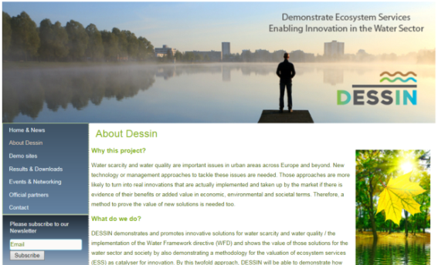
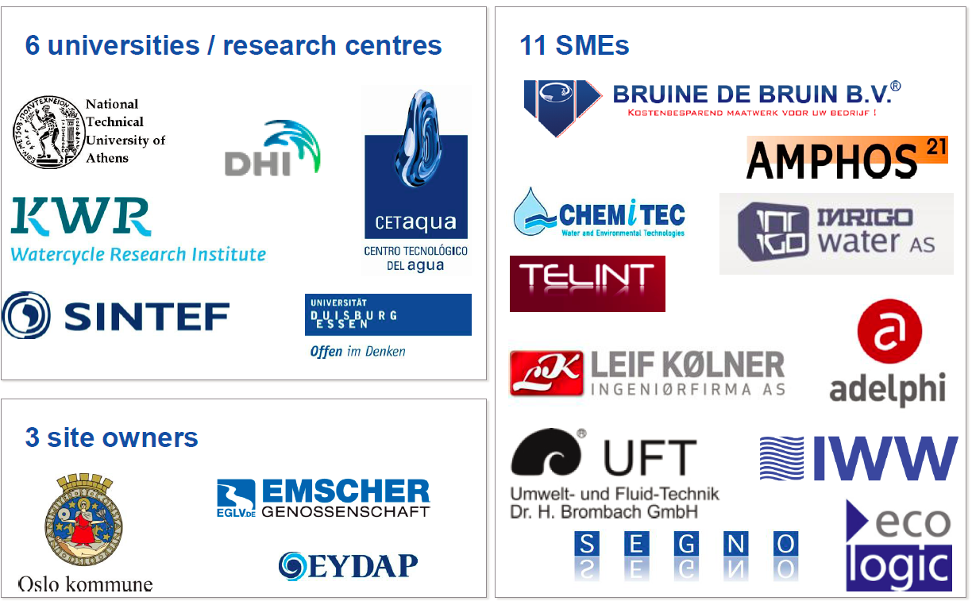
Website:
www.dessin-project.eu
Project consortium:
Newsletter & Annual report:

Slide 31
Many thanks for your attention!
Further questions? Please send them via email to: gerardo[dot]anzaldua[at]ecologic[dot]eu
gerner[dot]nadine[at]eglv[dot]de

