Slide 1
Llobregat Demo Site
Showcase actions
F. Gómez, L. Ventura, M. Hernández
Cetaqua

Slide 2
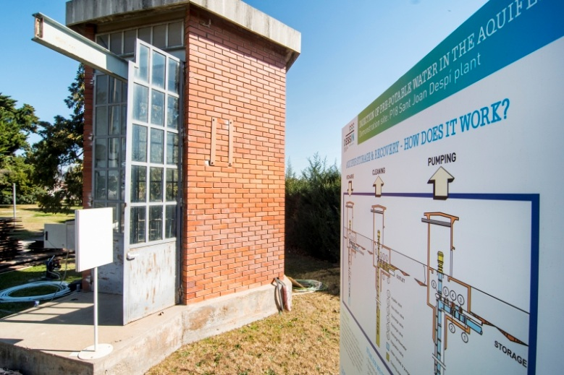
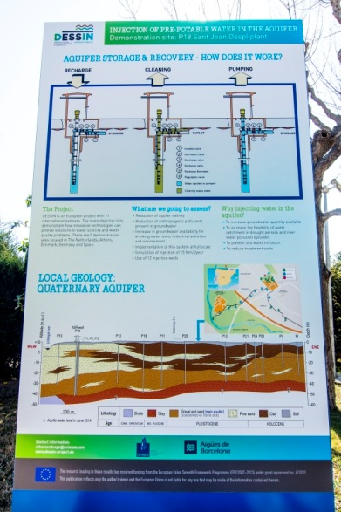
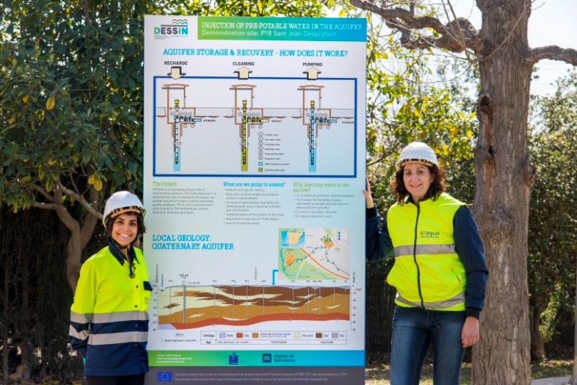
Notice Board
NOTICE BOARD located at the DESSIN well at Sant Joan Despí DWTP since December 2015

Slide 3
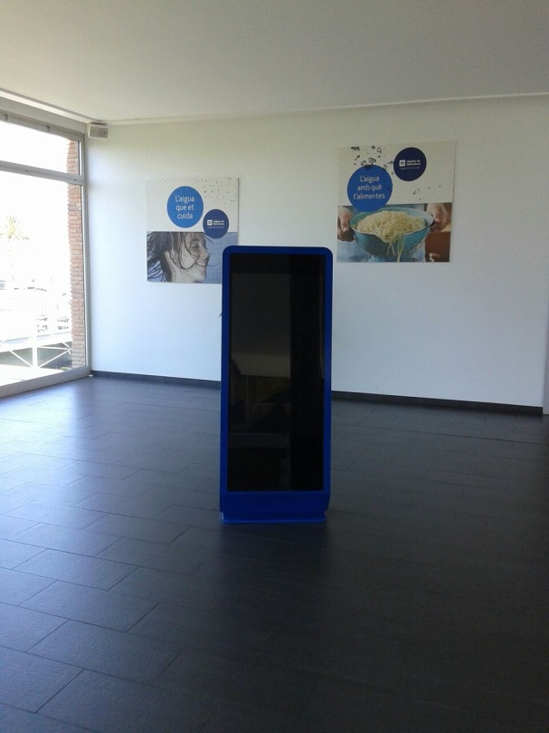
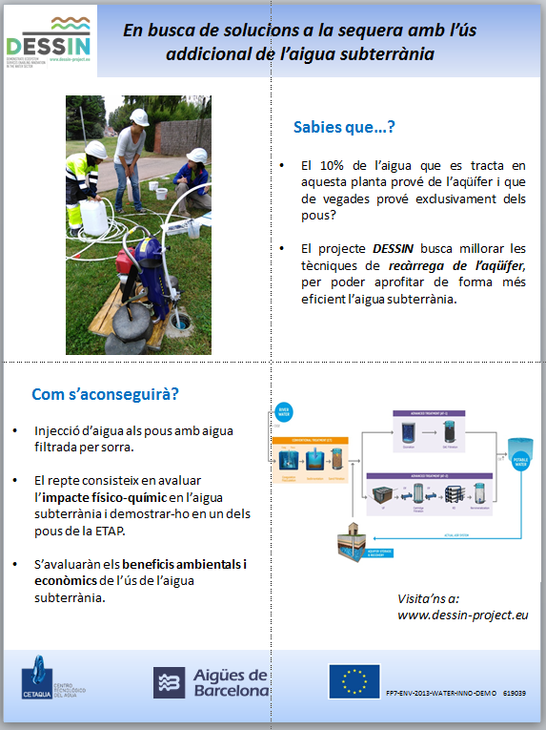
Digital Totem
A DIGITAL TOTEM was installed at the hall of the DWTP
Several projects and pilots, including DESSIN, will be shown daily (beginning April 2016)

Slide 4
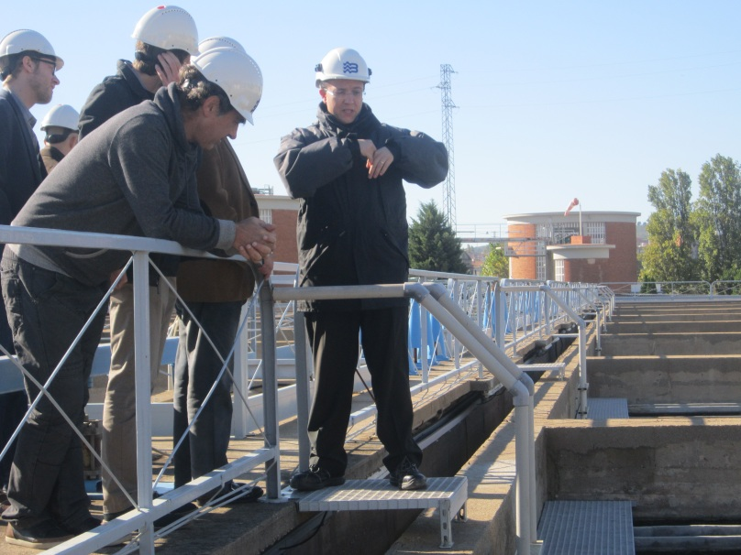
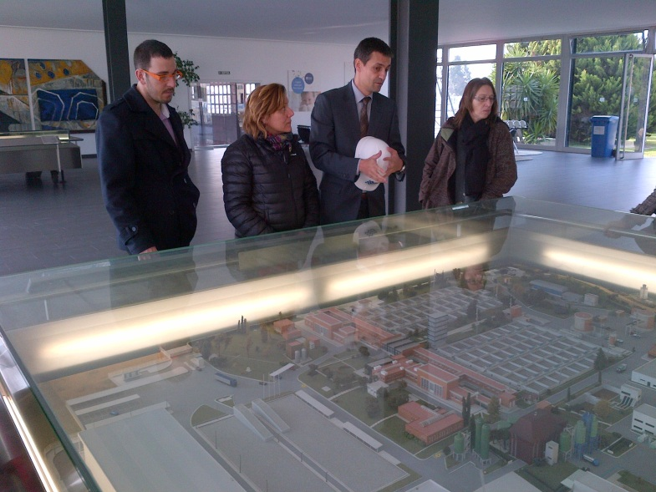
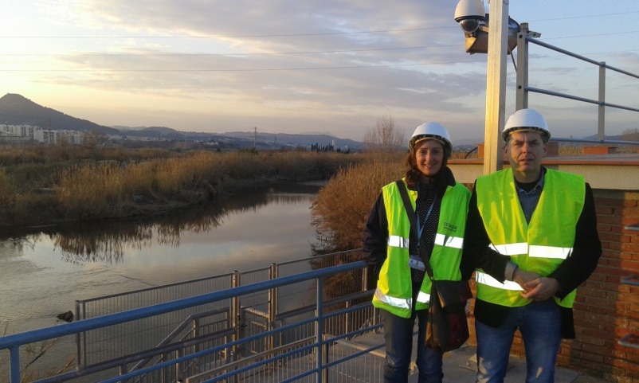
Visits at DWTP of Sant Joan Despí
Date | Co-organiser | Meeting | Visitor profile | Number of visitors
14/11/2014 | EIP Water | Technical visit to WWTP and DESSIN project | Commercial & Technicians of private water companies | 6
18/12/2014 | CUADLL | Networking visit (Catalonia - Pyrénées Orientales) | Manager & Technician of public entities of water | 19
05/03/2015 | ECOLOGIC | WP13 visit to mature site and demo site | Project partners | 5
13/03/2015 | - | Second Local stakeholder workshop | Water Administration and Health Administration managers | 12
 |  |  |  | 42

Slide 5
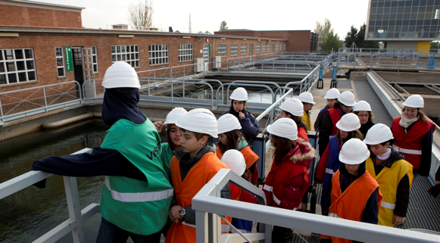
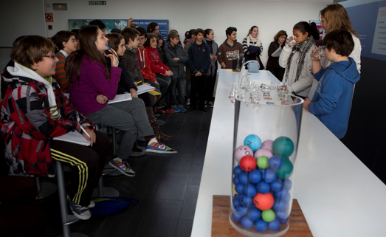
Visits at DWTP of Sant Joan Despí
Sant Joan Despí DWTP hosts visits of students from schools, high schools and institutions.
DESSIN to be included in the visit
Specific materials to be developed
VISITS RECORDS |  | 2011-2012 | 2012-2013 | 2013-2014
Schools | number of visits | 177 | 181 | 212
 | total visitors | 5591 | 4762 | 5283
 | average visitors per visit | 56 | 26 | 25
Technical students (Cicles formatius) | number of visits | 14 | 19 | 34
 | total visitors | 448 | 500 | 648
 | average visitors per visit | 32 | 26 | 19
Institutions | number of visits | 50 | 63 | 57
 | total visitors | 1039 | 1330 | 671
 | average visitors per visit | 21 | 21 | 12

Slide 6
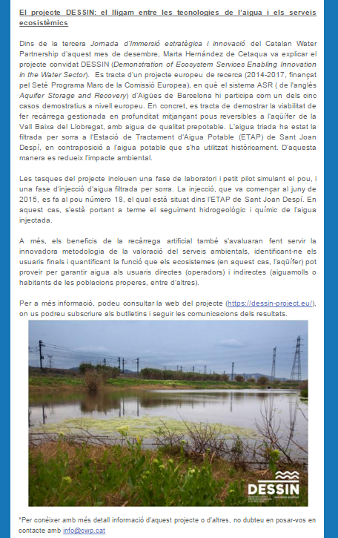
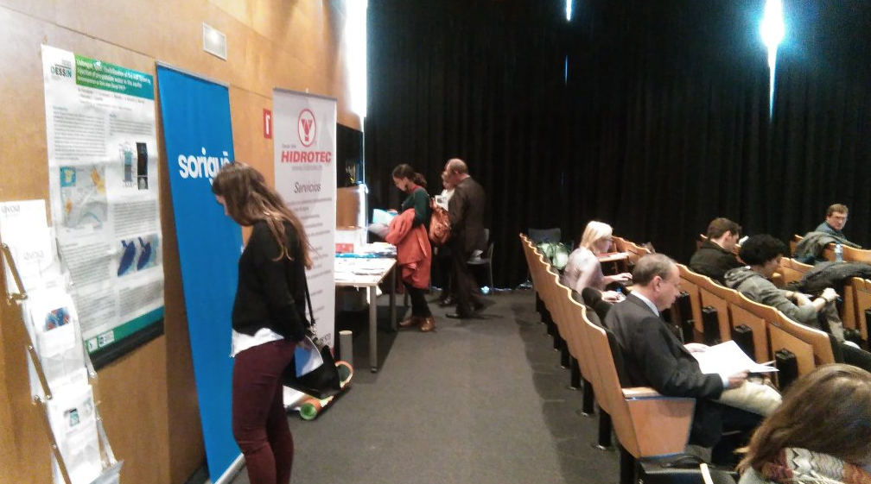
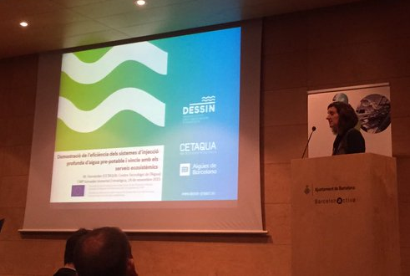
Catalan Water Partnership
DESSIN and the Llobregat Demo site were presented as invited project at the 3rd innovation day of the CWP
DESSIN material was distributed to the audience:
Poster of Llobregat site was exhibited
ANNUAL MAGAZINE distributed (100 ud. printed version)
Survey distributed (ESS valuation)
CWP Neswletter
Attendants: 70 (technicians, managers, SMEs, research…)

Slide 7
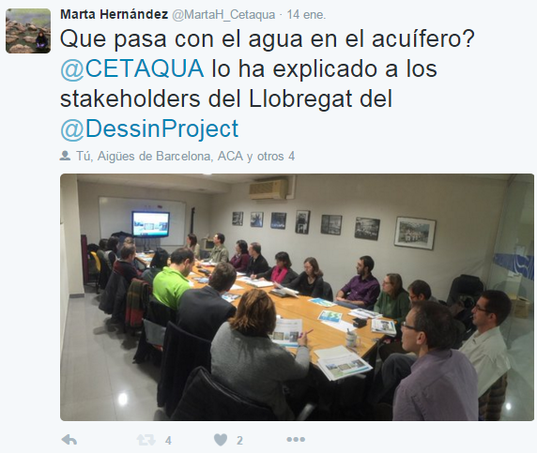
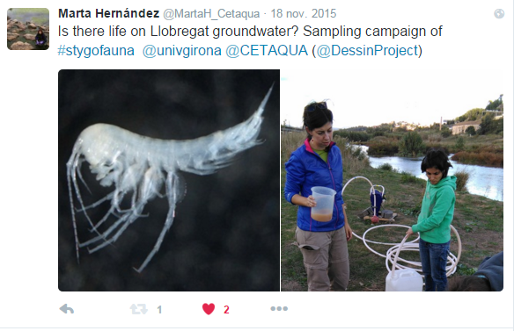
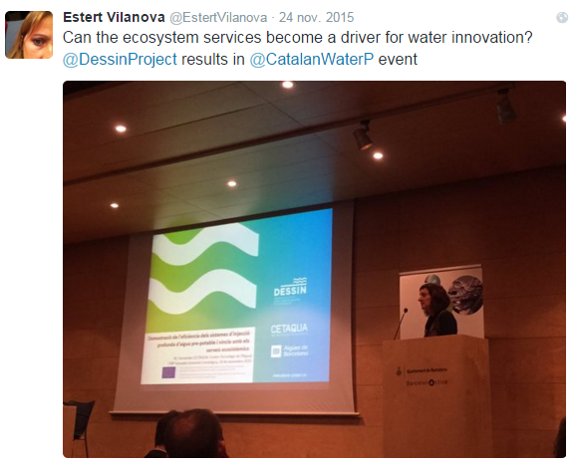
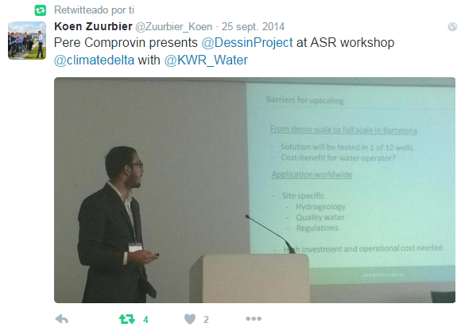
Social media

Slide 8
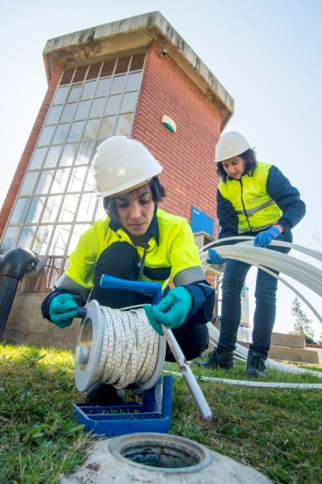
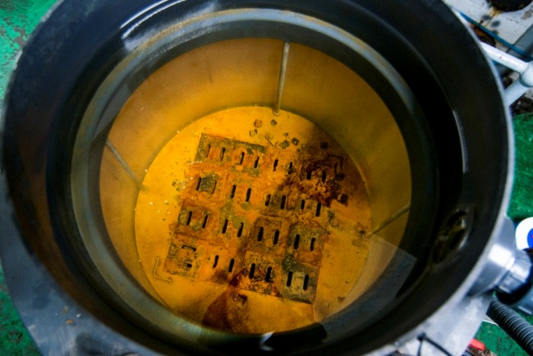
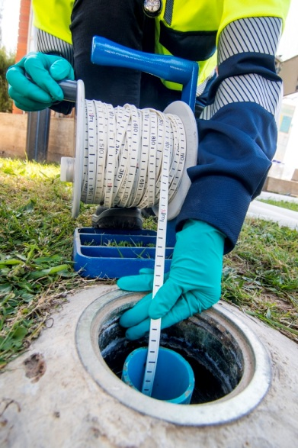
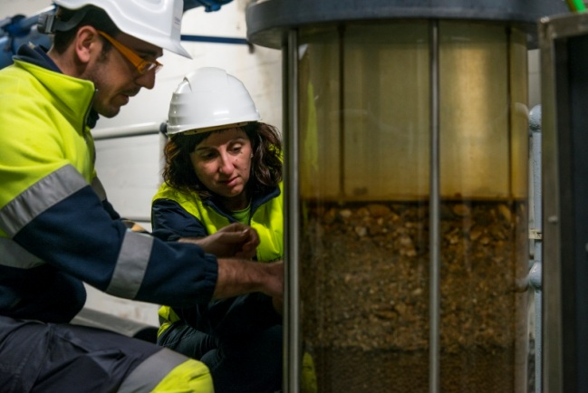
Photo session
PHOTO SESSION of the DESSIN Demo Site at Sant Joan Despí was held at the beginning of March 2016

Slide 9
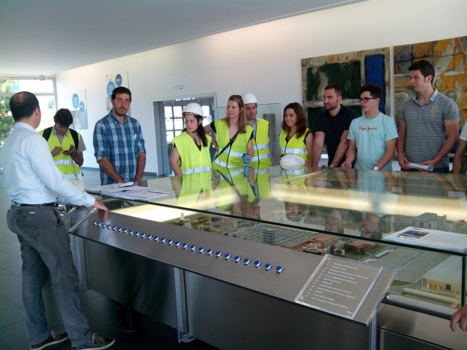
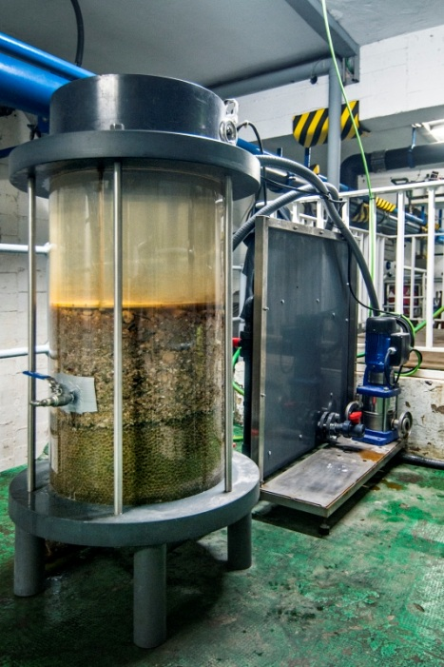
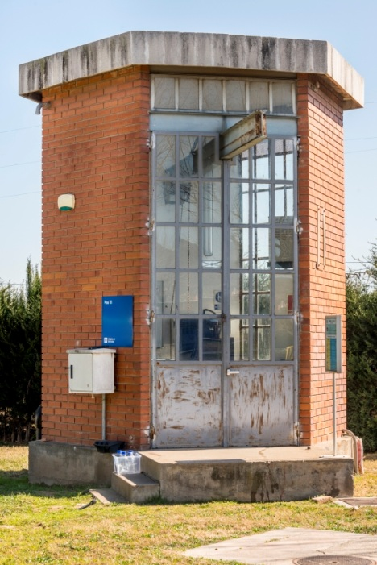
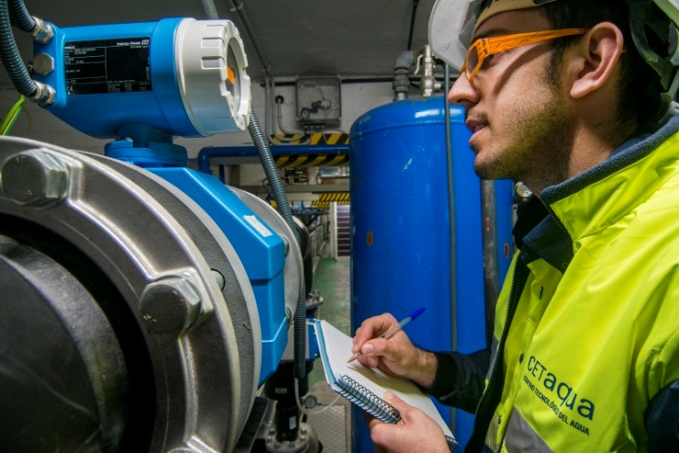
Incoming workshop / plenary project meeting
DESSIN project meeting late January 2017:
Llobregat showcase demonstration
Workshop/round tables/ technical sessions with local stakeholders
Further materials/actions to be developed

Slide 10
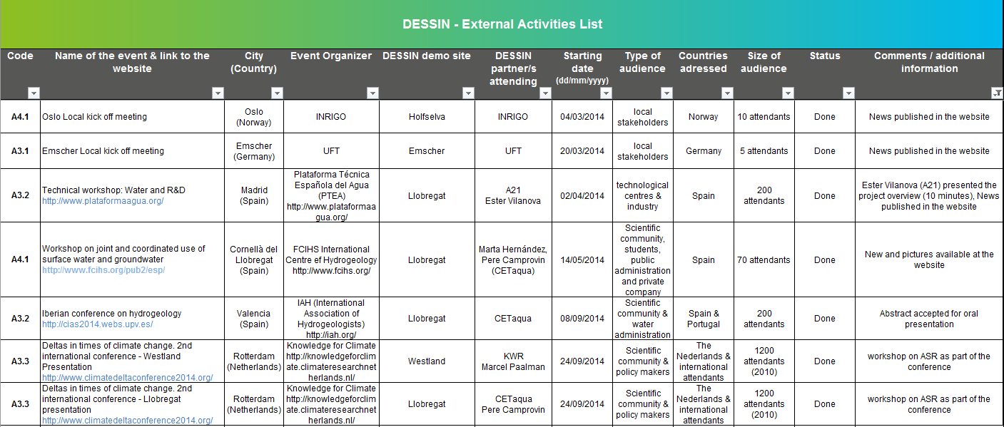
Dissemination reporting

Slide 11
Dissemination reporting
 | Summary of External Activities |  |  |  | Summary Publications
 | Codes | Type of activity | Authomatic account |  | Codes | Type of publication | Authomatic account
 | Conferences attended (without contribution) |  |  |  | P1 | Scientific | 0
 | A1.1 | Local/regional level | 0 |  | P2 | General public | 0
 | A1.2 | National level | 0 |  | P3 | Press releases | 9
 | A1.3 | European/international level | 0
 |  | Posters presented
 | A2.1 | Local/regional level | 0
 | A2.2 | National level | 1
 | A2.3 | European/international level | 1
 |  | Project presentations
 | A3.1 | Local/regional level | 2
 | A3.2 | National level | 3
 | A3.3 | European/international level | 3
 |  | Workshops
 | A4.1 | Local/regional level | 5
 | A4.2 | National level | 0
 | A4.3 | European/international level | 0
 |  | Site visits
 | A5.1 | Local/regional level | 1
 | A5.2 | National level | 1
 | A5.3 | European/international level | 2
 |  | Trophies and awards
 | A6.1 | Local/regional level | 0
 | A6.2 | National level | 0
 | A6.3 | European/international level | 0

